Slide 1
Being Financially Responsible
Unit 1
Unit 1: Getting Started
Topic 1: Imagining Your Financial Future What does the future hold for you? How will your goals change over time?
Topic 2: Setting SMART Goals What are your financial goals? How can you increase your chances of achieving these goals?
Topic 3: Examining Money Habits What are your current money habits? Are they helping or preventing your future financial success?
Topic 4: Budgeting for Success How does developing a budget help you manage your money? Is one way of budgeting better than another?
Topic 5: Spending Wisely What should you think about before making a purchase?
Wrap Up Glossary of Key Terms Personal Action Plan Continuing the Conversation at Home Dig Deeper

Slide 2
Unit 1: Getting Started
This unit explores a wide variety of personal finance topics within the theme of Being Financially Responsible. Going into this unit, how much do you already know about each topic?
 | Not Much | Some | A Lot
Topic 1: Imagining Your Financial Future What does the future hold for you? How will your goals change over time? Learn about goal setting and how your goals for the future (e.g., job, relationships, social) are likely to change over time.
Topic 2: Setting SMART Goals What are your financial goals? How can you increase your chances of achieving these goals? Make connections between personal and financial goals and the value of SMART goals.
Topic 3: Examining Money Habits What are your current money habits? Are they helping or preventing your future financial success? Explore your current money habits and the impact they might have on your future.
Topic 4: Budgeting for Success How does developing a budget help you manage your money? Is one way of budgeting better than another? Examine why budgeting is important and learn different approaches to budgeting.
Topic 5: Spending Wisely What should you think about before making a purchase? Explore factors that influence people’s spending decisions (affordability, price, durability, etc.) and how technology allows consumers to make more informed choices.

Slide 3
Imagining Your Financial Future
After completing the module for this topic, you should be able to:
Give examples of goals people set for themselves.
Explain the importance of goal setting.
Compare how goals vary from one life stage to another.
Identify long-term personal goals including those related to career, family, and lifestyle.
Explain how you could realistically accomplish these goals.

Slide 4
Use in conjunction with the Imagining Your Financial Future self-paced module.
A goal without a plan is just a wish.
Agree or disagree? Why?
List three things you can do to improve your chance of reaching a goal.
1.
2.
3.
 | Is this goal….
What are some of your goals for the future? | Short-term, Mid-term, or Long-term? | Small or Big? | Personal, Financial, or Professional?

Slide 5
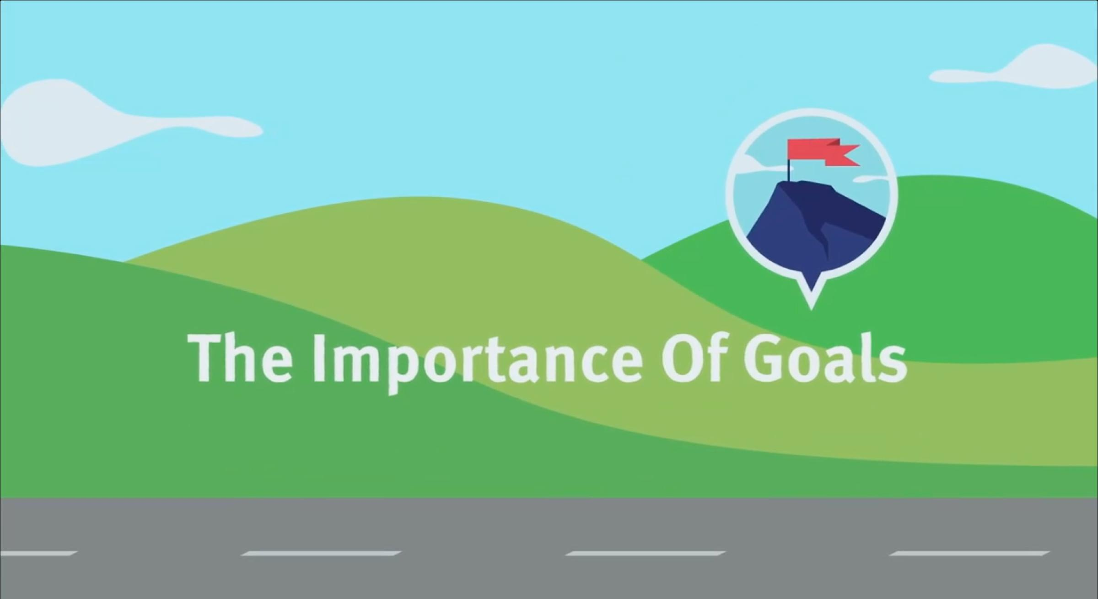
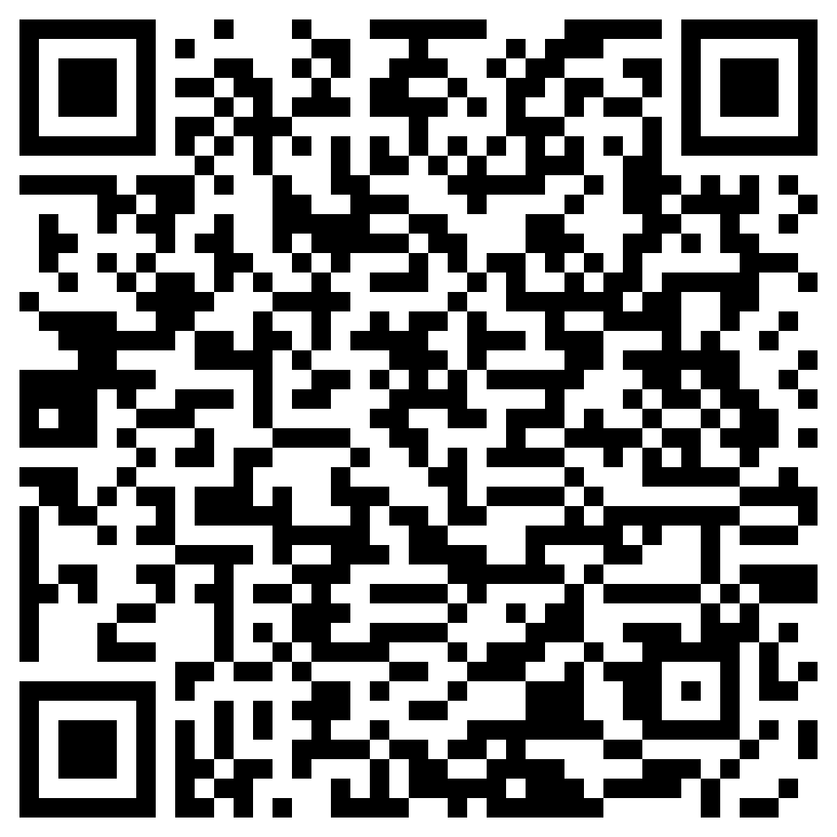
The Importance of Goals
Use in conjunction with the Imagining Your Financial Future self-paced module.
What did you think about goals before this module?
Use this link or the QR code to the right to replay the video from this module.
How did the video change your thinking about goals? Use this sentence frame to explain your new thinking: I used to think _________, but now I think __________.
Which details from the video support that thinking?

Slide 6
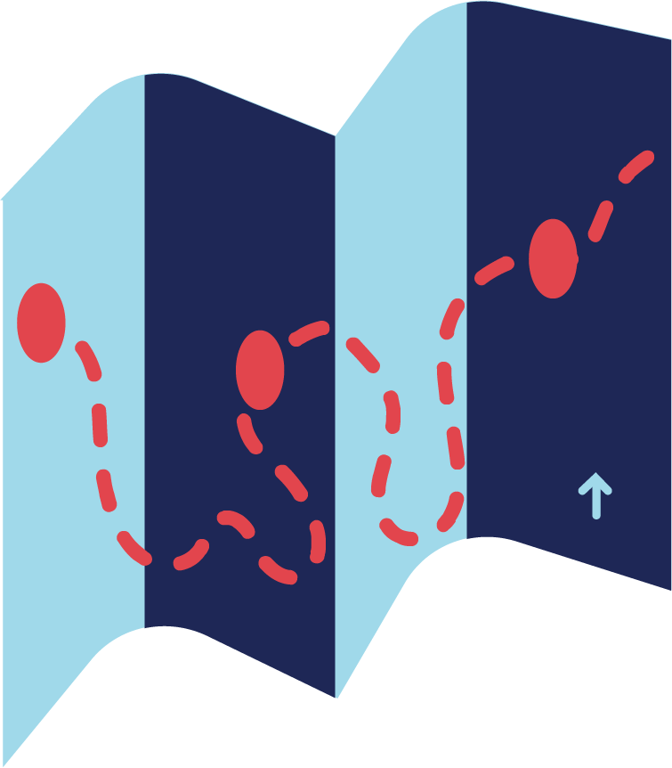
Use in conjunction with the Imagining Your Financial Future self-paced module.
How do you expect your goals to change over time?
Transform each general goal into a specific one. If possible, make it a goal that will work for you and your circumstances.
General | Specific
I want to travel.
I hope to have a good-paying job.
I want to save money for an emergency fund.

Slide 7
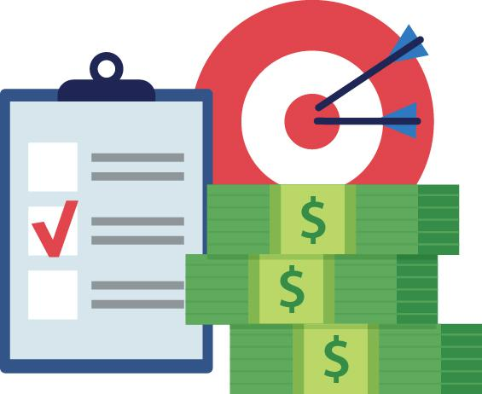
Goals with Financial Connections
Use in conjunction with the Imagining Your Financial Future self-paced module.
Think of three goals for your future—a short-term goal, a mid-term goal, and a long-term goal. Write each down and identify the financial connection.
Timeframe | Goal | Financial Connection
Short-term Less than one year
Mid-term One to five years
Long-term More than five years

Slide 8
Dream Big
Use in conjunction with the From Dream to Reality classroom activity.
Think about your life ten years from now. How old will you be? What will you be doing? What do you envision for each of the following? Complete at least six categories.
Where you Live | Your Job
Important People in Your Life | How You Spend Your Free Time
Transportation | Vacations
Clothing | Entertainment
Other/Your Choice

Slide 9
My Personal Vision Board
Use in conjunction with the From Dream to Reality classroom activity.
Add images and words representing goals you hope to accomplish in the future.

Slide 10
From Dream to Reality
Use in conjunction with the From Dream to Reality classroom activity.
After completing your vision board, answer the questions below for one of the goals you set.
What is your goal?
When do you plan to achieve this goal?
What resources will you need to achieve your goal (money, training, etc.)?
Who can help you achieve this goal?
What steps must you take to achieve this goal? What is the timeframe for each one?
Step | Timeframe

Slide 11
Use this page to reflect on what you have learned in Topic 1: Imagining Your Financial Future.
Do you think it is important to set goals? Explain your thoughts.
End-of-Module Self-Evaluation
Consider the learning objectives for this module. How do you feel about each one after completing it? | Strongly Agree | Somewhat Agree | Somewhat Disagree | Strongly Disagree
I can give examples of goals people set for themselves.
I can explain the importance of goal setting.
I can compare how goals vary from one life stage to another.

Slide 12
Setting
SMART Goals
After completing the module for this topic, you should be able to:
Identify financial goals.
Explain the importance of setting SMART goals.
Determine whether a goal meets the criteria for a SMART goal.

Slide 13
Use in conjunction with the Setting Smart Goals self-paced module.
Have you ever set a goal for yourself? What was it? Did you accomplish it?
What does each letter stand for in the term SMART goals?
S
M
A
R
T
Why do experts recommend making goals SMART? Do you agree with them? Explain.

Slide 14
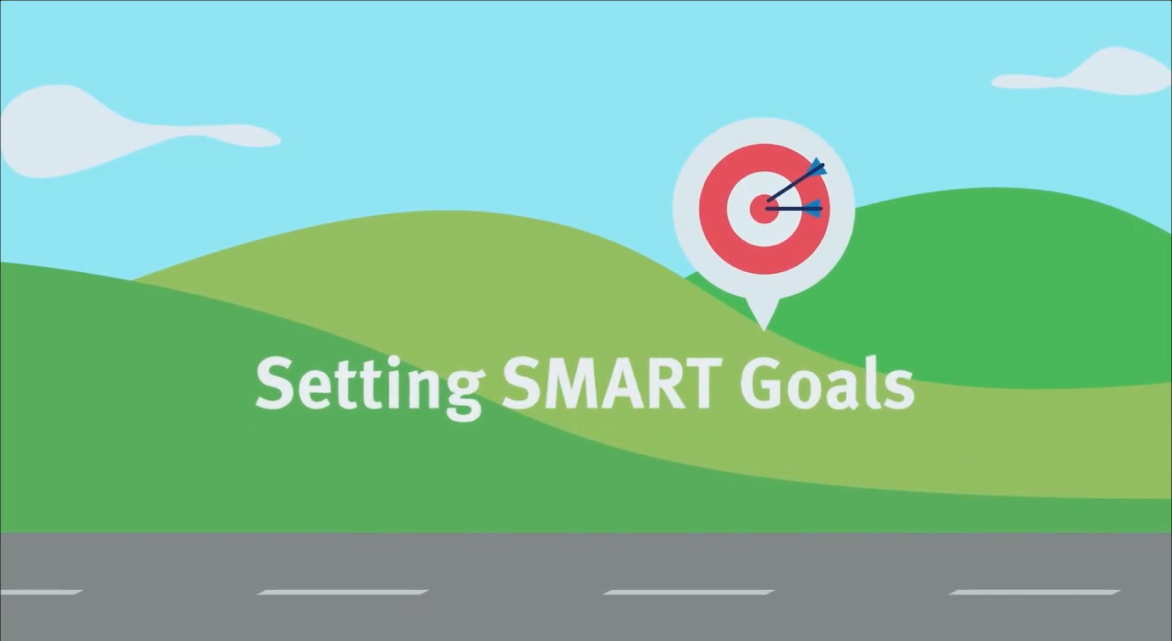
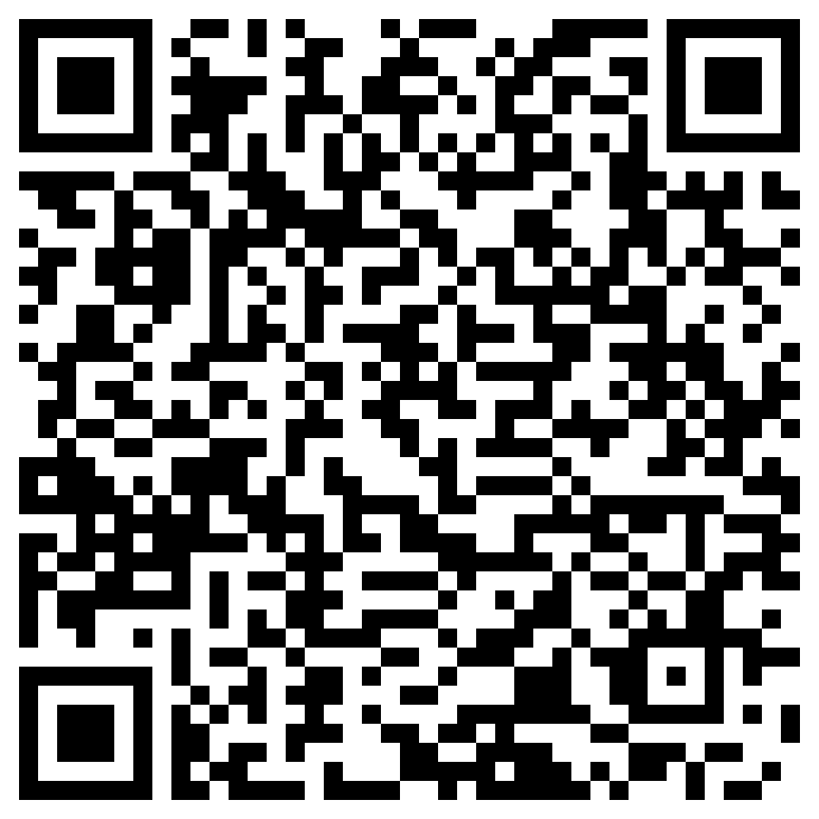
Setting SMART Goals
Use in conjunction with the animated video found in the Setting Smart Goals self-paced module.
The video in this module features a mountain climber. Use this link or the QR code below to replay the video. Imagine how someone climbing a mountain might think about setting SMART goals. Then, respond to the prompt below.
Write a journal entry or letter that describes how a mountain climber might use SMART goals to achieve goals. Use your imagination. A letter, for example, could be addressed to a friend, mentor, new climber, or someone else.

Slide 15
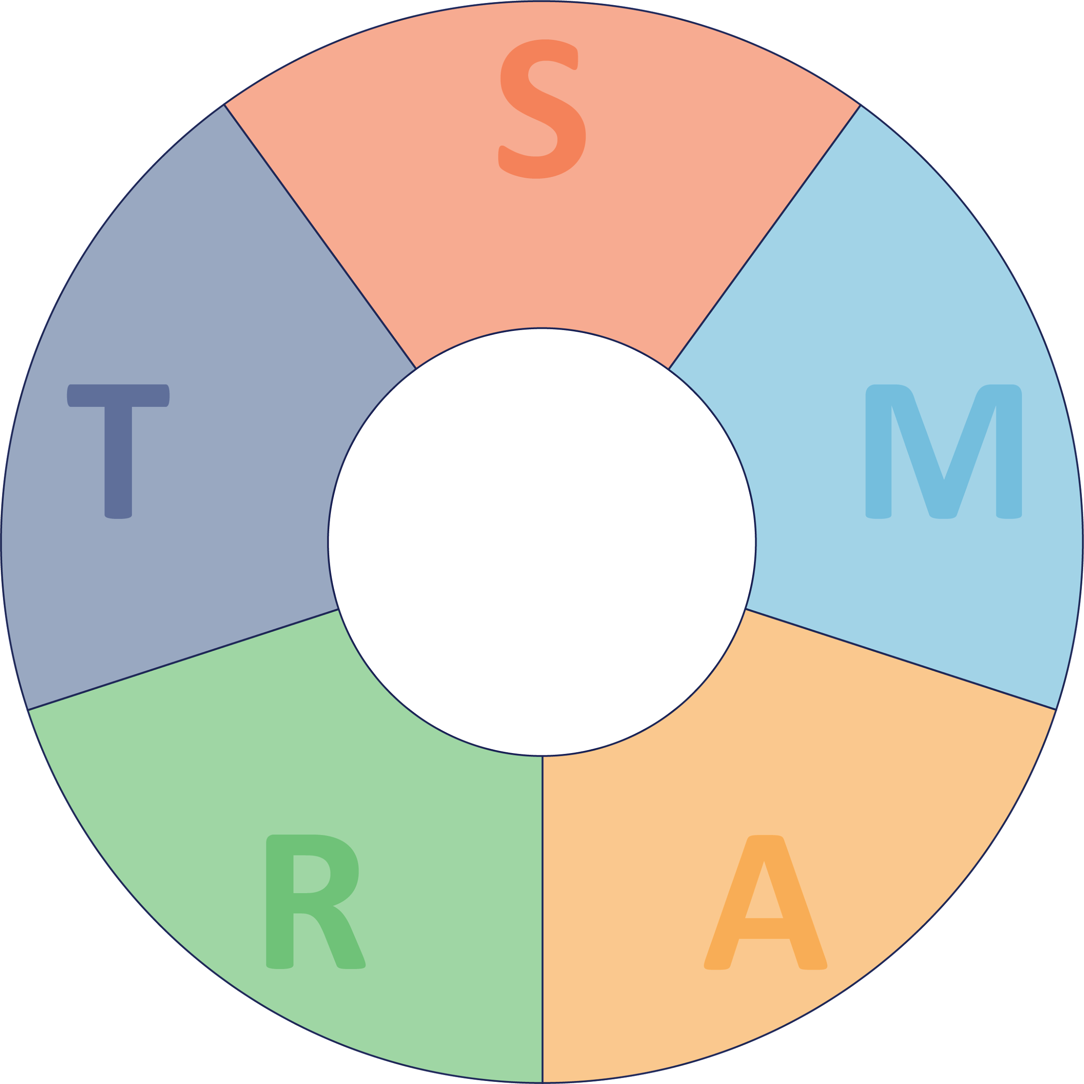
Use in conjunction with the Setting Smart Goals self-paced module.
Think of something you wish to achieve in the future that has a financial connection. Write a corresponding SMART goal in the center of the wheel. Then, identify which part of the goal corresponds to each SMART characteristic and how.
Your SMART Goal

Slide 16
Use in conjunction with the Setting Smart Goals self-paced module.
As you click through the “Questions to Ask” section of the module, fill in the blanks for the questions you can ask yourself when setting SMART goals.
S | What exactly do you plan to _______________? Where or how will this take place? What _______________ do you need to succeed?
M | How will you know ________ you have achieved this goal? What would be one of the best ways for you to __________ _____________ on this goal?
A | How _______________ are you that you can reach this goal? Are there major _______________ standing in your way of success?
R | What is __________________ to you about this goal? How does this goal relate to what you _______________?
T | What is your ___________________ to accomplish this goal? When do you need to start taking _________________?
Consider each goal below. Is it one you can imagine setting for yourself? | Yes | No
I will keep track of all my expenses for the next week using the notes app on my phone.
I will find out the current interest rate and deposit requirements for savings accounts at four banks or credit unions by the end of the month.
I will review my passwords for at least five online accounts and make sure they are all different by the end of next month.
Over the weekend, I will ask my family to help me identify two ways to earn money next summer.

Slide 17
Other Acronyms for Goals
Use this page to reflect on what you have learned in Topic 2: Setting SMART Goals.
In this module, you learned about setting SMART goals. There are other acronyms for goals. Consider the ones below and explain which you would choose: SMART, HARD, SMARTER, or an acronym of your own creation.
HARD: H = Heartfelt, A = Animated, R = Required, D = Difficult
SMARTER: E = Evaluated and R = Reviewed
End-of-Module Self-Evaluation
Consider the learning objectives for this module. How do you feel about each one after completing it? | Strongly Agree | Somewhat Agree | Somewhat Disagree | Strongly Disagree
I can identify financial goals.
I feel confident explaining the importance of setting SMART goals.
I can determine whether a goal meets the criteria for a SMART goal.

Slide 18
Examining Money Habits
After completing the module for this topic, you should be able to:
Assess your personal money habits.
Examine the origin of your money habits.
Evaluate the impact your money habits have on you and others.

Slide 19
Use in conjunction with the Examining Money Habits self-paced module.
People have all kinds of money habits. What money habits do you associate with each of these financial topics?
Spending
Saving
Talking About Money
Many factors can impact money habits. Fill in the graphic organizer below with ways each factor has made—or could make—a difference with your personal money habits.
Family | Friends
Media | Technology
What Influences Money Habits?

Slide 20
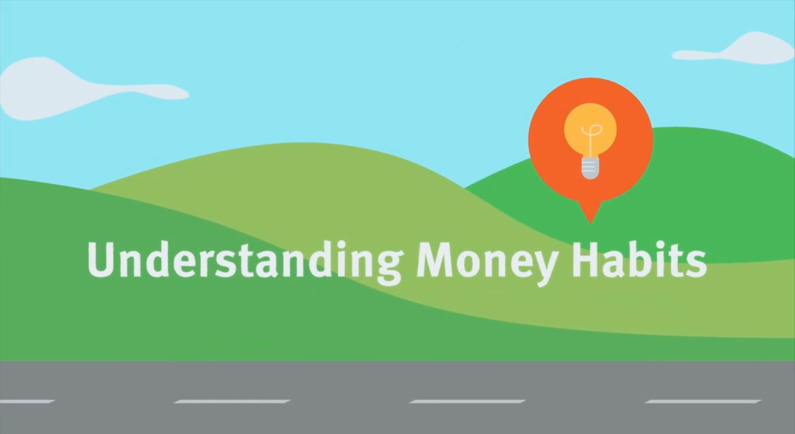
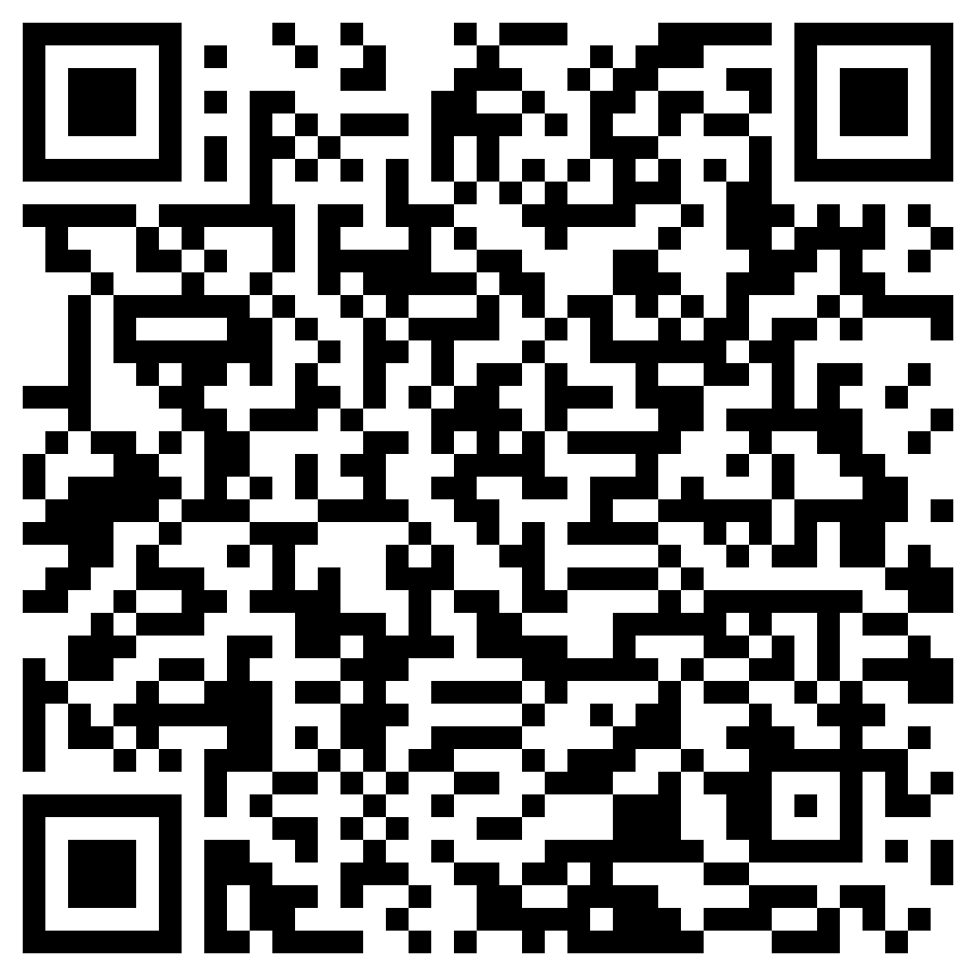
Two Truths and a Lie: Money Habits Edition
Use in conjunction with the animated video found in the Examining Money Habits self-paced module.
Have you ever played the game Two Truths and a Lie? The idea behind the game is that you share three statements about yourself and others have to guess which two are true and which one is false.
Use this link or the QR code below to replay the video from this module. As you watch it, think of two true statements about your own personal money habits and one false statement.
Share each of your statements below. Explain the true ones and share why people might believe the false one.
Category | Statement | Explanation
Truth
Truth
Lie

Slide 21
Use in conjunction with the Examining Money Habits self-paced module.
Below is a list of potential money habits. Select two you would like to improve on or make up your own. Describe why you chose each one and steps you can take to make progress.
Track my expenses
Make fewer unplanned purchases
Save money for the future
Get more comfortable talking about money
Donate to charities
Regularly monitor my account balances
Money Habit | Reason for Choosing | Steps to Progress
Are there any other money habits of yours that you would like to improve? If so, list them below.

Slide 22
Money Habits Report Card
Use this page to reflect on what you have learned in Topic 3: Examining Money Habits.
If you had to give yourself a grade for each of the following money habits, what would it be and why?
Money Habit | Grade | Reason
Tracking spending
Setting money aside to save
Regularly checkinging account balances
Comparing prices before making a large purchase
Looking for discounts, sales, or coupon codes
End-of-Module Self-Evaluation
Consider the learning objectives for this module. How do you feel about each one after completing it? | Strongly Agree | Somewhat Agree | Somewhat Disagree | Strongly Disagree
I can assess my personal money habits.
I have examined the origin of my own money habits.
I can evaluate the impact my money habits have on myself and others.

Slide 23
Budgeting for Success
After completing the module for this topic, you should be able to:
Explain more than one method of budgeting.
Differentiate between fixed and variable expenses.
Describe typical teen budget categories.
Understand the steps involved in developing a budget, including identifying sources of income and the cost of fixed and variable expenses.

Slide 24
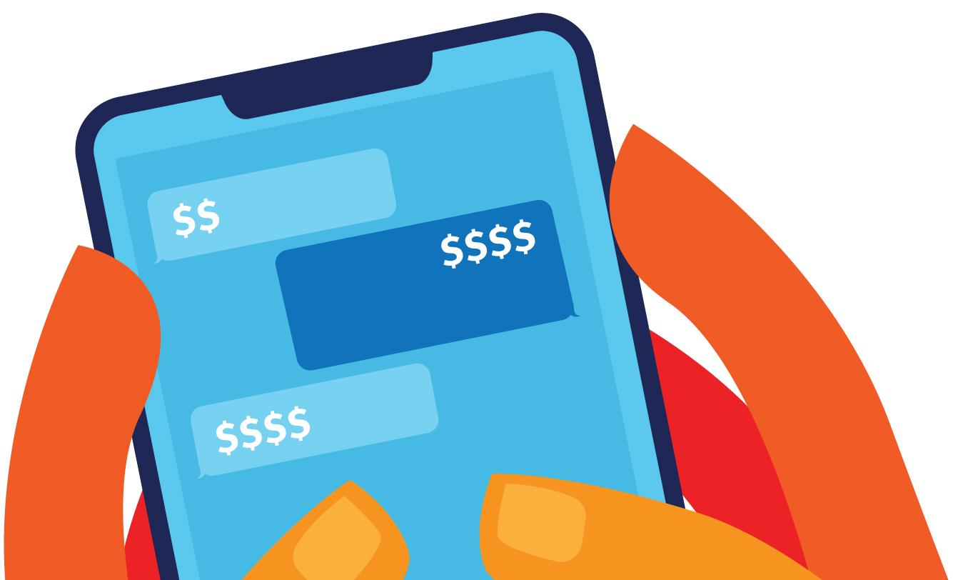
Use in conjunction with the Budgeting for Success self-paced module.
What’s the first thing you think of when you hear the term BUDGET?
Some people prefer to use the term “budget” while others like “spending plan” better. What are some of the pros and cons of each choice?
 | Budget | Spending Plan
Pros
Cons
Which do you prefer and why?

Slide 25
Use in conjunction with the Budgeting for Success self-paced module.
List examples of expenses you have now or can imagine having in the future that fall into each category.
Fixed Expenses | Variable Expenses
In your own words, what’s the difference between a fixed and a variable expense?
Do you have a budget or other method of tracking how you spend your money? If so, describe it. If not, do you think one would be helpful? Explain.

Slide 26
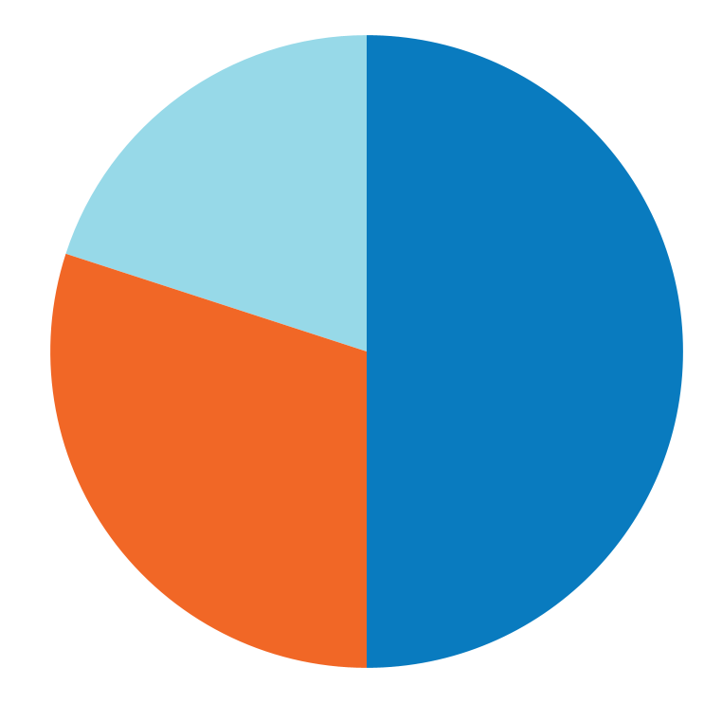
Use in conjunction with the Budgeting for Success self-paced module.
People’s budget categories often change as they get older. What categories can you imagine in a teen’s budget versus those of an adult or family?
Teen Budget Categories | Adult or Family Budget Categories
Label the pie chart below with the components of a 50-30-20 budget. What does each section represent? Describe each “piece of the pie” in your own words.
20%
50%
30%

Slide 27
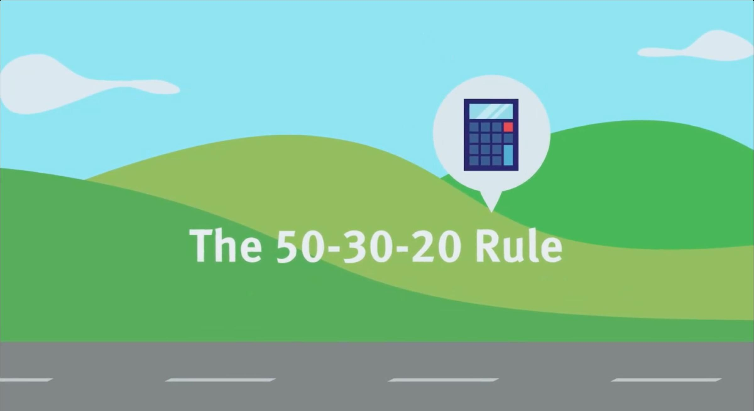
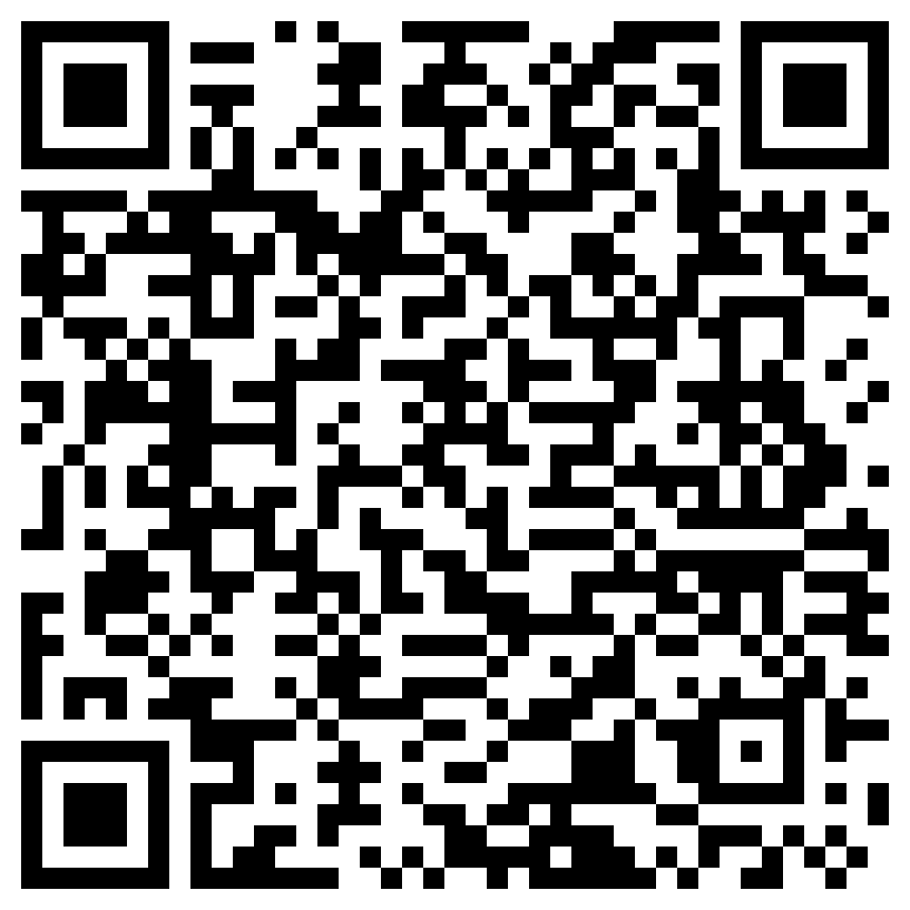
Diving into the 50-30-20 Budget
Use in conjunction with the animated video found in the Budgeting for Success self-paced module.
Focus on what you see, not hear, in the animation from this module. Watch the video with the sound OFF. Pause to take notes and then write a short summary. Watch the video a second time with the sound ON. Take notes as you go. Reflect on how your second set of notes compare to the first and how accurate your initial summary was (or wasn’t).
Viewing | Notes | Summary
#1 Sound Off
#2 Sound On

Slide 28
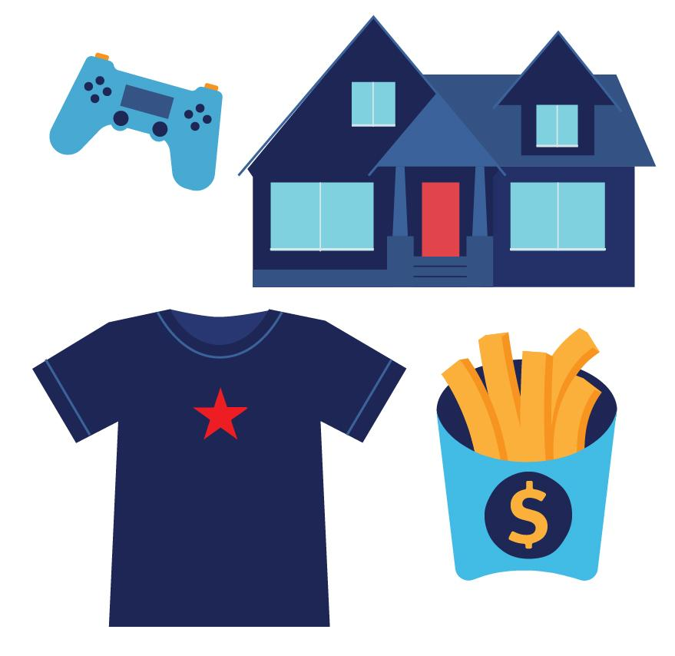
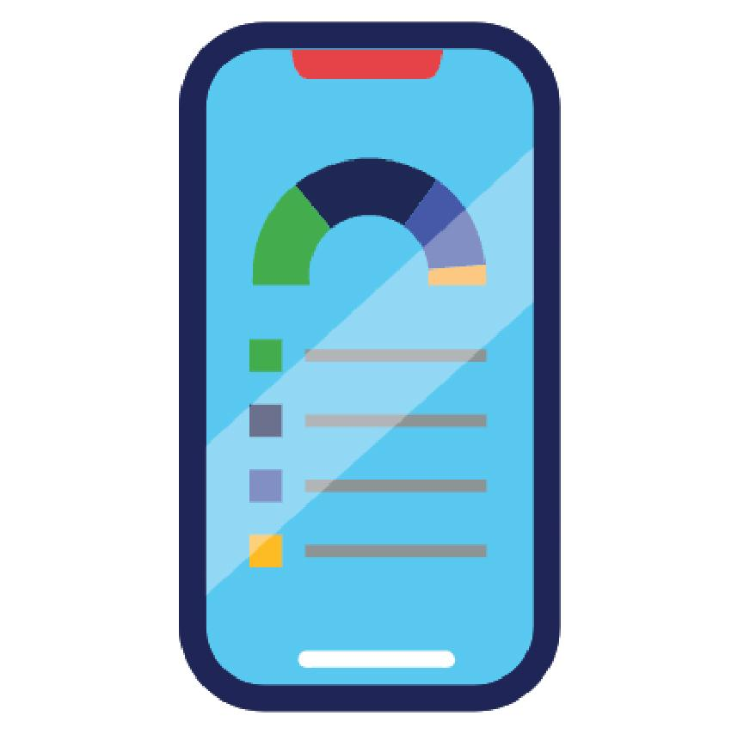
Use in conjunction with the Budgeting for Success self-paced module.
Summarize key characteristics of each budgeting strategy, term, or tool and why people choose to use each.
Traditional Budgeting
50-30-20 Rule
Zero-Based Budgeting
Envelope Method
Spreadsheets
Budgeting Apps

Slide 29
Use this page to reflect on what you have learned in Topic 4: Budgeting for Success.
In this module, you learned about a variety of ways to budget or establish a spending plan. Do you expect to track your income and expenses in the future? What approach(es) do you expect to take and why? If not, how will you make sure you don’t spend more than you earn?
End-of-Module Self-Evaluation
Consider the learning goals for this module. How do you feel about each goal after completing this topic? | Strongly Agree | Somewhat Agree | Somewhat Disagree | Strongly Disagree
I can explain more than one method of budgeting.
I can differentiate between fixed and variable expenses.
I am able to describe typical teen budget categories.
I understand the steps involved in developing a budget, including identifying sources of income and the cost of fixed and variable expenses.

Slide 30
Spending
Wisely
After completing the module for this topic, you should be able to:
Name factors that influence your spending decisions.
Cite examples of steps you can take to make more informed spending decisions.

Slide 31
Use in conjunction with the Spending Wisely self-paced module.
Track your answers to the What Kind of Spender Are You quiz at the beginning of the module. Are you happy with your answers, or is there something you want to change?
Question | X | Answers | Notes
If you want something that costs more than you can afford, what do you do? |  | Ask for it as a gift.
 |  | Wait for it to go on sale.
 |  | Borrow money from family or friends so I can buy it now.
Which statement best describes your spending habits? |  | I only buy things I absolutely need.
 |  | I love a bargain. If it isn’t on sale, I’m not buying it.
 |  | If I want it, I’ll find a way to pay for it.
If you were to buy a new phone, what would impact your decision the most? |  | Price and affordability
 |  | User reviews and key features
 |  | Size and how recently it was released
How would you describe your taste in clothes? |  | Fashion? Who cares about that. I’m all about getting the best deal.
 |  | It is nice to get the latest style when I can afford it.
 |  | If it doesn’t have a designer label, it isn’t in my closet.
How do your friends influence your spending? |  | My friends find things for us to do that don’t cost any money.
 |  | I wait for a friend to buy something before deciding if I should, too.
 |  | I like having the same things as my friends no matter the cost.
What was your result on the What Kind of Spender Are You quiz? Do you agree or disagree with it? Why?

Slide 32
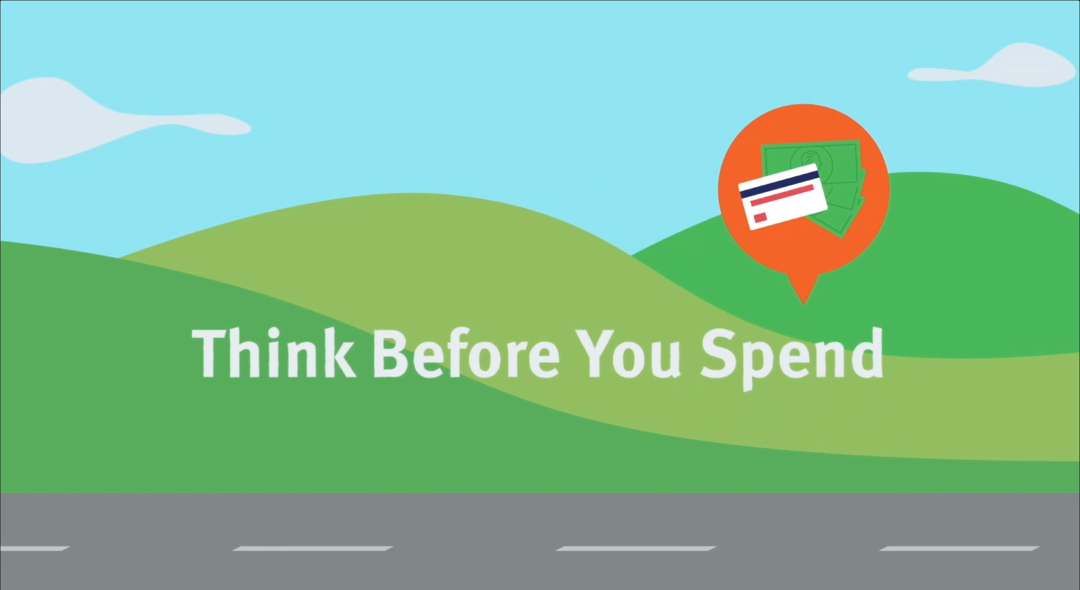
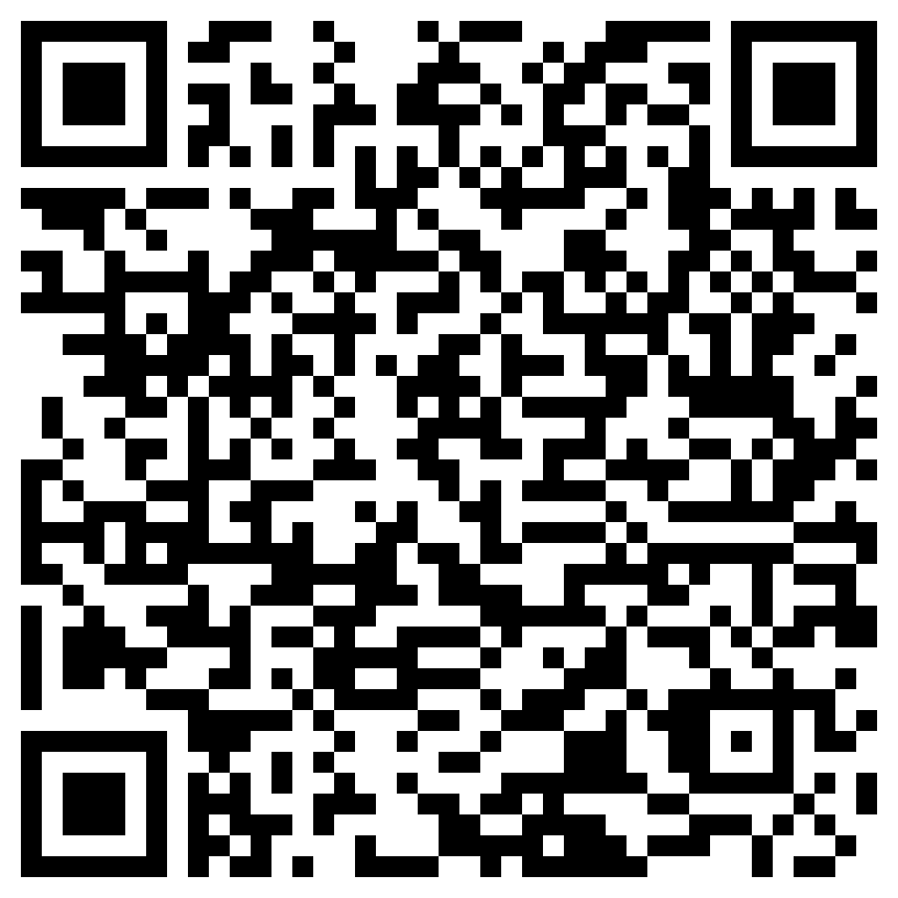
Think Before You Spend
Use in conjunction with the animated video found in the Spending Wisely self-paced module.
Your first thought when you see the letters AEIOU might be about vowels versus consonants, but in this case it is an abbreviation for an Adjective, Emotion, Interesting, Oh, and Um.
Use this link or the QR code below to replay the video from this module. As you watch it, think of answers to the questions corresponding to each vowel in the abbreviation.
A—Adjective What words describe what you saw?
E—Emotion How does it make you feel?
I—Interesting Info What do you find interesting?
O—Oh! Did something surprise you?
U—Um? What questions do you have?

Slide 33
Use in conjunction with the Spending Wisely self-paced module.
For each factor below, list a question you might ask yourself before making a purchase and explain why the factor is important to consider.
Factor | Question | Reason It Is Important
Affordability
Price
Durability
Think about three things you have purchased. What influenced your spending decision? Was it just something you wanted? Did you need it? Did you feel pressure to purchase it? Did you see it advertised?
What Was Purchased | Why You Bought it

Slide 34
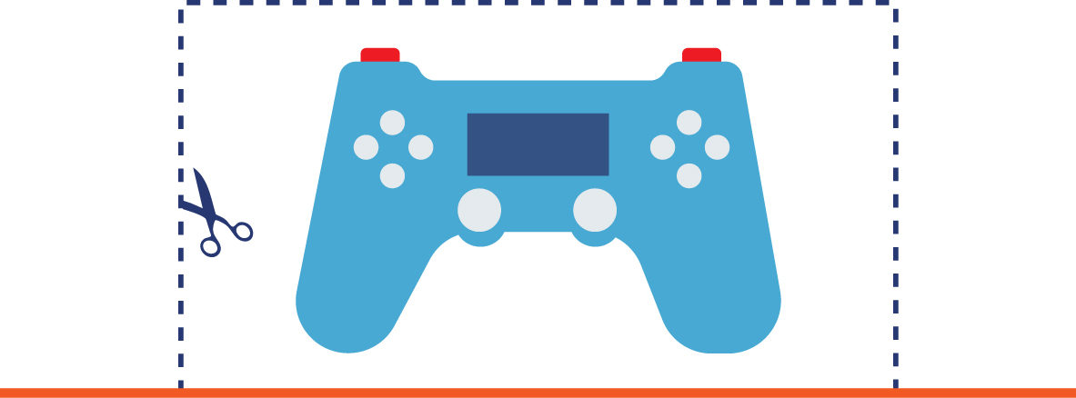
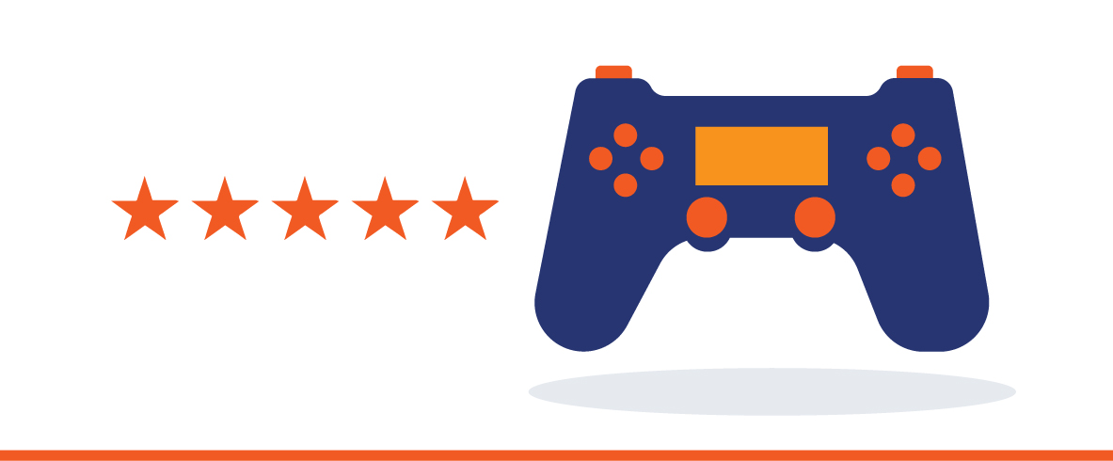
Use in conjunction with the Spending Wisely self-paced module.
Technology puts information and tools at your fingertips so you can be a smarter shopper. Identify two apps, websites, or other tools for each category. What are the main features of each?
Category | #1 | #2
Price Comparison
Online Coupons or Discount Codes
Consumer Reviews and Rating

Slide 35
Use this page to reflect on what you have learned in Topic 5: Spending Wisely.
In this module, you learned about ways to spend wisely. Consider a purchase you can see yourself making in the future and describe how you could apply what you have learned.
End-of-Module Self-Evaluation
Consider the learning goals for this module. How do you feel about each goal after completing this topic? | Strongly Agree | Somewhat Agree | Somewhat Disagree | Strongly Disagree
I can name factors that influence my spending decisions.
I can cite examples of steps I can take to make more informed spending decisions.

Slide 36
Being Financially Responsible
Wrap Up

Slide 37
Unit 1: Glossary of Key Terms
Term | Definition | My Notes
Action plan | Defines a goal or target, resources needed to achieve the goal, steps to be taken, and a timeline
Budget | Shows the sources of people’s income as well as their expenses
Debt | Owing money, often the result of spending more than you earn
Financial counselors | People who help clients develop budgets and make wise financial decisions
Fixed expenses | Expenses that are usually the same every month
Goals | Object of a person’s ambition; an aim or desired result
Money habits | Things you do—often without even thinking about them—that involve your money
Variable expenses | Expenses that are usually different from one month to another
Vision board | Tool used to help establish and maintain focus on life goals

Slide 38
Unit 1: Personal Action Plan
Consider each of the topics addressed in this unit. Which actions will you take to become financially responsible? | Already Doing | Need to Do | Not in My Plans
I have set goals for the future and considered the financial implications.
I have written my goals down and tried to make them SMART.
I have examined my current money habits and ways to improve them.
I track my income and expenses using some form of a budget.
I comparison shop when making large purchases.
I use technology to help me manage my money and shop smarter.
My notes and next steps:

Slide 39
Unit 1: Continuing the Conversation at Home
Families often approach conversations about money very differently. Some might welcome them, while others avoid the topic as much as possible. Review the conversations starters below. With whom could you have each conversation? How might you approach the conversations?
Conversation Starters | My Notes
Goal Setting What goals did you have for your future when you were my age? Which ones did you achieve? Have you ever had a financial goal? What made you set it? Are there any strategies or tricks you use to help you achieve the goals you set for yourself? How have your goals—especially financial ones—changed over time?
Money Habits On a scale from 1–10, how would you rate your personal money habits? Who or what influenced your money habits? What, if anything, about your money habits could use improvement?
Budgeting Would you say you do a good job of tracking your expenses? Have you ever created a budget? If so, what categories, if any, did your budget have? If you could change something about how you’ve kept track of your expenses in the past, what would that be and why?
Spending Would you say you are more of a spender or a saver? What is the best spending decision you have ever made? What is the worst? Before making a big purchase, what kind of things do you consider?

Slide 40
Unit 1: Dig Deeper
Interested in learning more about the topics covered in this unit? Consider exploring one or more of the following questions.
Dig into the Topics | My Notes
Goal Setting Does setting goals really help your chances of reaching them? How do people’s financial goals change over time? What percentage of people set goals and what percent reach them? What helps people reach the goals they set? What kinds of financial goals do people set?
Money Habits Where do most people learn about money? When are your money habits formed? What does it mean to have “good money habits”?
Budgeting What apps can help people create and stick to a budget? What are the most effective ways to budget? How does the average family divide its expenses? What are the most common budget categories for people my age? How does budgeting change when you do it with someone else (like a roommate, partner, or spouse)?
Spending What tools can I use to make comparison shopping easier? How much does social media impact teen spending? At what age do kids start to think about spending money? How many people have subscription services they don’t remember signing up for?

