Slide 1
Using Financial Services
Unit 2
Unit 2: Getting Started
Topic 1: Understanding Financial Institutions What does the future hold for you? How will your goals change over time?
Topic 2: Deciding Where and How to Bank What are your financial goals? How can you increase your chances of achieving these goals?
Topic 3: Opening New Accounts What are your current money habits? Are they helping or preventing your future financial success?
Topic 4: Using Mobile Banking How does developing a budget help you manage your money? Is one way of budgeting better than another?
Topic 5: Making Everyday Purchases What should you think about before making a purchase?
Wrap Up Glossary of Key Terms Personal Action Plan Continuing the Conversation at Home Dig Deeper

Slide 2
Unit 2: Getting Started
This unit explores a wide variety of personal finance topics within the theme of Using Financial Services. Going into this unit, how much do you already know about each topic?
 | Not Much | Some | A Lot
Topic 1: Understanding Financial Institutions How can banks and credit unions help you achieve your financial goals? Learn about financial institutions and the products and services they offer.
Topic 2: Deciding Where and How to Bank What factors should you consider when selecting a financial institution? Learn about the benefits of using financial institutions, common banking products, and mistakes to avoid.
Topic 3: Opening New Accounts What financial products will you need? How do you open an account at a financial institution? Learn what to expect when opening a new account with a financial institution.
Topic 4: Using Mobile Banking How can you safely bank from your phone? Which mobile banking services are important to you? Examine common online and mobile banking functions and how to bank safely using technology.
Topic 5: Making Everyday Purchases What is the difference between using cash, debit, checks, and credit? How do you choose the best payment method when making everyday purchases? Consider the payment method you use before making a purchase.

Slide 3
Understanding Financial Institutions
After completing the module for this topic, you should be able to:
Describe how interest paid by borrowers allows financial institutions to pay interest to savers.
List differences between “brick and mortar” financial institutions and those that are completely online.
Share ways financial institutions can help people accomplish their financial goals.
Explain several alternatives to banking and the risks associated with each.

Slide 4
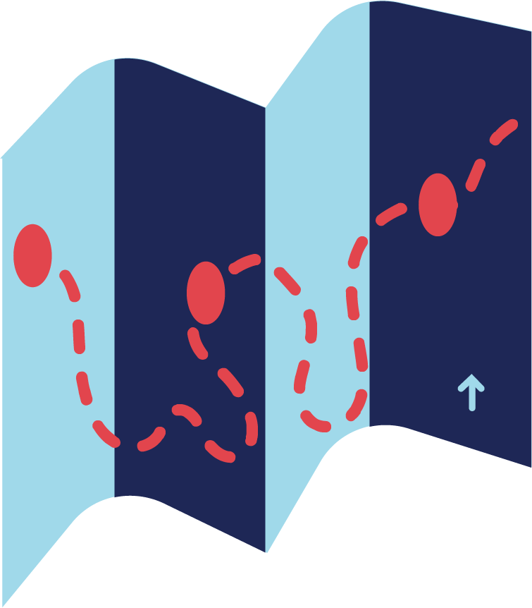
Use in conjunction with the Understanding Financial Institutions self-paced module.
Name three things you already know about banks, credit unions, and the services they offer.
1.
2.
3.
Have you ever been to a bank or credit union? What did you do there?
How many banks, credit unions, or other financial institutions can you think of by name? List as many as you can. Put a ☆ next to those that are in your community.

Slide 5
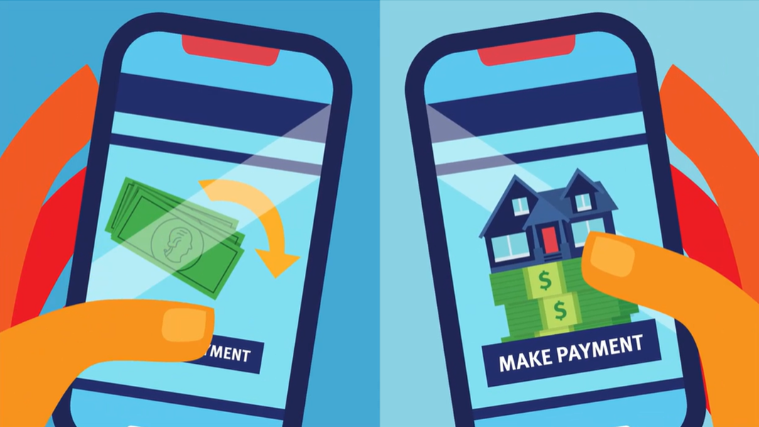
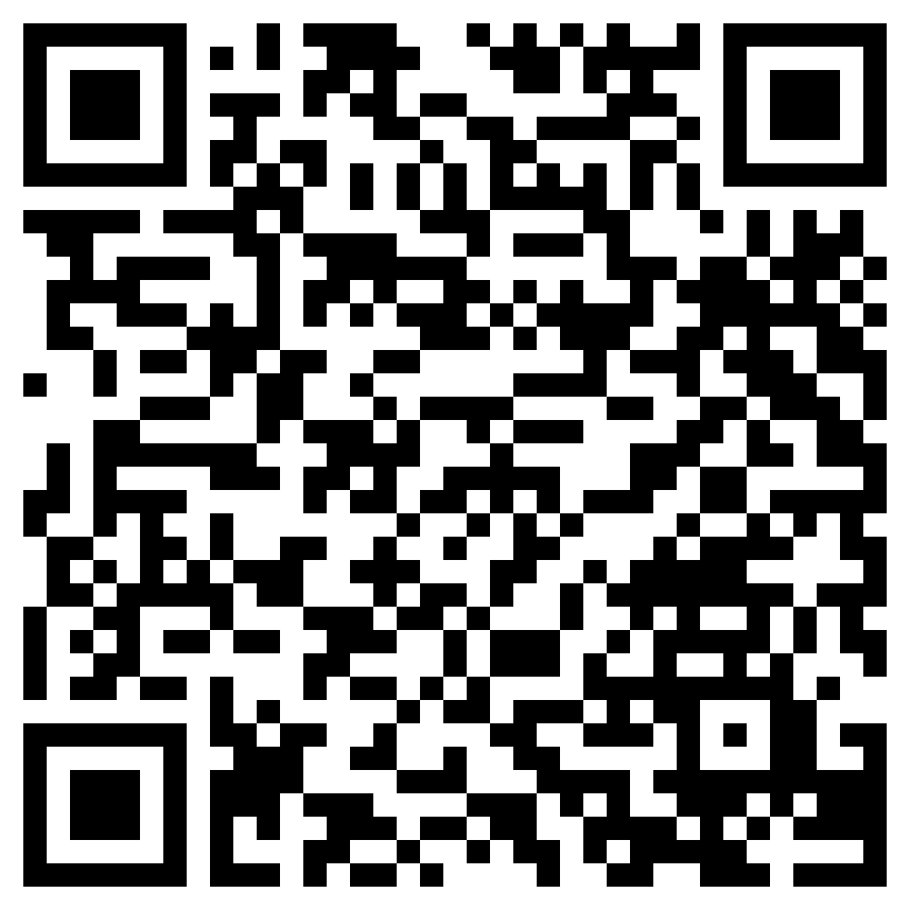
How Financial Institutions Work
Use in conjunction with the animated video found in the Understanding Financial Institutions self-paced module.
Use this link or the QR code to the right to replay the video from this module.
Think about what you knew about the topic of banks and financial institutions going into the module and what you learned from the video. Write a paragraph (3–4 sentences) about what you knew and how watching the video expanded on your prior knowledge.

Slide 6
Use in conjunction with the Understanding Financial Institutions self-paced module.
Give an example of how or when you might use each.
From | Use
Direct Deposit of Pay
Bill Payments
Peer-to-Peer Payments
Cash
Would you rather use an online-only financial institution that might pay higher interest or one with local branches where you can go in person? Explain your response.

Slide 7
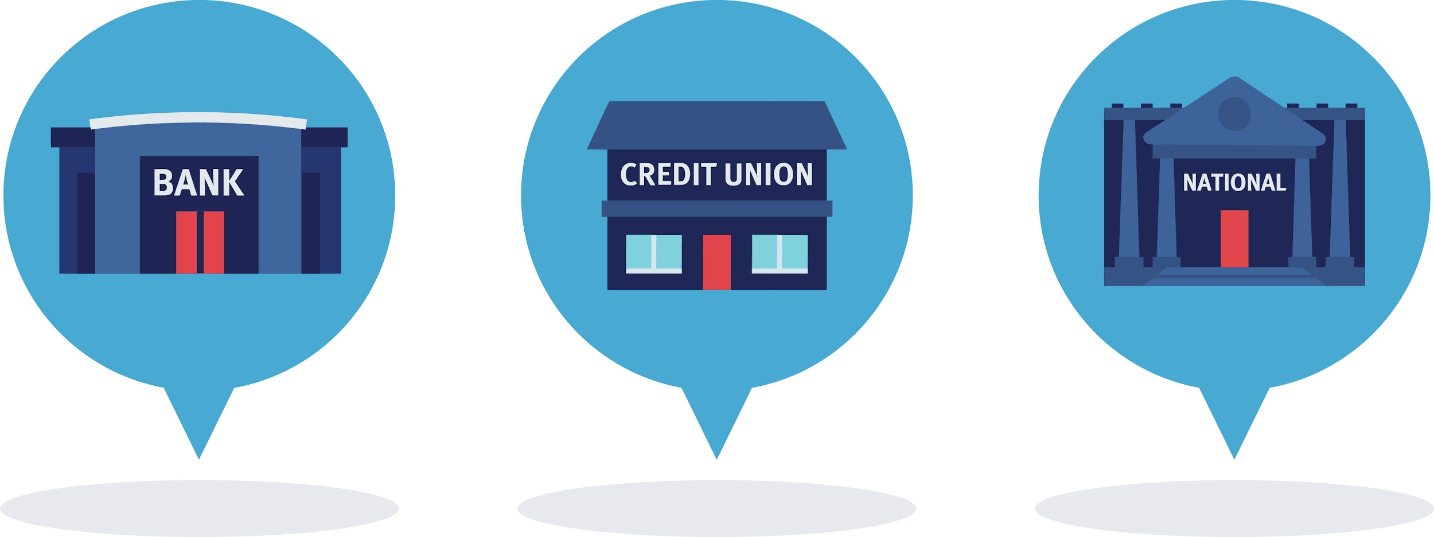
Use in conjunction with the Understanding Financial Institutions self-paced module.
Separate Savings Accounts: Most financial institutions will allow you to create separate savings accounts for different purposes. This can help you track your progress toward specific financial goals. Imagine you have created three savings accounts. Give each a name that describes the account’s purpose.
Account | Name
1.
2.
3.
Money you deposit in banks and credit unions is insured up to $250,000 per account holder. That means if there is a problem with the financial institution, you are still guaranteed to get your money back—so long as you don’t have more than $250,000 in any one account. Fill in the blanks below with the full name of each government agency that insures deposits. If you don’t know them, look them up.
Agency | Full Name
FDIC
NCUA

Slide 8
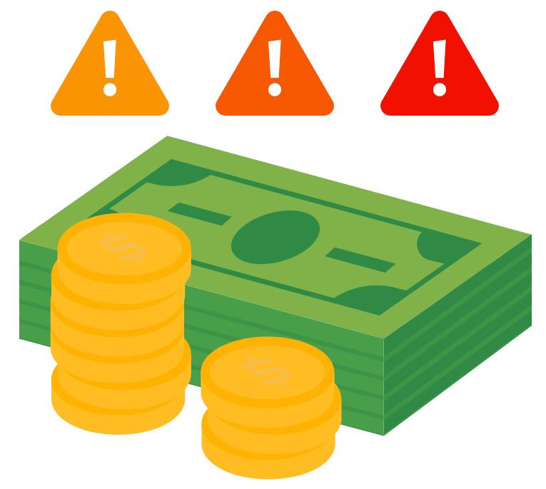
Use in conjunction with the Understanding Financial Institutions self-paced module.
What risks are associated with each of the banking alternatives below?
Alternative | Risk(s)
Check Cashers
Payday Loans
Pawn Shop Loans
Money Orders
Despite the downsides of using banking alternatives, many people still do. Some find them more convenient. Others may not be familiar with traditional banking services. Write a short paragraph in which you try to convince a frequent user of one of these services to try a traditional financial institution instead.

Slide 9
Use this page to reflect on what you have learned in Topic 1: Understanding Financial Institutions.
Do you think it is important to use a financial institution? Why or why not?
End-of-Module Self-Evaluation
Consider the learning objectives for this module. How do you feel about each one after completing it? | Strongly Agree | Somewhat Agree | Somewhat Disagree | Strongly Disagree
I can describe how interest paid by borrowers allows financial institutions to pay interest to savers.
I can list differences between “brick and mortar” financial institutions and those that are completely online.
I can share ways financial institutions help people accomplish their financial goals.
I can explain several alternatives to banking and the risks associated with each.

Slide 10
Deciding Where and How to Bank
After completing the module for this topic, you should be able to:
Describe different types of financial institutions, including banks and credit unions.
Explain how young adults can benefit from using financial services.
Examine your own use of financial services and identify opportunities to expand or enhance your use.

Slide 11
Use in conjunction with the Deciding Where and How to Bank self-paced module.
Think about your own use of banking services and products. Have you ever used any of the following?
Rank | Banking Service
 | Savings account
 | Checking account
 | Coin counting machine
 | ATM
 | Online banking
 | Mobile banking
 | Debit card
 | Direct deposit
 | Check cashing
One of the benefits of keeping your money in an account at a bank, credit union, or other financial institution is that it is safe. Rank the following safety considerations with 1 being the most important or applicable to you and 4 being the least.
Rank | Banking Service
 | Unlikely to be stolen
 | Won’t be damaged or lost in case of fire or an accident
 | Less likely to spend it than if it was at home in cash
 | People don’t know I have it and can’t find it

Slide 12
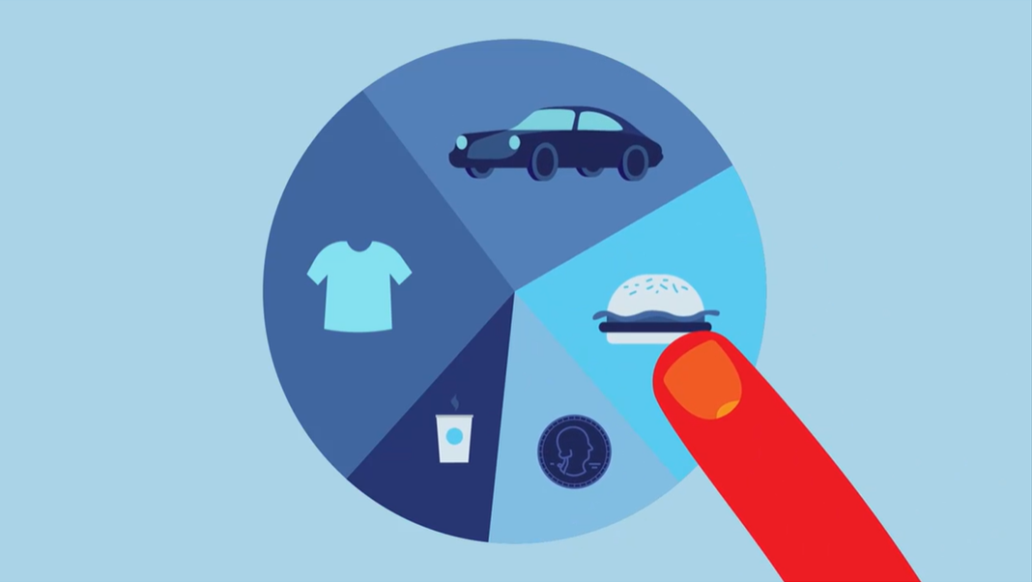
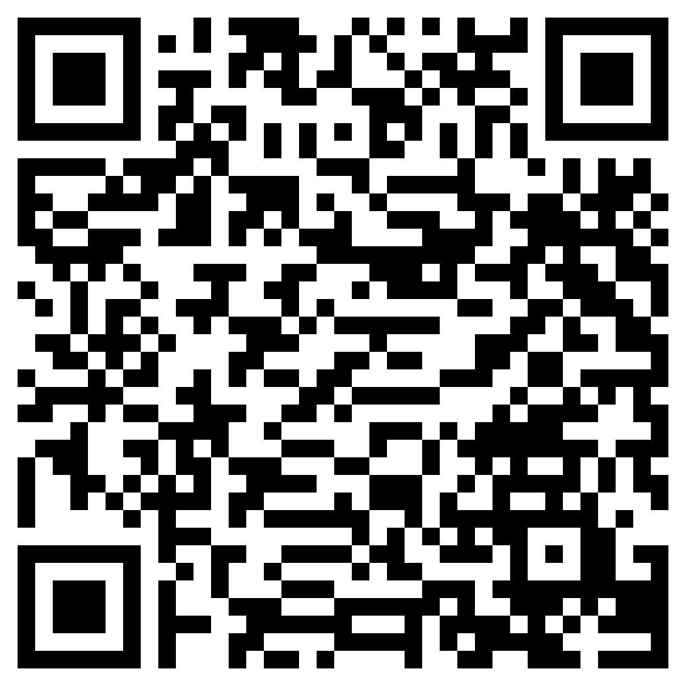
About Financial Institutions
Use in conjunction with the animated video found in the Deciding Where and How to Bank self-paced module.
Use this link or the QR code to the right to play the video from the module. Pause as needed to complete the graphic organizer below.
Write three interesting facts about the topic.
Share two reasons the information in the video is important.
Write a one-sentence summary of what you learned.

Slide 13
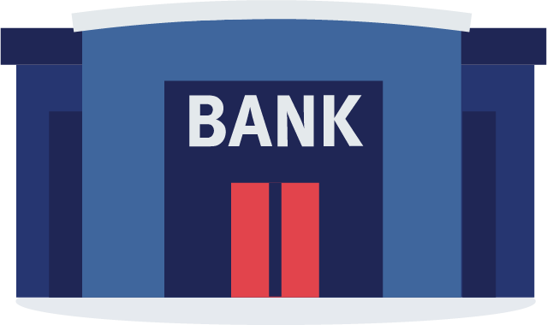
Use in conjunction with the Deciding Where and How to Bank self-paced module.
Banks and credit unions have some characteristics in common, but others are different.
Unique Characteristics of Banks | Similarities | Unique Characteristics of Credit Unions
Take notes about each of the common banking services below.
Checking Accounts
Savings Accounts
Mobile Banking
Loans

Slide 14
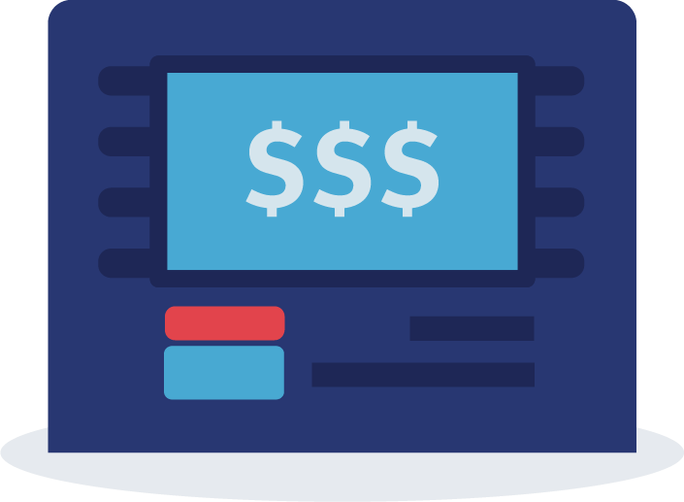
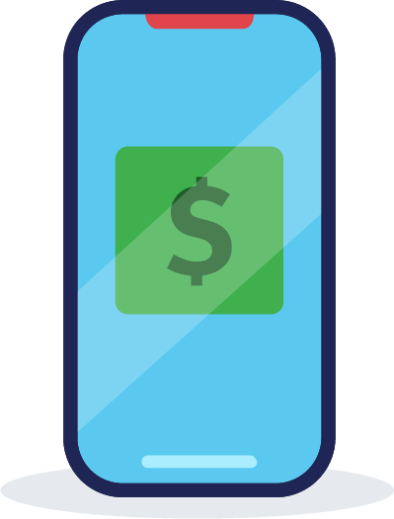
Use in conjunction with the Deciding Where and How to Bank self-paced module.
Describe each fee and how to avoid it.
Fee | Why the Fee is Charged | How to Avoid
Maintenance Fees
ATM Fees
Mobile Banking Fees
Overdraft Fees
Rank the financial institutions that are described in the “Making a Choice” section of the module based on what is most important to you. Then, explain how you came to this conclusion.
1st or Best Choice
2nd or Better Choice
3rd or Good Choice
Your Reasons

Slide 15
Use this page to reflect on what you have learned in Topic 2: Deciding Where and How to Bank.
In this module, you learned about different types of financial institutions, the services they provide, and ways to avoid costly fees. List at least three key takeaways from the module.
End-of-Module Self-Evaluation
Consider the learning goals for this module. How do you feel about each goal after completing this topic? | Strongly Agree | Somewhat Agree | Somewhat Disagree | Strongly Disagree
I feel confident describing different types of financial institutions, including banks and credit unions.
I am able to explain how young adults can benefit from using financial services.
I have examined my own use of financial services and identified opportunities to expand or enhance my use.

Slide 16
Opening New Accounts
After completing the module for this topic, you should be able to:
List questions you should ask yourself before opening a new account with a financial institution.
Describe how age impacts a person’s ability to open certain types of financial accounts.
Identify information you will need in order to open a new account.
Explain fees charged by banks or credit unions.

Slide 17
Use in conjunction with the Opening New Accounts self-paced module.
What do you think is involved in opening an account (like a checking or savings account) at a financial institution?
Which statement best describes your experience with completing forms and applications? | X
I am comfortable completing forms on my own and without assistance.
I prefer to have help when completing important forms.
I’d rather someone else complete the form than do it myself.

Slide 18
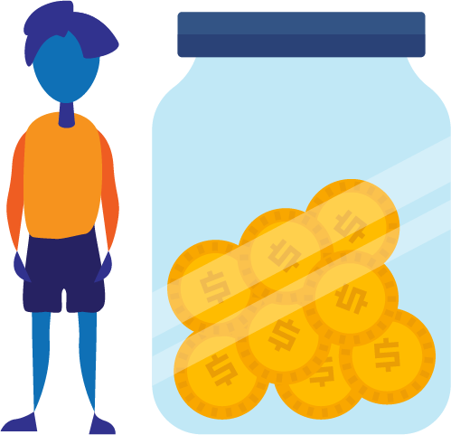
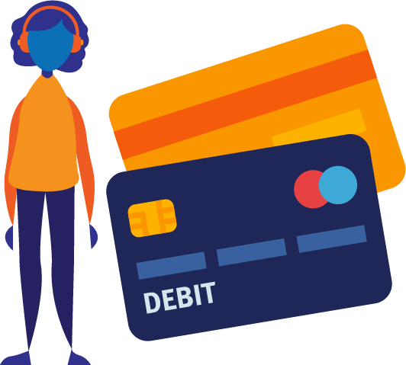
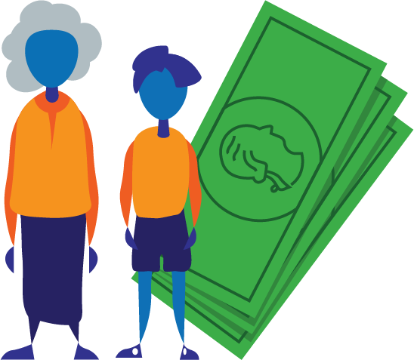
Use in conjunction with the Opening New Accounts self-paced module.
List at least five questions you should ask when opening an account.
How does age impact the type of accounts you can open?
Children | Teens | Young Adults | Older Adults

Slide 19
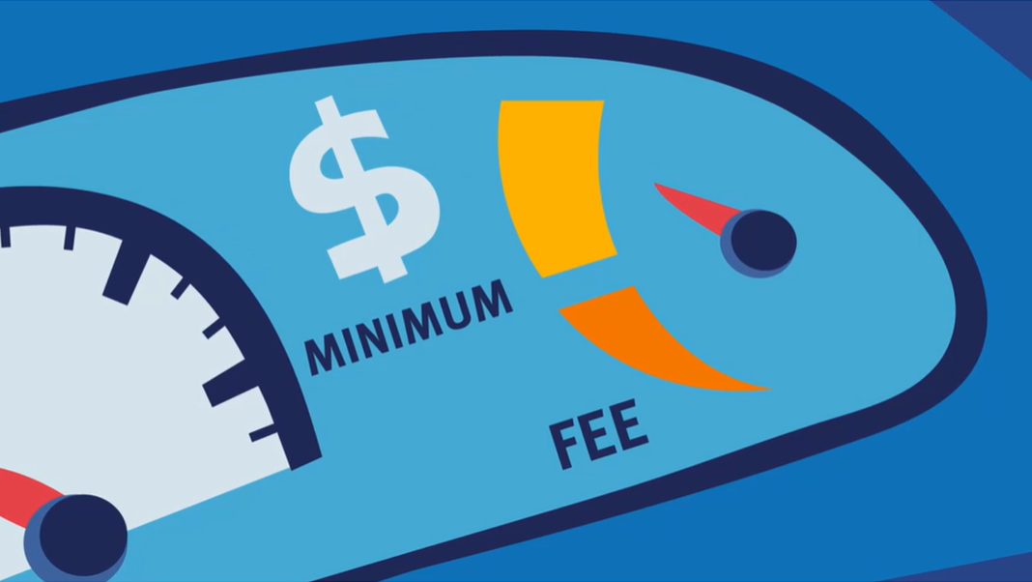
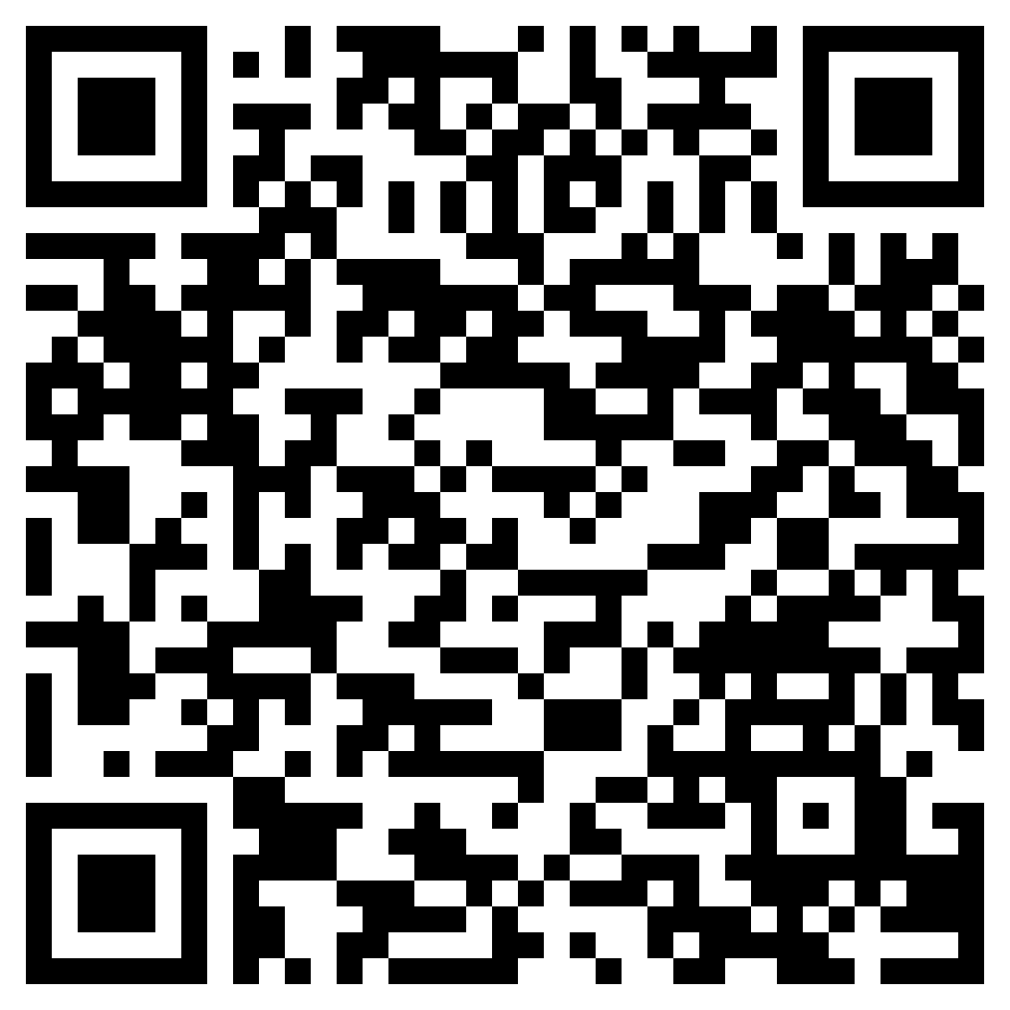
Understanding Account Fees
Use in conjunction with the animated video found in the Opening New Accounts self-paced module.
Use this link or the QR code to the right to watch the video from this module. As you watch it, consider which of the sentence starters below you could complete.
Pick three of the sentence starters below, and write your own completed versions. Base them on information in the video and your own background knowledge.
I think _________ because ______________. ____ is important because ______________. I am curious about _____________________. | This reminds me of ____________________. I was most interested in ________________. This made me reconsider _______________.
Sentence Starter # | Your Completed Sentence

Slide 20
Use in conjunction with the Opening New Accounts self-paced module.
You might have accounts now or plan to have some in the future. How will you accomplish each of the tasks below? Which tasks have you already taken care of?
How will you? | Your Answer
Access your account information
Keep track of your deposits and withdrawals
Remember your password
Make sure others don’t access your password
Make a habit of checking your balances and recent transactions
End-of-Module Self-Evaluation
Consider the learning objectives for this module. How do you feel about each objective after completing it? | Strongly Agree | Somewhat Agree | Somewhat Disagree | Strongly Disagree
I can list questions I should ask myself before opening a new account with a financial institution.
I feel confident describing how age impacts a person’s ability to open certain types of financial accounts.
I can identify information I will need in order to open a new account.
I can explain fees charged by banks or credit unions.

Slide 21
Using Mobile Banking
After completing the module for this topic, you should be able to:
Explain common mobile banking features.
Describe situations in which you might use mobile banking.
Categorize examples of mobile banking practices as safe or unsafe.

Slide 22
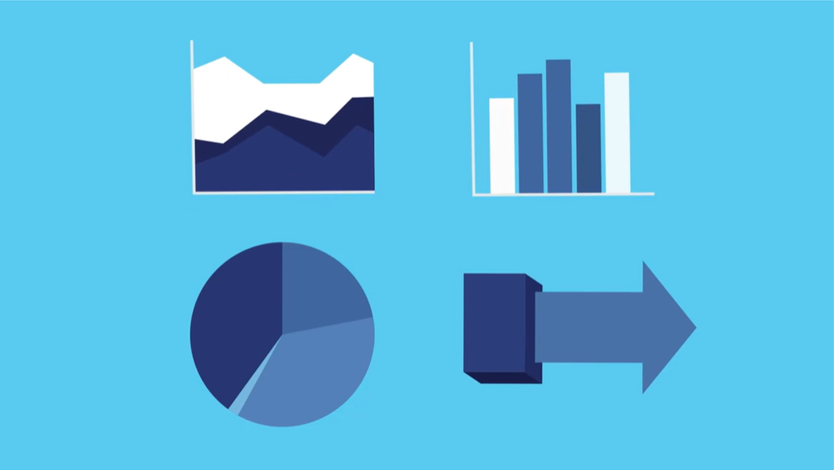
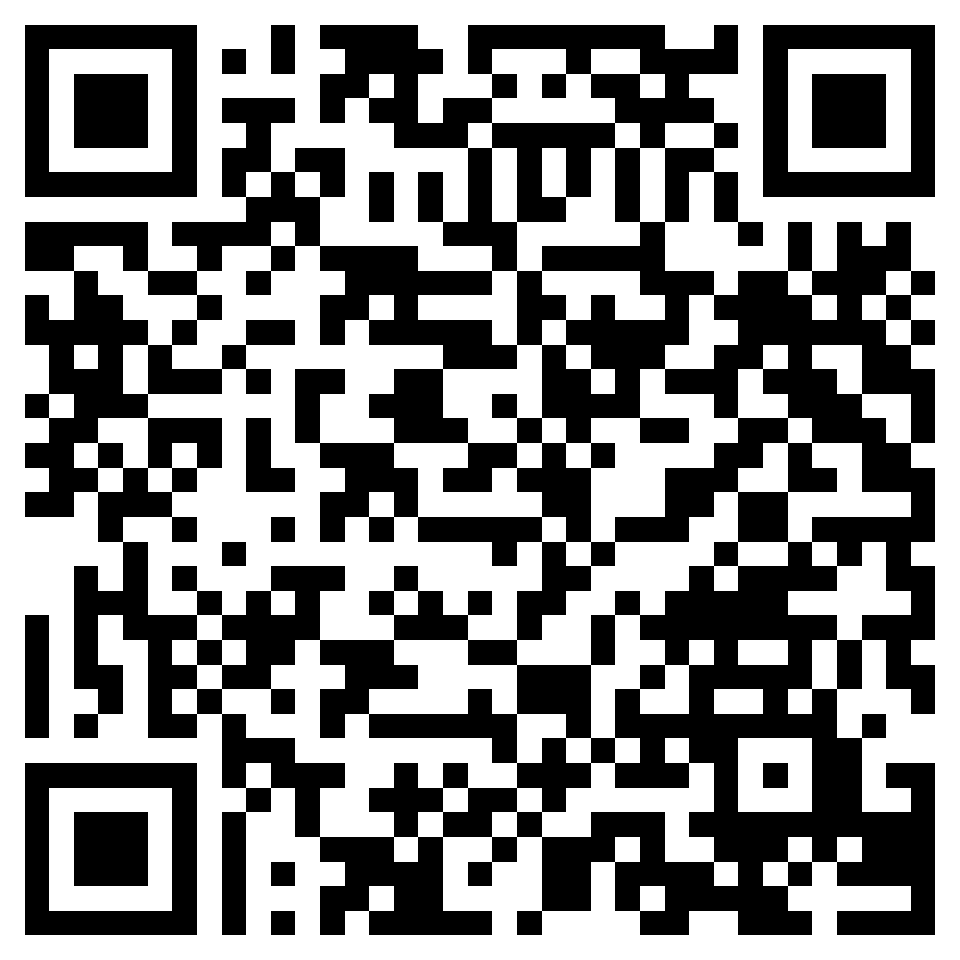
Banking: Now and in the Future
Use in conjunction with the animated video found in the Using Mobile Banking self-paced module.
Use this link or the QR code to the right to watch the video from this module. As you watch, categorize information as being a plus, minus, or interesting.
Plus | Minus | Interesting
Information that seems to be a plus, or positive, to you. | Information that seems to be a minus, or negative, to you. | Information that is neither a plus nor a minus, but is interesting to you.

Slide 23
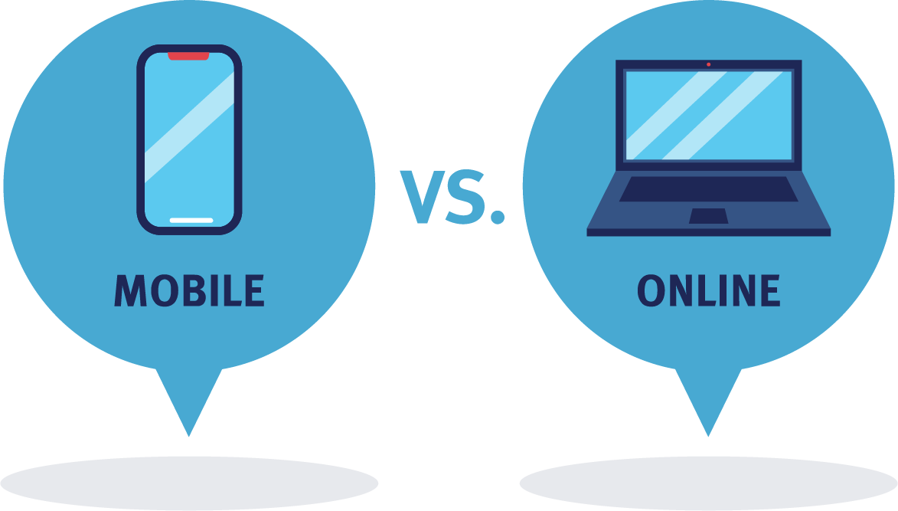
Use in conjunction with the Using Mobile Banking self-paced module.
How are online and mobile banking different?
Describe each of the features below and put an X to show if you think it applies to online and/or mobile banking.
Feature | Brief Description | Online | Mobile
Secure Access
Check Balances
Move Money Around
Pay Bills
Deposit Checks
Find a Location
Receive Text Alerts

Slide 24
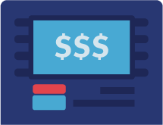
Use in conjunction with the Using Mobile Banking self-paced module.
What features would be most important to you when evaluating a mobile app? Use the blank rows to add other features you consider important.
Feature | Very Important | Somewhat Important | Not Very Important
Easily move money between accounts
Ability to send money to friends or family members
Set alerts if my balance gets low
Find the nearest in-person branch
Locate an ATM close to my location
Would you choose mobile, online, or in-person banking as your primary method? Why?

Slide 25
Use in conjunction with the Using Mobile Banking self-paced module.
Locate the terms and conditions of two mobile banking apps. Share the name of the financial institution, links to the terms and conditions, and at least one phrase or sentence you found interesting or concerning. For example, what happens if you use the app over insecure internet or don’t protect your device with a password?
Financial Institution Name | Link | Interesting or Concerning Information
Name an app that falls into each of the categories below. Have you used it personally or know anyone who does? What are the pros and cons of using it?
 | Name | Notes
Mobile Payment App
Budgeting App
Automatic Savings App
Deals and Coupons App

Slide 26
Use in conjunction with the Using Mobile Banking self-paced module.
Which of these new and evolving possibilities would you use? | Yes or No? | Why?
Virtual Currency (bitcoin and cryptocurrency)
Bots or Robo-advisors Powered by artificial intelligence
Payment by Voice
How do you see banking and the way we spend, transfer, or access money changing in the future? How might it be different when you are older?

Slide 27
Use this page to reflect on what you have learned in Topic 4: Using Mobile Banking.
In this module, you learned about mobile banking. Do you think the risks of using technology for your finances outweighs the benefits or is it the other way around? Why?
End-of-Module Self-Evaluation
Consider the learning goals for this module. How do you feel about each goal after completing this module? | Strongly Agree | Somewhat Agree | Somewhat Disagree | Strongly Disagree
I can explain common mobile banking features.
I am able to describe situations in which you might use mobile banking.
I can categorize examples of mobile banking practices as safe or unsafe.

Slide 28
Mobile Banking Comparison
Use in conjunction with the Banking on the Go classroom activity.
Directions: Work in a group or on your own and select financial institutions to research. Look online or contact the institution to obtain information about the features and limitations of each one’s mobile banking services. Which would you select?
 | #1 | #2 | #3 | #4
Name of Institution
Can you…
Check account balances?
Monitor recent transactions?
Transfer money?
Make remote deposits?
Locate a branch or ATM?
Send money to people?
Receive alerts?
Pay a bill?
Contact financial institution?
Other features
Your Choice and Why

Slide 29
Making Everyday Purchases
After completing the module for this topic, you should be able to:
Give examples of situations in which one payment method is more appropriate to use than another.
Compare and contrast various methods of payment.

Slide 30
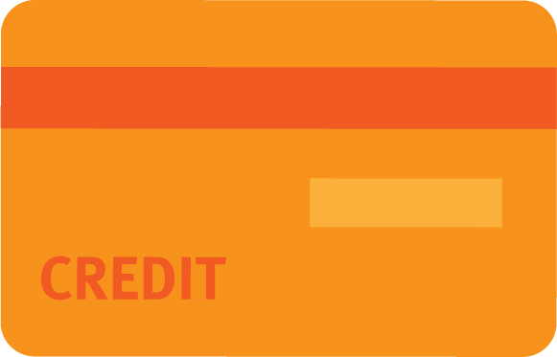
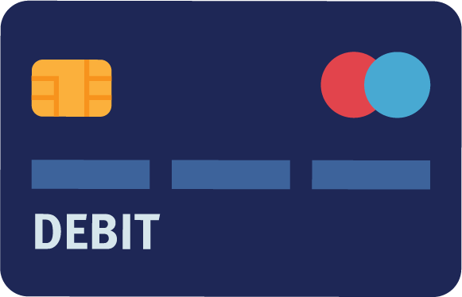
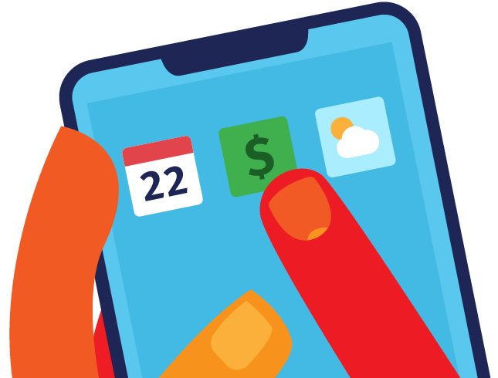
Use in conjunction with the Making Everyday Purchases self-paced module.
Which payment method are you most likely to use? What would a family member likely use? Rank each method from 1 (most likely to use) to 4 (least likely to use).
 | You | A Friend or Family Member
Cash
Credit Card
Debit Card
App or Digital Wallet
Why did you rank the payment methods in the order that you did?

Slide 31
Use in conjunction with the Making Everyday Purchases self-paced module.
Fill in the organizer below with pros and cons of each payment method.
 | Pros | Cons
Cash
Checks
Debit Card
Credit Cards
Automatic Withdrawal
App or Digital Wallet
Some people believe that credit cards should be avoided at all costs. Others think it is good to use credit cards in moderation—for purchases that can be paid off at the end of the month or within a short period of time. Where do you stand on the issue? Why?

Slide 32
Use in conjunction with the Making Everyday Purchases self-paced module.
Consider the music streaming example. After reviewing the different questions and the benefits and tradeoffs of each choice, which would you pick: pay for it with a credit card or through automatic withdrawal from your checking account? Why?
What payment apps have you heard about or seen used? What do you know about each one?

Slide 33
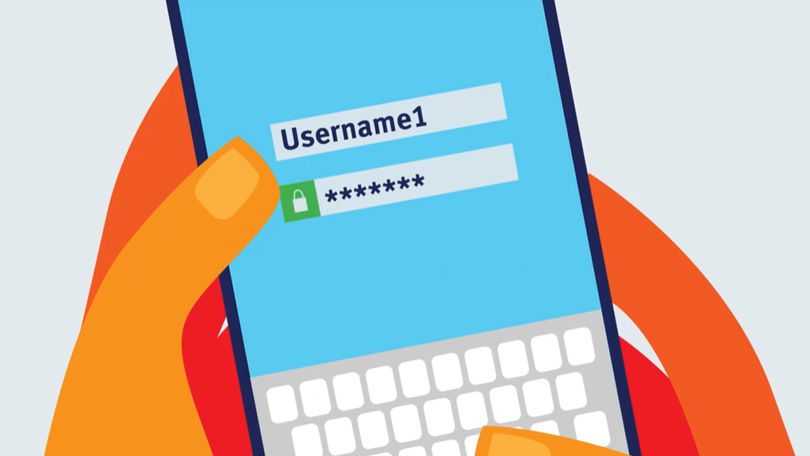
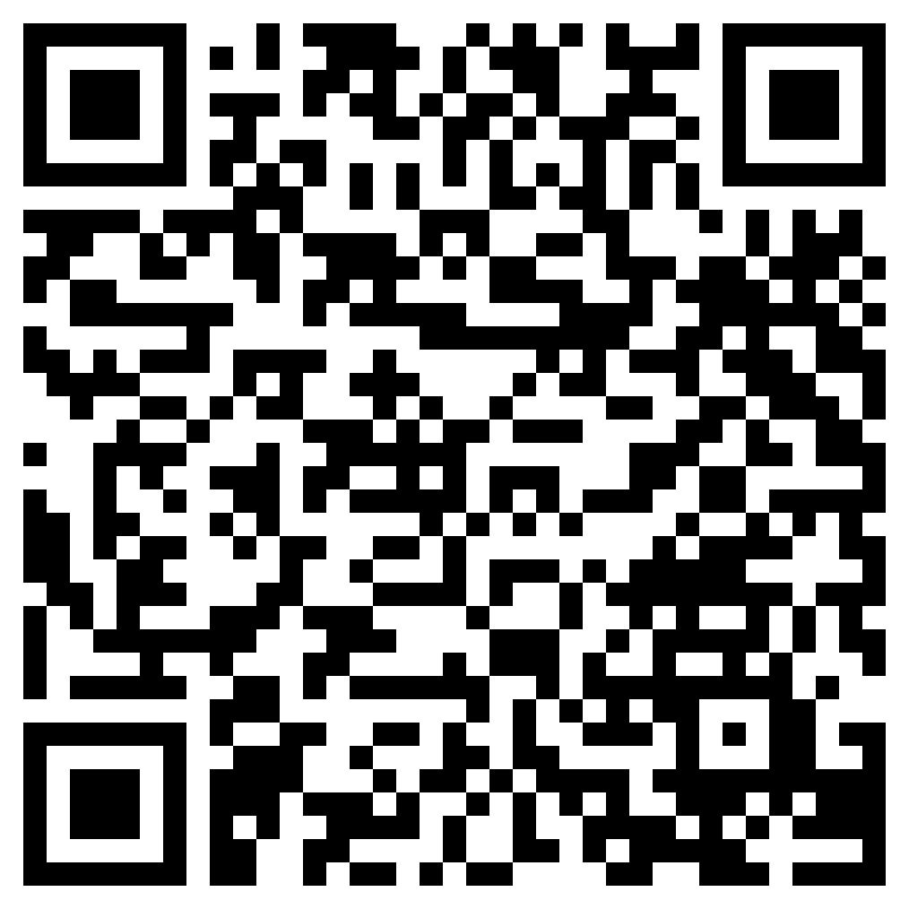
Going Mobile
Use in conjunction with the animated video found in the Making Everyday Purchases self-paced module.
Use this link or the QR code to the right to replay the video from this module then consider the “would you rather” question below.
Would You Rather?
Skip reading the ter`ms and conditions of a payment app and take your chances | OR | Read the conditions so you know what you’re getting into if you use the app
Share your choice and explain your decision.

Slide 34
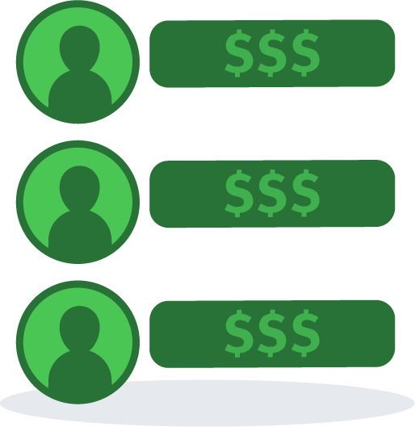
Use in conjunction with the Making Everyday Purchases self-paced module.
Write four tips for people who are considering using mobile payment options, such as a digital wallet or an app to send money to friends.
 | Tip
1
2
3
4
What payment method would you select for each scenario and why?
Going Out to Eat with Friends | Paying a Friend | Buying a New Phone

Slide 35
Use this page to reflect on what you have learned in Topic 5: Making Everyday Purchases.
In this module, you learned about different forms of payment. As you think about your future, which ones do you think you will use? Describe a scenario in which you would use each form of payment you selected.
 | Expect to Use? | Scenario
Cash
Checks
Debit Card
Credit Card
Automatic Withdrawal
A Digital Wallet on Your Phone
App to Send Money to Friends
End-of-Module Self-Evaluation
Consider the learning goals for this module. How do you feel about each one after completing this topic? | Strongly Agree | Somewhat Agree | Somewhat Disagree | Strongly Disagree
I can give examples of situations in which one payment method is more appropriate to use than another.
I can compare and contrast various methods of payment.

Slide 36
USING FINANCIAL SERVICES
Wrap Up

Slide 37
Unit 2: Glossary of Key Terms
Term | Definition | My Notes
ATM | A machine that lets people put money into or take money out of their bank accounts; short for Automated Teller Machine.
Automatic Withdrawal | The process of removing a predetermined amount of money from a person’s account at a financial institution according to a set schedule often for the purpose of paying a bill.
Balance | The amount of money in one’s account at a specific point in time.
Bank | A financial institution licensed to receive deposits and make loans.
Branch | A physical location of a bank or credit union.
Check Cashers | Businesses that cash checks for a fee.
Checking Accounts | An account at a financial institution which people often use to pay bills, make purchases, and deposit money they earn from working.

Slide 38
Unit 2: Glossary of Key Terms (continued)
Term | Definition | My Notes
Credit Card | A payment card issued to a user (cardholder) as a method of payment, which allows the cardholder to buy goods and services based on the promise to pay for them later.
Credit Union | A cooperative association that makes small loans to its members at low interest rates and offers other banking services (such as savings and checking accounts).
Debit Card | A plastic payment card that provides the user (cardholder) electronic access to their bank account and enables the cardholder to immediately pay for items.
Deposit | Adding money to an account at a financial institution.
Digital Wallet | A way to use payment methods such as debit and credit cards from a smartphone; examples include Apple Pay, Google Pay, and Samsung Pay.
Direct Deposit | The electronic transfer of a payment directly from the payer’s account to the recipient's account, such as from an employer’s account to an employee’s.

Slide 39
Unit 2: Glossary of Key Terms (continued)
Term | Definition | My Notes
Fees | Financial institutions may charge fees such as maintenance, ATM, mobile banking, and overdraft fees.
Financial Institution | A company that deals with money such as a bank or credit union.
FinTech | A blend of “financial” and “technology,” referring to apps, software, or other technology used to support or enable banking and financial services.
Hacker | Someone who uses technology to gain unauthorized access to data, often for financial gain.
Interest | Money paid by financial institutions to savers or paid by borrowers to lenders.
Loan | A sum of money borrowed from a bank or other financial institution that is expected to be paid back with interest.
Minimum balance | The lowest amount of money that can be in an account and still allow the user access to its full services without incurring a fee.

Slide 40
Unit 2: Glossary of Key Terms (continued)
Term | Definition | My Notes
Mobile Banking | Financial transactions and other services done via text message or through a bank’s mobile app.
Money Order | A printed order for payment of a specified sum, issued by a bank, Post Office, or retailer.
Online Banking | Transactions that are conducted using a financial institution’s website.
Overdraft Protection | A service that covers a payment when an account balance drops below zero, often accompanied by a fee.
Pawn Shop Loans | Money lent to a person when they provide an item of value to a pawn shop.
Payday Lender | A company that lends customers small amounts of money at high interest rates on the agreement that the loan plus interest will be repaid when the borrower receives their next paycheck.
Peer-to-Peer Payments | Money sent directly from one person to another, usually by some form of electronic transfer.

Slide 41
Unit 2: Glossary of Key Terms (continued)
Term | Definition | My Notes
Required Minimum Deposit | The least amount of money that can be used to open a new account, often called an initial deposit.
Savings Account | An account at a financial institution that usually pays interest on the money that is stored in the account.
Virtual Currency | An electronic representation of monetary value that may be issued, managed, and controlled by private issuers, developers, or the founding organization; bitcoin is an example.

Slide 42
Unit 2: Personal Action Plan
Consider each of the topics addressed in this unit. Which actions will you take to use financial services? | Already Doing | Need to Do | Not in My Plans
I know which bank or credit union I will use.
I have opened a savings account at a bank or credit union.
I have opened a checking account at a bank or credit union.
I regularly check my account balances.
I use a mobile banking app tied to my account.
I consider which payment method to use before making a purchase.
My notes and next steps:

Slide 43
Unit 2: Continuing the Conversation at Home
Families often approach conversations about money very differently. Some might welcome them, while others avoid the topic as much as possible. Review the conversation starters below. With whom could you have each conversation? How might you approach the conversations?
Conversation Starters | My Notes
Financial Institutions What financial institution(s), such as banks or credit unions, does our family use? How often do you visit a local branch? Do you feel in-person branches are necessary, or would you be okay with an online only bank? What do you like about the financial institution you use? What would it take for you to change financial institutions? Have you ever considered a change?
Financial Services What was your first account? Savings? Checking? How old were you when you opened it? What do you think is a good age to open a savings account? Checking account? What factors do you think are important to consider when deciding to get or use a debit card? Credit card? What features do you like about your current accounts? Have you noticed any fees related to your accounts? What are they for?
Mobile Banking Do you use mobile banking? If so, how? If not, why? What mobile banking features are most important to you?
Payment Methods What is your preferred or most commonly used form of payment? Why? What do you think about when deciding how to pay for something?

Slide 44
Unit 2: Dig Deeper
Interested in learning more about the topics covered in this unit? Consider exploring one or more of the following questions.
Dig into the Topics | My Notes
Financial Institutions What financial institutions are in your community? Has that changed in recent years? Have any of them merged or changed names in recent years? If there are credit unions in your area, what is required to become a member?
Financial Services What are the age requirements to open a savings or checking account? How do these vary by institution? Why do most savings accounts limit the number of transactions you can make in a month? What are the current interest rates for savings accounts?
Mobile Banking How is your information kept private and secure? What happens if your phone or another device gets lost? How has mobile banking technology changed, and what changes might happen in the future?
Purchase Methods What features do debit and credit cards have in common? What are the differences? How do digital wallets work? What is the future of cash with so many people choosing other payments? What is the difference between a wire transfer and an ACH transfer? How has the use of specific payment methods changed over time?

