Slide 1
Financing Your Future
Unit 3
Unit 3: Getting Started
Topic 1: Exploring Earning Potential How does education and training impact how much money you will earn in the future?
Topic 2: Weighing Your Career Options How do you pick a career? Will your career be in demand in the future?
Topic 3: Choosing Your Path After High School What education and/or training will you need to achieve your personal career goal?
Topic 4: Financing Further Education What options are available to finance your further education and training?
Topic 5: Understanding Education Financing Options How do you read and interpret a financial aid offer?
Wrap Up Glossary of Key Terms Personal Action Plan Continuing the Conversation at Home Dig Deeper

Slide 2
Unit 3: Getting Started
This unit explores a wide variety of personal finance topics within the theme of Financing Your Future. Going into this unit, how much do you already know about each topic?
 | Not Much | Some | A Lot
Topic 1: Exploring Earning Potential How does education and training impact how much money you will earn in the future? Learn about factors that influence your earning potential.
Topic 2: Weighing Your Career Options How do you pick a career? Will your career be in demand in the future? Consider the many factors you can consider when choosing a career.
Topic 3: Choosing Your Path After High School What education and/or training will you need to achieve your personal career goals? Explore your options after high school including further education and work.
Topic 4: Financing Further Education What options are available to finance your further education and training? Discover that the true cost of college goes beyond tuition, room, and board.
Topic 5: Understanding Education Financing Options How do you read and interpret a financial aid offer? Learn why many college students find themselves stressed over finances and that many borrowers wish they had taken on less student debt.

Slide 3
Exploring Earning Potential
After completing the module for this topic, you should be able to:
Explain the concept of earning potential.
Locate data to research careers.
Identify ways people can increase their earnings.

Slide 4
Use in conjunction with the Exploring Earning Potential self-paced module.
What hobbies or interests do you have that could lead to a career?
Hobby or Interest | Potential Career(s)
Many factors influence a person’s selection of a career. Order the factors below from most to least important.
Topic of interest Where you’ll work Ability to make a difference | When you will work Your earning potential Ability to get a job
Most
Least

Slide 5
Exploring Earning Potential
Use in conjunction with the animated video found in the Exploring Earning Potential self-paced module.
Use this link or the QR code to the right to watch the video from this module and answer the questions below. You’ll end up watching it three times—looking for something different each time.
Watch the video. Identify key ideas and details from the video and write them below.
Watch the video a second time. Identify and define three key vocabulary terms in your own words.
Term | Definition
Watch the video a third and final time. How does the video connect to what you already knew about the factors that influence earning potential?

Slide 6
Use in conjunction with the Exploring Earning Potential self-paced module.
In the Who Earns More section of the module, you find out which education or training is likely to lead to a higher income. What did you take away from each scenario?
Scenario | Key Takeaways
4-Year College: Engineer or Latin Major?
2-Year College: Dental Hygienist or Veterinary Technician?
Certificate: Massage Therapist or Firefighter?
Check out the Occupational Outlook Handbook from the U.S. Bureau of Labor Statistics. Find information on three occupations of interest and fill in the table below.
Occupation | Median Pay | Entry-Level Education | Job Outlook

Slide 7
Use in conjunction with the Exploring Earning Potential self-paced module.
Where you live can influence the amount you earn—even doing the exact same job. Use Career One Stop’s Salary Finder to explore how much people earn in different places. Search for information on three occupations using three locations.
Occupation | Locations
What did you learn from this exploration of occupations, salaries, and locations?
Want to dig a little deeper? Use a cost of living calculator like this one to see how much expenses vary from one place to another. Does the income change like the expenses?

Slide 8
Use in conjunction with the Exploring Earning Potential self-paced module.
Explain what return on investment means when thinking about paying for education beyond high school, and what factors might influence a person’s return on investment.
List four ways you might be able to increase your earning potential that don’t involve education, training, or where you live.

Slide 9
Use this page to reflect on what you have learned in Topic 1: Exploring Earning Potential.
How important is earning potential to you? Do you think it will be one of your top considerations, or will other factors be more important? Explain your answer.
End-of-Module Self-Evaluation
Consider the learning objectives for this module. How do you feel about each one after completing it? | Strongly Agree | Somewhat Agree | Somewhat Disagree | Strongly Disagree
I can explain the concept of earning potential.
I can locate data to research careers.
I can identify ways people can increase their earnings.

Slide 10
Weighing Your Career Options
After completing the module for this topic, you should be able to:
Give examples of factors you might consider when choosing a career.
Explain why some jobs may go away in the future while other future jobs are difficult to predict.
Identify tradeoffs people make when selecting one career over another.

Slide 11
Use in conjunction with the Weighing Your Career Options self-paced module.
The average person will spend _______ hours at work over the course of their lifetime.
What number fills in the quote?
In Work and You, you are asked to consider the factors below and how important each might be to you when considering a future career.
How much money you’ll earn
Amount of education or training you’ll need
Where and when you will work
If you’ll make an impact on the world
How easy it will be to find a job
What OTHER factor(s) might you or someone else consider that aren’t on this list?

Slide 12
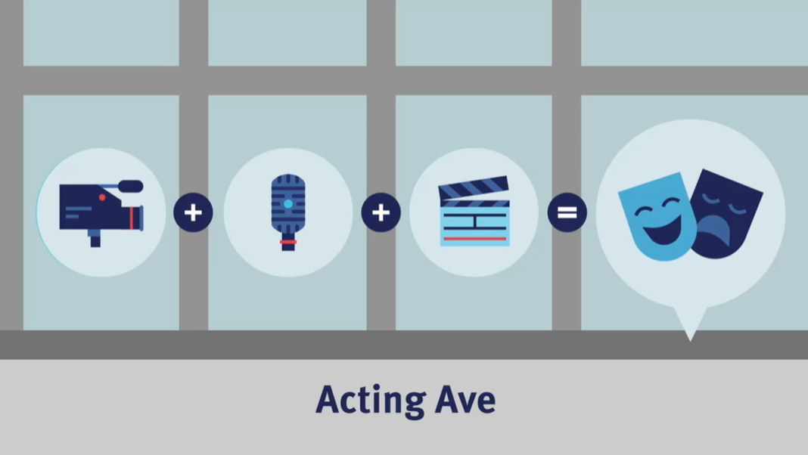
Understanding Careers
Use in conjunction with the animated video found in the Weighing Your Career Options self-paced module.
Use this link or the QR code to the right to watch the video from this module. Respond to the questions below.
What did you SEE in the video that was interesting?
What do you KNOW now that you didn’t before watching the video?
What do you WONDER as a result of watching the video?

Slide 13
Use in conjunction with the Weighing Your Career Options self-paced module.
Choose four of the eight jobs from So Many Options and fill in the information below.
Occupation | Education | Median Wage | Job Outlook

Slide 14
Use in conjunction with the Weighing Your Career Options self-paced module.
Some things can both help and hurt the outlook for certain jobs. Describe one for each factor below. Not all of these were mentioned in the module. Think for a bit or do an online search to find an example.
 | Improves Job Outlooks | Hurts Job Outlooks
Technology
Economy
Demographics
Think about two careers that interest you. How does each factor relate to them?
 | Career 1: |  | Career 2:
Where you work
Amount of education
Passion versus pay
Flexibility

Slide 15
Use this page to reflect on what you have learned in Topic 3: Weighing Your Career Options.
After completing the module, what factors do you think you will pay attention to the most when thinking about your career options? Which will matter the least? Why?
End-of-Module Self-Evaluation
Consider the learning goals for this module. How do you feel about each goal after completing this topic? | Strongly Agree | Somewhat Agree | Somewhat Disagree | Strongly Disagree
I can give examples of factors I might consider when choosing a career.
I can explain why some jobs may go away in the future while other future jobs are difficult to predict.
I can identify tradeoffs people make when selecting one career over another.

Slide 16
Choosing Your Path After High School
After completing the module for this topic, you should be able to:
Explain options you will have after graduating from high school.
Compare 2-year and 4-year colleges.
Provide examples of careers someone would pursue with education from a trade or technical school.
Identify the benefits and tradeoffs of military service.

Slide 17
Use in conjunction with the Choosing Your Path after High School self-paced module.
Describe the “paths” available to students at your high school. What options are there, if any?
Think about the choices you have made in high school (courses, electives, extracurriculars, etc.). How might these choices influence you in the future?
What are you thinking about doing after high school? What are some of the benefits and tradeoffs of each option?
 | Options You Are Considering
Benefits
Tradeoffs

Slide 18
Your Path After High School
Use in conjunction with the Choosing Your Path after High School self-paced module.
Watch the video, pausing it to take notes. Use what you learned to write a aiku poem. Haiku is a traditional form of Japanese poetry written about a topic the reader knows well. The poem consists of three lines that rarely rhyme.
First line 5 syllables
Second line 7 syllables
Third line 5 syllables
Use this link or the QR code to the right to watch the video from this module.
First Line 5 syllables
Second Line 7 syllables
Third Line 5 syllables

Slide 19
Use in conjunction with the Choosing Your Path after High School self-paced module.
What do you already know about each of the topics below? What might you want to learn?
Topic | Already Know | Want to Learn
College
Apprenticeship
Internship
Gap Year

Slide 20
Use in conjunction with the Choosing Your Path after High School self-paced module.
Summarize the benefits and tradeoffs of each college option.
 | Benefits | Tradeoffs
2-Year College
4-Year College
Some students start at a 2-year college and then transfer to a 4-year college. What might the benefits and tradeoffs be of this choice?
Benefits | Tradeoffs

Slide 21
Use in conjunction with the Choosing Your Path after High School self-paced module.
List jobs you can do with training from a trade school, apprenticeship, or certificate program. Do any of these interest you?
Would you consider serving in the military? Why or why not?
Which branch(es) would you consider? Put an X for yes or no.
 | Air Force | Army | Coast Guard | Marine Corps | Navy | Space Force
Yes
No
Did you know there are thousands of careers in the military and many ways to join?
You can enlist straight out of high school, consider a college ROTC program, or serve part-time in the reserve or national guard. Use the Careers in the Military website to explore career options, the branches of service, and different ways to serve. Note: Not everyone is eligible to serve. Conditions such as food allergies, type 1 diabetes, or very poor vision, may limit a person’s ability to serve. Be sure to find out if you are eligible before getting your heart set on military service.

Slide 22
Use in conjunction with the Choosing Your Path after High School self-paced module.
Choosing what path you will take after high school is a big step. Answer the questions below based on your current thoughts and feelings on the subject.
Clear Destination How confident are you about a future career?
High Priority What is your biggest priority? Living on your own? Earning money? Finding a job? Something else?
Looking Ahead Where do you see yourself in five years? Ten? What paths are likely to get you there?
Getting Help Who do you know that can help you think about your future?

Slide 23
Use this page to reflect on what you have learned in Topic 3: Choosing Your Path after High School.
This module focuses on your career choices after high school. Answer one of the questions below: How did this module confirm your existing thoughts about your plans after high school? What is something new that you are considering about your path after high school?
End-of-Module Self-Evaluation
Consider the learning objectives for this module. How do you feel about each objective after completing it? | Strongly Agree | Somewhat Agree | Somewhat Disagree | Strongly Disagree
I can explain options I will have after graduating from high school.
I can compare 2-year and 4-year colleges.
I can provide examples of careers someone could pursue with education from a trade or technical school.
I can identify the benefits and tradeoffs of military service.

Slide 24
Financing Further Education
After completing the module for this topic, you should be able to:
Explain the difference between tuition and the total cost of attendance.
Examine options for paying for higher education.
Evaluate the impact borrowing for education might have on your future.
Identify ways to reduce the cost of higher education.

Slide 25
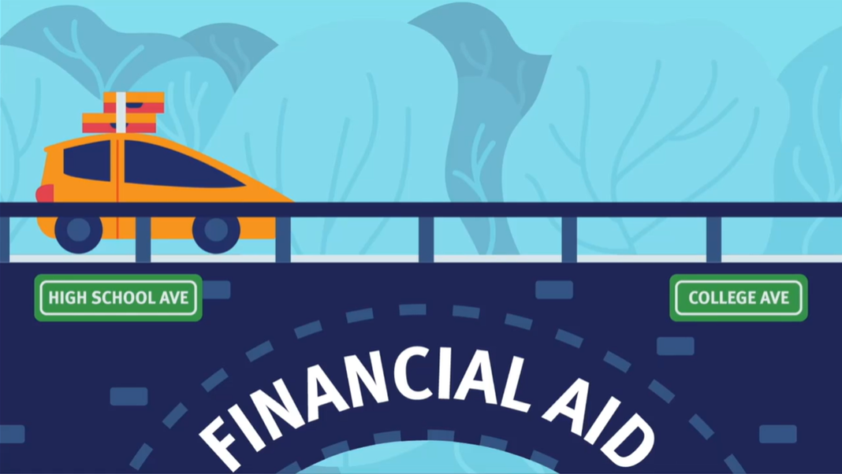
Financing Further Education
Use in conjunction with the animated video found in the Financing Further Education self-paced module.
Use this link or the QR code to the right to watch the video from this module. As you watch it, consider which of the sentence starters below you could complete.
Pick three of the sentence starters below, and write your own completed versions. Base them on information in the video and your own background knowledge.
I think _________ because ______________. ____ is important because ______________. I am curious about _____________________. | This reminds me of ____________________. I am most interested in ________________. This made me wonder if _______________.
Sentence Starter # | Your Completed Sentence

Slide 26
Use in conjunction with the Financing Further Education self-paced module.
Fill in the word that goes with each description.
Description | Term
Often referred to as room and board, you might be able to influence these costs by the choices you make.
The distance between your home and school along with how often you plan to go home or have visits from family will make a big difference on this cost.
The school might require you to purchase a device, such as a laptop, or specific reading material.
At public schools, this might be a different amount based on where you live (for example, in-state or out-of-state).
What you get when adding up all of the charges, fees, and other expenses associated with college.
What expenses do you anticipate having related to pursuing higher education?

Slide 27
Use in conjunction with the Financing Further Education self-paced module.
Do you know what it costs to attend college? Visit the websites of three different schools and find the current cost of tuition, room and board, and other fees. Add them up to determine the total cost of attendance. Tips: Be sure to use the cost for the full year (not a semester or other smaller amount of time). Look for information for the current or upcoming school year. Some schools have different amounts for in-state and out-of-state residents, certain majors, or campuses. Note what selections you made when choosing an amount. The same applies to other fees or expenses that might vary from person to person or school to school (like travel or personal expenses).
 | Which colleges or universities did you research?
Direct Costs
Tuition
Housing and Food
Required Fees
Indirect or Estimated Expenses
Books and Supplies
Personal Expenses
Transportation
Total Cost of Attendance
Notes

Slide 28
Use in conjunction with the Financing Further Education self-paced module.
There are many ways to pay for higher education. Take notes about each category.
Free Money | Borrowed Money
Earned Money | Your Money
Ways to Pay for Higher Education
List four strategies students can use to reduce college costs.

Slide 29
Use this page to reflect on what you have learned in Topic 4: Financing Further Education.
What have you learned in this module about paying for education beyond high school?
End-of-Module Self-Evaluation
Consider the learning objectives for this module. How do you feel about each objective after completing it? | Strongly Agree | Somewhat Agree | Somewhat Disagree | Strongly Disagree
I am confident explaining the difference between tuition and the total cost of attendance.
I can examine options for paying for higher education.
I am able to evaluate the impact borrowing for education might have on my future.
I can identify ways to reduce the cost of higher education.

Slide 30
Understanding Education Financing Options
After completing the module for this topic, you should be able to:
Explain the differences between loans, grants, and scholarships.
Identify key elements in a financial aid offer.
List factors you should consider before accepting a financial aid offer or taking on a loan for higher education.

Slide 31
Use in conjunction with the Understanding Education Financing Options self-paced module.
What are your thoughts on borrowing money to pay for college? Do you think borrowing is a wise choice? Why or why not?
This module focuses on paying for college and the options people have, including financial aid, scholarships, and loans. Complete the Know and Want columns below. Come back at the end of the module, and complete the Learn section.
Know What do you already know about this topic? | Want What do you want to learn about this topic? | Learn What have you learned after completing the module?

Slide 32
Applying for Financial Aid
Use in conjunction with the Understanding Education Financing Options self-paced module.
Use this link or the QR code to the right to watch the video from this module two times. Answer the prompts below.
Watch the video without pausing. Write down as many key details as you can remember in one minute.
Watch the video again. Take one minute and list any additional key details that you missed the first time.
Use the key details to write a paragraph (3–4 sentences) summarizing the content of the video.

Slide 33
Use in conjunction with the Understanding Education Financing Options self-paced module.
While they are not all formatted the same, most financial aid offers contain similar information. Fill in the chart with six pieces of information you are likely to find, and provide a fact about each one.
Financial aid offers usually have similar information, but they are often presented differently. Take notes on the four tips for comparing financial aid offers.
Decode the Offer
Be Real with Yourself
Do Some Math
Estimate Your Debt

Slide 34
Use in conjunction with the Understanding Education Financing Options self-paced module.
Fill in the table with information about each type of student loan.
 | Direct Subsidized Loans | Direct Unsubsidized Loans | Direct PLUS Loans | Private Loans
Who provides the loan? government or bank
Who borrows the money? student or parent(s)
Is the loan based on financial need? yes or no
Other important information
Borrowing more than you can afford may have negative consequences. List five potential outcomes.
Want to estimate how much and what kinds of federal student aid you may be eligible to receive? Use the Federal Student Aid Estimator to find out. Note: You will need your and your parents’ financial information in order to answer the questions.
Know what colleges you are considering? Get an even more accurate idea of what you can expect to pay by searching for each school’s “net price calculator.”

Slide 35
Use this page to reflect on what you have learned in Topic 5: Understanding Education Financing Options.
What suggestions would you give to someone who is thinking about borrowing money to finance education beyond high school?
End-of-Module Self-Evaluation
Consider the learning objectives for this module. How do you feel about each goal after completing it? | Strongly Agree | Somewhat Agree | Somewhat Disagree | Strongly Disagree
I can explain the differences between loans, grants, and scholarships.
I am able to identify key elements in a financial aid offer.
I can list factors I should consider before accepting a financial aid offer or taking on a loan for higher education.

Slide 36
Financing Your Future
Wrap Up

Slide 37
Unit 3: Glossary of Key Terms
Term | Definition | My Notes
2-Year College | An institution of higher education that typically offers associate degrees and credential programs
4-Year College | An institution of higher education which typically leads to the award of a bachelor’s degree
Apprenticeship | A training program that leads to an industry-recognized credential and pays wages to people completing it
Associate Degree | A degree typically obtained by seeking education from a 2-year college
Bachelor’s Degree | A degree typically obtained by pursuing a specific field of study at a 4-year college or university
Career | Based on working at jobs in the same occupation or profession for many years; different careers require different education and training
Cost of Attendance | Estimate of the total costs of attending a particular school for a period of one year; should include tuition, room and board, books, and living expenses

Slide 38
Unit 3: Glossary of Key Terms (continued)
Term | Definition | My Notes
CSS Profile | A form from the College Board used to determine eligibility for student financial aid; required only for specific colleges and universities.
Earning Potential | The amount of money a person can expect to earn in a given field based on education, training, and experience.
FAFSA | Free Application for Federal Student Aid; A form the federal government uses to determine eligibility for student financial aid.
Financial Aid | Any grant, scholarship, loan, or paid employment offered to help a student meet their college expenses.
Financial Aid Award Letter | Information provided by a school that describes any financial aid being offered and the amount the student and their family will be responsible for paying.
Grant | Payment made for a person’s higher education or training costs, often given based on financial need; does not require repayment.
Human Capital | The economic value of a person’s skills, knowledge, and abilities.

Slide 39
Unit 3: Glossary of Key Terms (continued)
Term | Definition | My Notes
Income | Money received, especially on a regular basis, for work or through investments.
Job Outlook | The projected percent change in employment over a specific period.
Loan | A sum of money borrowed from a bank or other financial institution that is expected to be paid back with interest.
Net Costs | The amount a student and their family is responsible for paying at a particular school for a period of one year; equals the cost of attendance minus total grants and scholarships.
Pell Grant | A grant provided by the U.S. federal government to college students based on financial need.
Private Student Loan | A loan issued by private lenders (banks and other financial institutions as opposed to the government) to help students pay for higher education.
Return on Investment (of Education) | The additional amount a person can expect to earn following education minus the cost of that education, also known as ROI.

Slide 40
Unit 3: Glossary of Key Terms (continued)
Term | Definition | My Notes
Room and Board | Money charged by schools to cover housing and meals.
Scholarship | Payment made for a person’s higher education or training costs, often earned because of an academic or other achievement; does not require repayment.
Student aid Index | A number colleges use to determine how much financial aid a student will receive based on information submitted in the FAFSA, also called SAI.
Student Loan | A loan that helps students pay for higher education.
Trade School | Also known as a technical or vocational school, a trade school offers hands-on training in skills related to specific jobs.
Tuition | Money charged by schools to cover instruction.
Work Study | A program that allows students to earn money by doing a job while also fully participating in school.

Slide 41
Unit 3: Personal Action Plan
Consider each of the topics addressed in this unit. Which actions will you take to use financial services? | Already Doing | Need to Do | Not in My Plans
I have explored careers that interest me.
I have investigated the job outlook for careers of interest.
I know about how much I can expect to earn in the career(s) I am considering.
I have considered ways to increase my earning capacity.
I know about how much any education or training I plan to pursue beyond college will cost me.
I have estimated how much federal student aid I might be eligible to receive.
My notes and next steps:

Slide 42
Unit 3: Continuing the Conversation at Home
Families often approach conversations about money very differently. Some might welcome them, while others avoid the topic as much as possible. Review the questions below. With whom could you have each conversation? How might you approach the conversations?
Conversation Starters | My Notes
Earning Potential What steps have you taken to increase your earning potential in the past? Have you ever asked for a raise? Have you ever switched jobs in order to earn more? How important is pay when considering job options?
Career Options What was your first job? How did you decide what career path to follow? What careers did you consider? Did you ever change your mind? What factors should I consider when choosing a career? Did you feel pressured by anyone to choose the career that you did? What jobs have you seen go away, change, or be created?
Education and Training Beyond High School What are your feelings about education and training beyond high school? Are there schools or training programs that you think I should consider? What factors would you recommend considering when deciding to get more education or training?
Ways to Finance Further Education Did you or anyone you know borrow money to pay for education? Do you think it is worth getting loans to pay for an education? What money has been saved, if any, for me to pursue more education? Which do you think is most important when selecting a college: cost, academics, location, something else?

Slide 43
Unit 3: Dig Deeper
Interested in learning more about the topics covered in this unit? Consider exploring one or more of the following questions.
Dig into the Topics | My Notes
Earning Potential What are the highest paying jobs in your region, state, and the nation? What jobs require little education but have above average pay? Is it worth moving to a place where incomes are higher after taking into consideration the cost of living?
Career Options What occupations are expected to see an increase in demand over the next decade or so? What are the most common jobs in your area? What occupations are likely to decrease or go away because of changes in technology, demographics, etc.?
Education and Training Beyond High School How much do 2-year and 4-year colleges near me cost? How does this compare to other states? What careers offer apprenticeships as a way to make money while you learn? How much does the school that you go to matter if you plan to study the same thing?
Ways to Finance Further Education What factors are considered by the federal government when a person applies for financial aid? What scholarships could I apply for to help cover education costs? What repayment plans are available to people with student loan debt? What is the average amount of student loan debt in my states? The nation?

