Slide 1
Getting Paid
Unit 4
Unit 4: Getting Started
Topic 1: Preparing for Work How can you get the job you want? What should you include in a job application, resume, or cover letter?
Topic 2: Calculating Different Types of Pay How do people get paid for the work that they do? Does it make a difference if you are an employee or work as a contractor?
Topic 3: Comparing Job Offers What should you look for in a job offer?
Topic 4: Paying Taxes Why is money taken out of your paycheck? How do you benefit from paying taxes?
Topic 5: Creating Your Own Job What does it take to be your own boss?
Wrap Up Glossary of Key Terms Personal Action Plan Continuing the Conversation at Home Dig Deeper

Slide 2
Unit 4: Getting Started
This unit explores a wide variety of personal finance topics within the theme of Getting Paid. Going into this unit, how much do you already know about each topic?
 | Not Much | Some | A Lot
Topic 1: Preparing for Work How can you get the job you want? What should you include in a job application, resume, or cover letter? Learn about writing a resume and common mistakes you should avoid.
Topic 2: Calculating Different Types of Pay How do people get paid for the work that they do? Does it make a difference if you are an employee or work as a contractor? Discover the various ways people are paid for their work.
Topic 3: Comparing Job Offers What should you look for in a job offer? Explore factors you might consider when choosing between multiple job offers.
Topic 4: Paying Taxes Why is money taken out of your paycheck? How do you benefit from paying taxes? Examine different types of taxes and why people pay them.
Topic 5: Creating Your Own Job What does it take to be your own boss? Consider entrepreneurship as a way to create your own job and be your own boss.

Slide 3
Preparing for Work
After completing the module for this topic, you should be able to:
Identify information commonly included in a resume.
Explain how employers use resumes and other information to screen candidates.
Give examples of how your interests and activities can be highlighted in a resume.
List ways technology impacts job seekers.

Slide 4
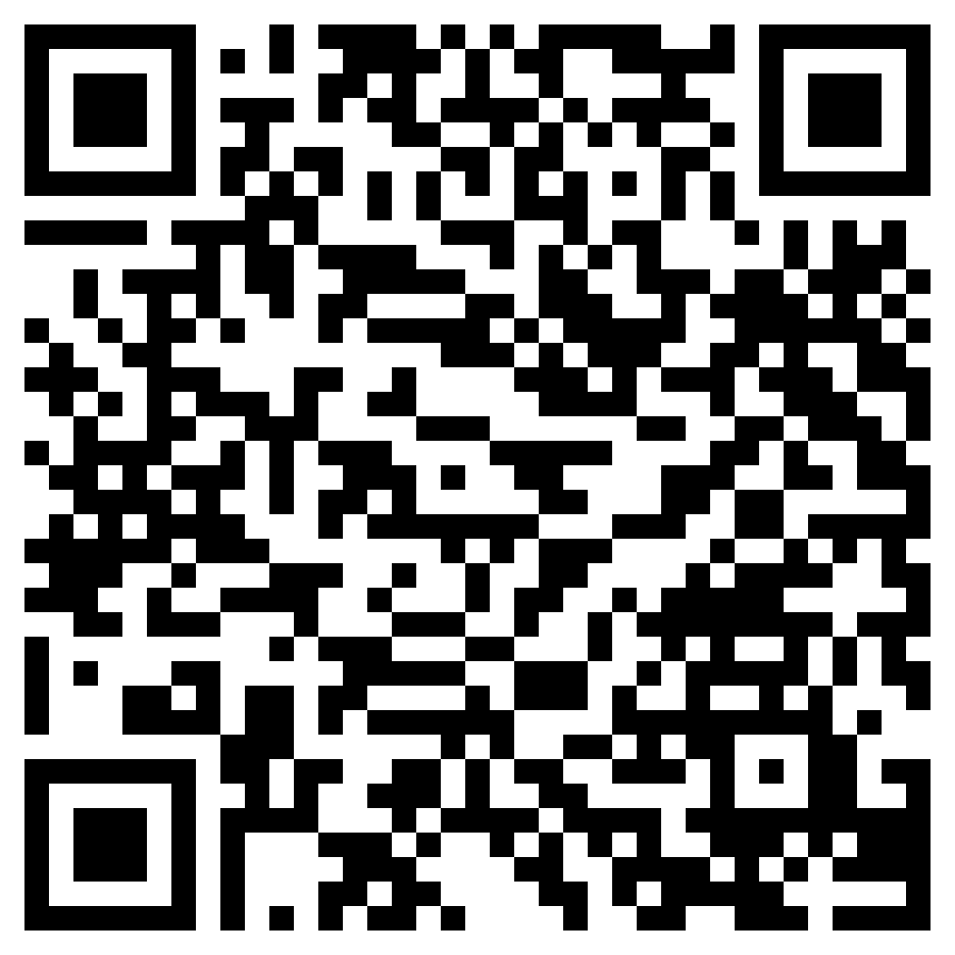
What Are Resumes?
Use in conjunction with the animated video found in the Preparing for Work self-paced module.
The video in this module features a human resources director, someone who regularly reads the resumes of potential employees.
Use this link or the QR code to the right to replay the video. Pay attention to what the human resources director is looking for when reviewing resumes. Then, respond to the prompt below.
Imagine you are a human resources director reviewing resumes for an open position. Write an email you might send after reading one or more resumes. Use your imagination. Perhaps one resume really stood out, or maybe you read through an entire stack and didn’t find a single good candidate. The email could be to a coworker, your boss, or one of the candidates. You decide.

Slide 5
Use in conjunction with the Preparing for Work self-paced module.
Do you have a resume? If so, when and why did you create it? If not, when do you think you might need one in the future?
Resumes start with the basics, including your name and contact information. Consider each item below and decide what you would include. Will you need to do anything before providing this information to a potential employer?
Categories | Considerations | Your Information and Potential Follow-Up Actions
Name | What name will you list? Will you include your middle name or initial?
Address | What is your full mailing address?
Phone Number | What phone number will you provide? Will it be your own or a parent’s? Is your voicemail message appropriate for a potential employer to hear?
Email Address | Will you use a personal or a school email address? Is the email address appropriate for professional use? Do you want or need to set up a new email address?

Slide 6
Use in conjunction with the Preparing for Work self-paced module.
Consider what you learned in the module about each section of a resume. What could you include?
Education and Accomplishments | Experience
Activities | Skills

Slide 7
Use in conjunction with the Preparing for Work self-paced module.
Choose three of the active words mentioned in the Resume Tips section and apply each to one of the items you listed on the previous page.
Active Word | Your Use of the Active Word
List two people you would consider asking for each. Include each person’s name and their role or relationship to you.
Proofreading Assistance Who could you ask to proofread your resume? | Help with the Content Who could review what you include and suggest things you might have forgotten?
Who are two people you would consider asking to serve as a reference for a potential employer? Think of people who are not related to you.

Slide 8
Use in conjunction with the Networks: Not Just Social classroom activity.
How you are perceived by others is important when applying for jobs and developing a professional network. Sometimes how you see yourself might be different from how others view you. Consider each point of view below and list four adjectives each would use to describe you.
Point of View | Adjectives Each Person Would Use to Describe You
You
Classmate
Teacher
Close Friend
Family Member
If someone has never met you and could only describe you based on what they find in your public social media profile or a search engine result, what four words might they use?
Would you want a potential employer to view your social media accounts? Why or why not?

Slide 9
Use in conjunction with the Preparing for Work self-paced module.
What did you learn about the ways technology might impact your job search?
Technology | What You Learned
Applicant Tracking Systems
Templates
Website
Social Media
Remote Interview
How do you think other forms of technology, such as artificial intelligence (AI), might impact job searches in the future?

Slide 10
Use this page to reflect on what you have learned in Topic 1: Preparing for Work.
In this module, you explored ways to use a resume and other tools to help you obtain a job in the future. What did you learn in the module that you can apply in your own life?
End-of-Module Self-Evaluation
Consider the learning objectives for this module. How do you feel about each one after completing it? | Strongly Agree | Somewhat Agree | Somewhat Disagree | Strongly Disagree
I am able to identify information commonly included on a resume.
I can explain how employers use resumes and other information to screen candidates.
I can give examples of how my interests and activities can be highlighted in a resume.
I am able to list ways technology impacts job seekers.

Slide 11
Calculating Different Types of Pay
After completing the module for this topic, you should be able to:
Describe ways people can be paid for their work, including a salary, hourly wage, commission, and tips.
List similarities and differences between being an employee and an independent contractor.
Give examples of factors you might consider when exploring how you will be paid in the future.

Slide 12
Use in conjunction with the Calculating Different Types of Pay self-paced module.
How did you classify each factor related to pay preferences?
 | Very Important | Important | Not Important
Getting paid the same amount each time.
Being paid at least twice each month.
Having your employer figure out how much to take out of your pay for taxes.
People get paid to work in different ways. Describe each in your own words and provide at least one example of someone who might receive their pay in this way. Use an example from the module or one you discover on your own.
Method | Description | Job Example(s)
Hourly
Salary
Commission
Tips
Piecework

Slide 13
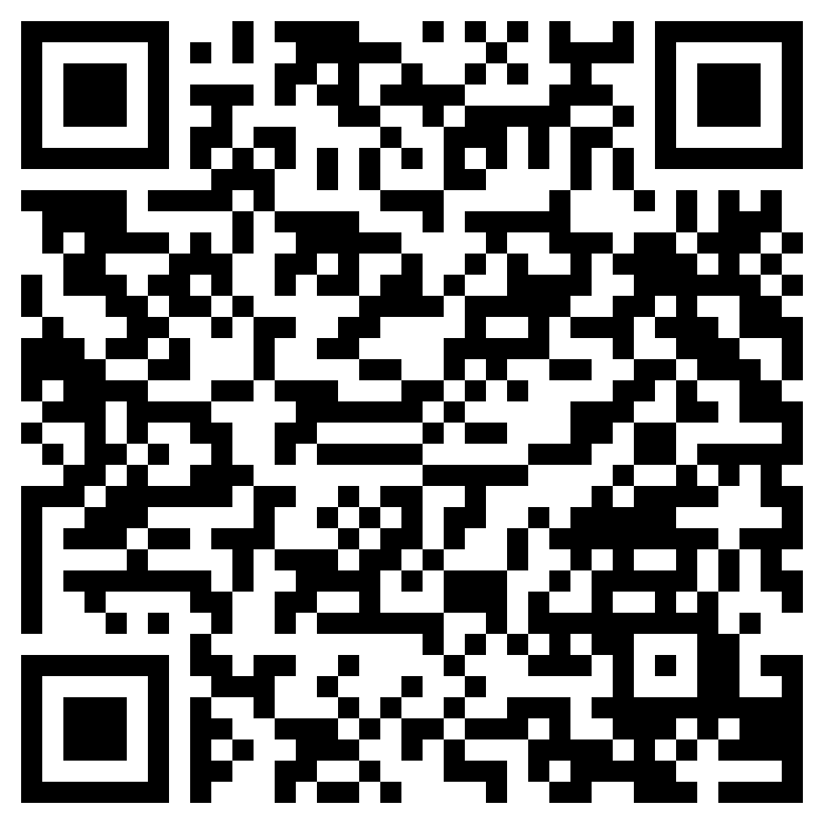
Employee vs. Contractor: What’s the Difference?
Use in conjunction with the animated video found in the Calculating Different Types of Pay self-paced module.
Use this link or the QR code to the right to watch the video from this module. As you watch, categorize information as being a plus, minus, or interesting.
Plus Information that seems to be a plus, or positive, to you. | Minus Information that seems to be a minus, or negative, to you. | Interesting Information that is neither a plus nor a minus, but is interesting to you.

Slide 14
Use in conjunction with the Calculating Different Types of Pay self-paced module.
List three jobs that you might consider doing in the future. Would you be more likely to be an employee or independent contractor, or could it be your choice? Classify each job and explain your reasoning.
Job | Employee, Contractor, or My Choice | Reason for Selection
If given the option to work as an employee or contractor, which would you choose and why?

Slide 15
Use this page to reflect on what you have learned in Topic 2: Calculating Different Types of Pay.
In this module, you learned about different ways that people are paid for the work that they do. What information from this module will you be able to apply as you look ahead to the future? How might this benefit you?
End-of-Module Self-Evaluation
Consider the learning goals for this module. How do you feel about each goal after completing this topic? | Strongly Agree | Somewhat Agree | Somewhat Disagree | Strongly Disagree
I can describe ways people can be paid for their work, including a salary, hourly wage, commission, and tips.
I am able to list similarities and differences between being an employee and an independent contractor.
I can give examples of factors to consider when exploring how I will be paid in the future.

Slide 16
Comparing Job Offers
After completing the module for this topic, you should be able to:
Compare income and non-income factors that may influence your job decisions.
Explain how benefits such as retirement and health insurance can be factors in weighing job offers.
Evaluate job offers for potential benefits and tradeoffs.

Slide 17
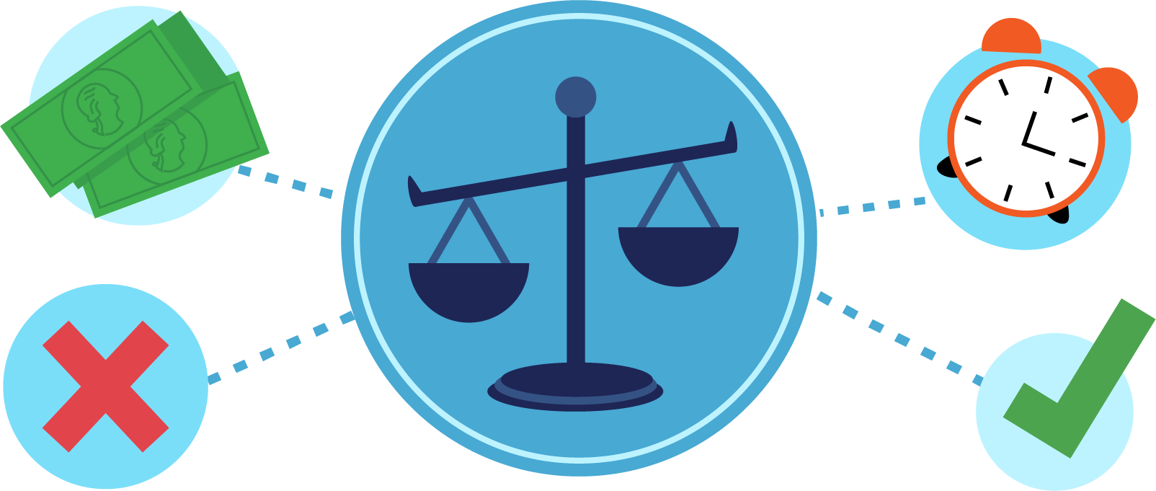
Use in conjunction with the Comparing Job Offers self-paced module.
There are many factors to consider when choosing a job. Sometimes you can’t get everything you want in a single position or employer. Consider each of the scenarios below. Select a maximum of three scenarios to put in each category: high, medium, and low priority.
Scenario | High Priority (maximum of three) | Medium Priority (maximum of three) | Low Priority (maximum of three)
Work anytime, from any location
High pay with excellent benefits
Travel the world and experience new cultures
Work from home three days a week
Earn more money by meeting specific goals
Get more time off for vacations
Have more opportunities for advancement
Work for a large corporation
Work four 10-hour days and get every Friday off

Slide 18
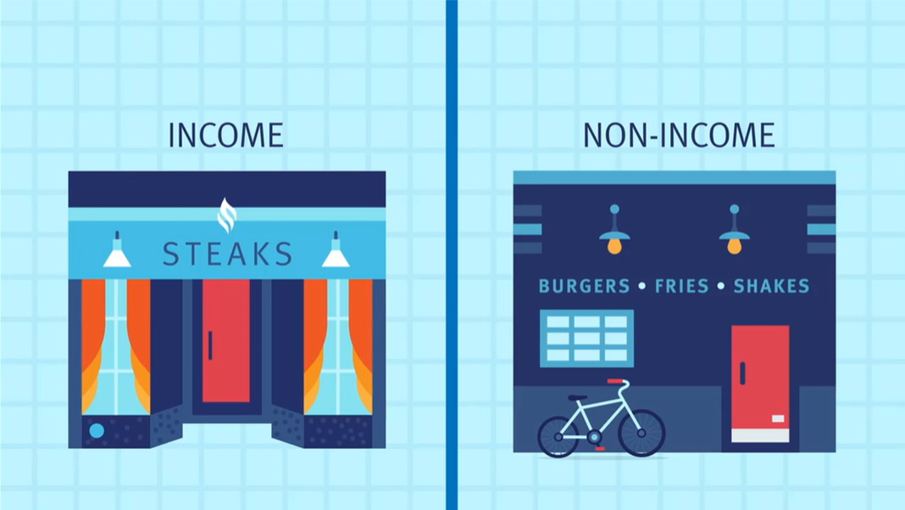
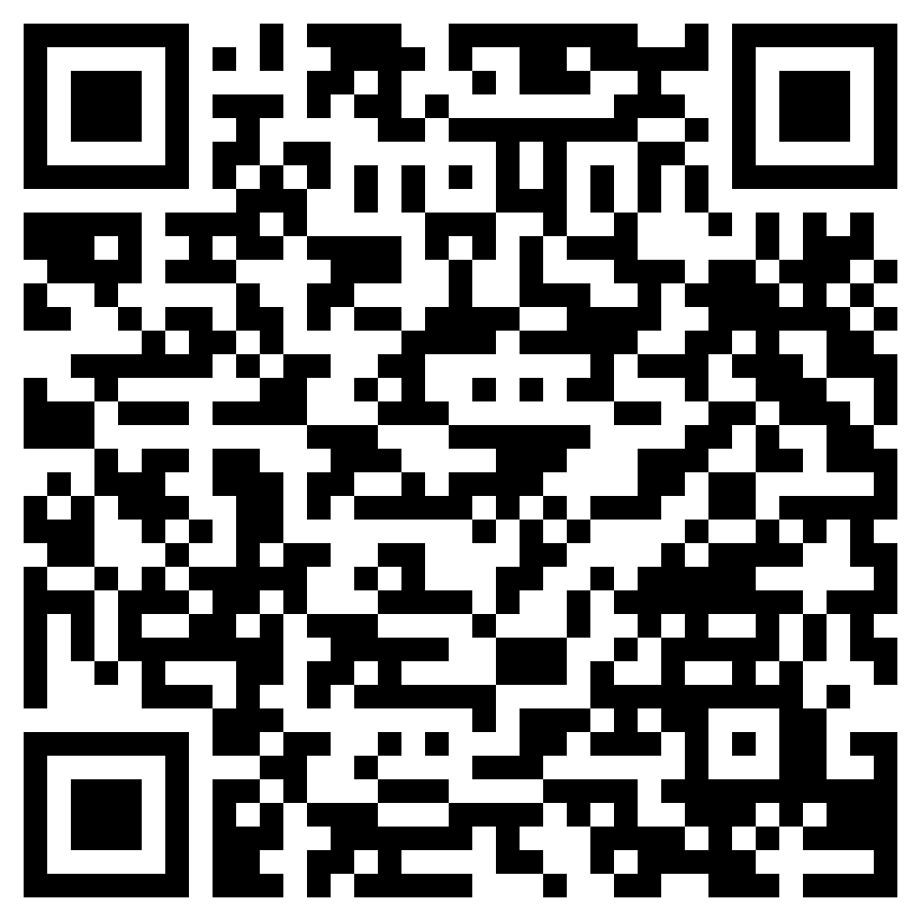
Job Selection Factors
Use in conjunction with the animated video found in the Comparing Job Offers self-paced module.
Focus on what you see, not hear, in the animation from this module. Watch the video with the sound OFF. Pause to take notes and then write a short summary. Watch the video a second time with the sound ON. Take notes as you go. Reflect on how your second set of notes compare to the first and how accurate your initial summary was (or wasn’t).
Viewing | Notes | Summary
#1 Sound Off
#2 Sound On

Slide 19
Use in conjunction with the Comparing Job Offers self-paced module.
List at least four examples of income-based and non-income-based factors to consider when comparing jobs.
Income-Based | Non-Income-Based
Use the space below to take notes about each type of insurance that might be offered by an employer.
Insurance Type | Notes
Health
Dental
Vision
Life
Disability

Slide 20
Use in conjunction with the Comparing Job Offers self-paced module.
Create a list of ten questions you could ask a potential employer before accepting a job offer based on the information you learned in the module.
Number | Question
1
2
3
4
5
6
7
8
9
10

Slide 21
Use this page to reflect on what you have learned in Topic 3: Comparing Job Offers.
Imagine you have several jobs to choose from and are going to make a list to compare them. What factors would you compare and why? Describe at least four.
End-of-Module Self-Evaluation
Consider the learning objectives for this module. How do you feel about each objective after completing it? | Strongly Agree | Somewhat Agree | Somewhat Disagree | Strongly Disagree
I can compare income-based and non-income-based factors that may influence my job decisions.
I am able to explain how benefits such as retirement and health insurance can be factors in weighing job offers.
I can evaluate job offers for potential benefits and tradeoffs.

Slide 22
Paying Taxes
After completing the module for this topic, you should be able to:
Identify public goods and services that are provided as a result of people paying taxes.
Give examples of different types of taxes.
Explain typical paycheck deductions.

Slide 23
Use in conjunction with the Paying Taxes self-paced module.
When and where did you first learn about taxes?
At the beginning of the module, you’re asked if you agree, disagree, or are neutral about each of the statements below. Select one of them. Share your response and explain your thoughts.
Everyone should help pay for new schools to be built—whether they have kids or not. People should pay taxes on things they use like gas and food. The government uses taxes to provide valuable services. People who make more money should pay more in taxes. Workers should save for retirement on their own without help from the government.

Slide 24
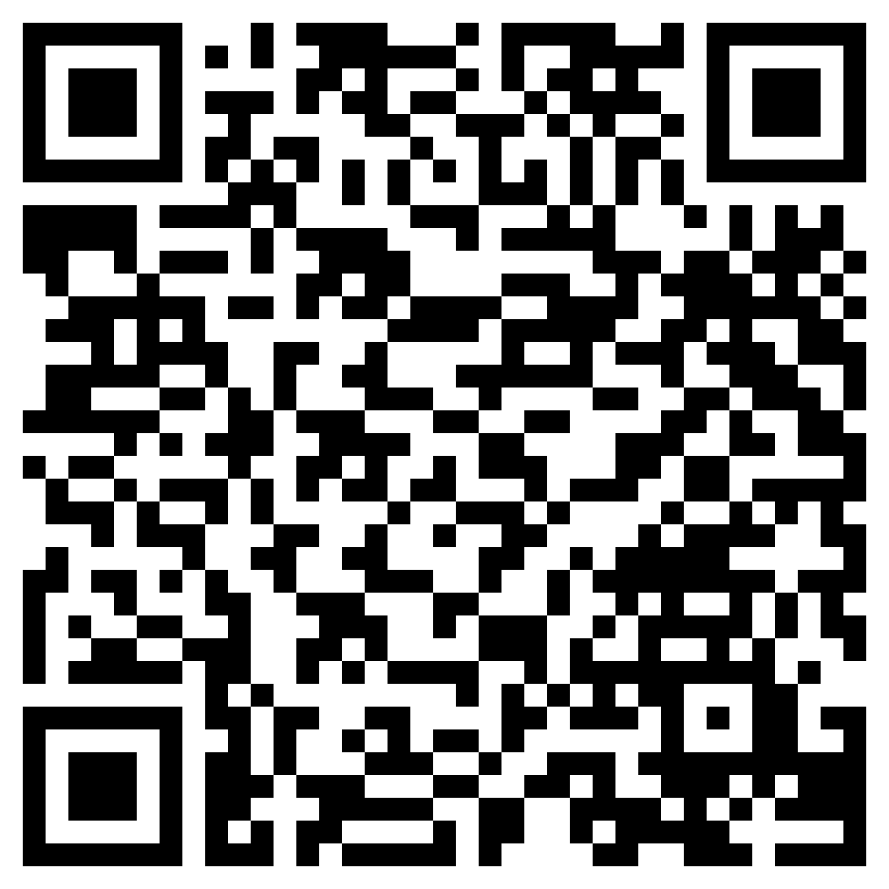
Public Goods and Services
Use in conjunction with the animated video found in the Paying Taxes self-paced module.
What did you think about the reasons people pay taxes before this module?
Use this link or the QR code to the right to replay the video from this module.
How did the video change your thinking about paying taxes? Use this sentence frame to explain your new thinking: I used to think _________, but now I think __________.
Which details from the video support that thinking?

Slide 25
Use in conjunction with the Paying Taxes self-paced module.
Take notes about each type of taxes. Include examples of how each one is used.
Income Taxes | Payroll Taxes
Consumption Taxes | Property Taxes

Slide 26
Use in conjunction with the Paying Taxes self-paced module
Describe each of the following terms and what it stands for, if applicable.
Term | Description
Gross Pay
FICA
Federal Income Tax
YTD
Time Off Balances
Account Number
Deductions
Net Pay
There are strategies people can use to minimize how much they pay in taxes. Select one and describe it.

Slide 27
Use this page to reflect on what you have learned in Topic 4: Paying Taxes.
Share three key takeaways from this module about paying taxes.
End-of-Module Self-Evaluation
Consider the learning goals for this module. How do you feel about each goal after completing this topic? | Strongly Agree | Somewhat Agree | Somewhat Disagree | Strongly Disagree
I can identify public goods and services that are provided as a result of people paying taxes.
I can give examples of different types of taxes.
I am able to explain typical paycheck deductions.

Slide 28
Creating Your Own Job
After completing the module for this topic, you should be able to:
Describe ways people can be paid for their work, including a salary, hourly wage, commission, and tips.
List similarities and differences between being an employee and an independent contractor.
Give examples of factors you can consider when exploring how you will be paid in the future.

Slide 29
Use in conjunction with the Creating Your Own Job self-paced module.
Have you ever considered becoming an entrepreneur? Why or why not?
Name three local businesses. What goods or services does each provide? What interests or talents do you think the entrepreneur who started each might have?
Business Name
Goods or Services Provided
Entrepreneur’s Interests or Talents
What business(es) do you think could be successful where you live? Why?

Slide 30
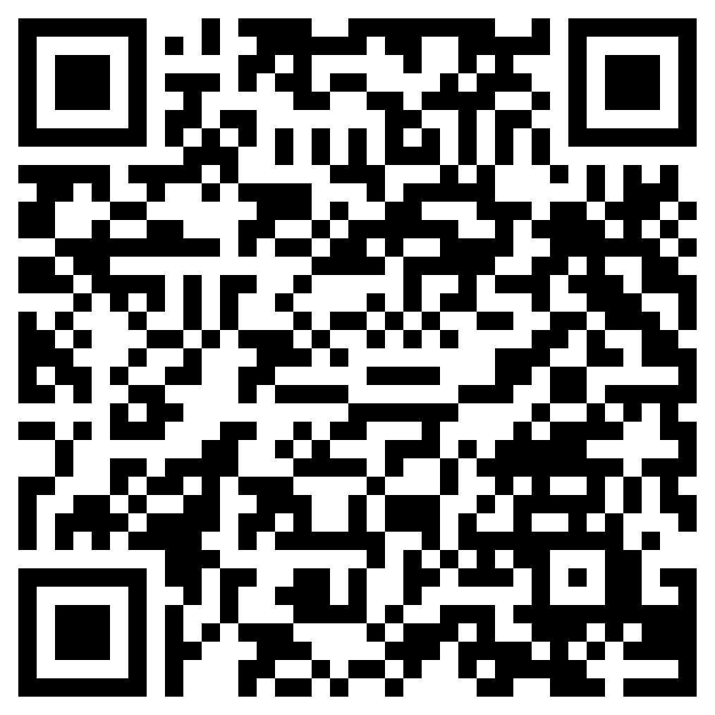
How Entrepreneurs Make Money
Use in conjunction with the animated video found in the Creating Your Own Job self-paced module.
Use this link or the QR code to the right to play the video from the module. Pause as needed to complete the graphic organizer below.
Write three interesting facts about the topic.
Share two reasons the information in the video is important.
Write a one-sentence summary of what you learned.

Slide 31
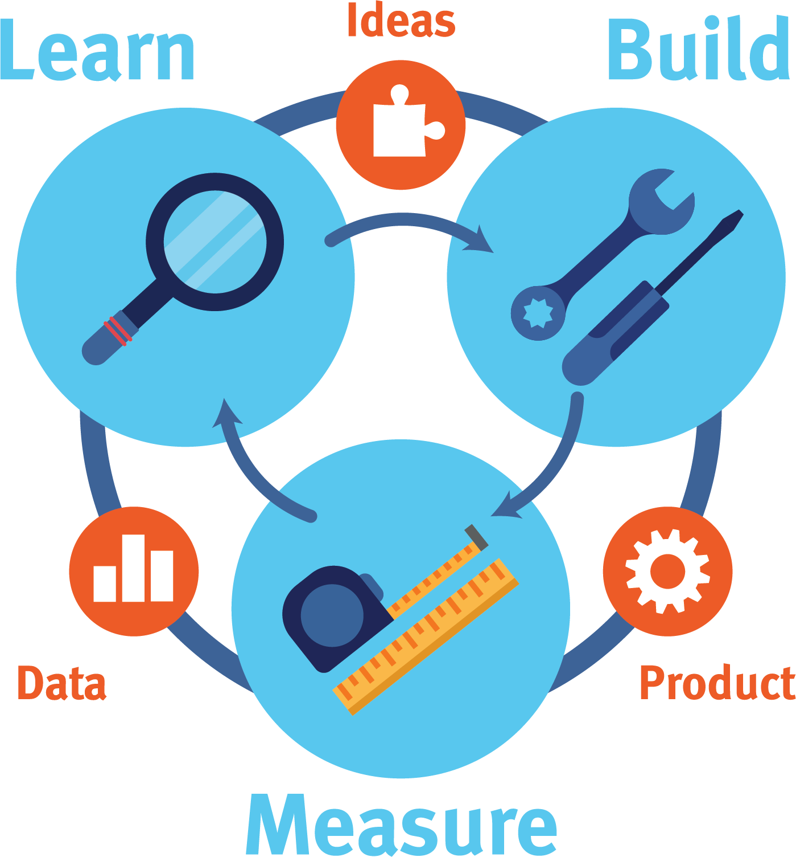
Use in conjunction with the Creating Your Own Job self-paced module.
Describe each step in the lean startup method.
Step | Description
Learn
Build
Measure
Describe how an entrepreneur could apply the lean startup method to a specific type of business.

Slide 32
Use this page to reflect on what you have learned in Topic 5: Creating Your Own Job.
Think about what you learned in this module. Is entrepreneurship something you might consider in the future? Why or why not? Be sure to mention at least one of the benefits or tradeoffs of entrepreneurship that are mentioned in the module.
End-of-Module Self-Evaluation
Consider the learning goals for this module. How do you feel about each goal after completing it? | Strongly Agree | Somewhat Agree | Somewhat Disagree | Strongly Disagree
I can describe ways people can be paid for their work, including a salary, hourly wage, commission, and tips.
I am able to list similarities and differences between being an employee and an independent contractor.
I can give examples of factors you can consider when exploring how you will be paid in the future.

Slide 33
Getting Paid
Wrap Up

Slide 34
Unit 4: Glossary of Key Terms
Term | Definition | My Notes
Benefits | Services (such as health insurance) or rights (like vacation time) that are provided to employees in addition to the money they earn
Commission | Money paid to someone for a sale—usually a percentage of the amount sold
Digital Footprint | Information about a particular person that exists on the internet as a result of their online activity
Employee | Someone who works for a business and receives their pay on a regular basis with taxes withheld by the company
Entrepreneur | A person who starts and operates a business, usually taking on risks in order to do so
Gross Pay | The amount a person earns before taking out deductions or taxes
Income | Money received, especially on a regular basis, for work or through investments
Independent Contractor | A person hired to do work who controls how the work is done

Slide 35
Unit 4: Glossary of Key Terms (continued)
Term | Definition | My Notes
Insurance | A benefit provided by some employers which can reduce an employee’s costs for services such as healthcare or provide money in the case of an injury or inability to work
Net Pay | The amount a person earns after taking out deductions or taxes
Networking | The exchange of information or services among individuals, groups, or institutions
Piecework | Work in which you are paid for each thing you make or do
Portfolio | A collection of a person’s work that can be shared with a potential employer or client
Resume | A document prepared by job seekers to showcase their education, experience, skills, and achievements
Salary | An amount of money that an employee is paid per year—usually divided into equal amounts and paid weekly or every two weeks

Slide 36
Unit 4: Glossary of Key Terms (continued)
Term | Definition | My Notes
Taxes | Money collected by the government to pay for public goods and services
Tips | Extra money earned for exceptional service
Wage | Money paid for a set amount of time that work is performed (usually hourly)

Slide 37
Unit 4: Personal Action Plan
Consider each of the topics addressed in this unit. Which actions will you take to use financial services? | Already Doing | Need to Do | Not in My Plans
I will create a resume showcasing my education, experience, and skills.
I will investigate a career that interests me and found out how people in those jobs are paid.
I will develop a list of criteria to consider when comparing potential jobs.
When I receive a pay statement, I will compare my gross and net pay.
I will think about ways I can become an entrepreneur.
My notes and next steps:

Slide 38
Unit 4: Continuing the Conversation at Home
Families often approach conversations about money very differently. Some might welcome them, while others avoid the topic as much as possible. Review the conversation starters below. With whom could you have each conversation? How might you approach the conversations?
Conversation Starters | My Notes
Resumes When did you write your first resume? What did it include? Have you ever had to hire someone? If so, did you review people’s resumes? What did you look for? What skills, experiences, activities, or accomplishments do you think I should include in my resume?
Types of Pay Are you paid a salary or an hourly wage? Do you receive other forms of pay, like a commission or tips? What do you think are the pros and cons of different ways to be paid? Would you want to be paid a commission for the work you do or have a bonus tied to how well you do your job? Why?
Job Considerations What do you think are the most important factors to consider when choosing a job? How important is employer-provided insurance when thinking about a job or career?
Taxes What different types of taxes do we pay as a household? How do we benefit from paying those? Do you consider taxes to be high or low based on where we live?
Entrepreneurship Have you ever considered starting your own business? Can you see me as an entrepreneur? If so, what kind of business could you see me starting?

Slide 39
Unit 4: Dig Deeper
Interested in learning more about the topics covered in this unit? Consider exploring one or more of the following questions.
Dig into the Topics | My Notes
Resumes What types of resume templates are available? How are resumes used by teenagers who are considering education beyond high school?
Types of Pay Why do people in management positions often earn a salary? How do people in the jobs I might consider get paid? Which taxes are paid differently for employees and independent contractors? What is a typical percentage or amount of commission for those who earn them?
Job Considerations What employers require people to work onsite? What is the difference between sick leave and vacation time? How does this compare to companies that combine the two under a single category, such as paid time off (PTO)? What laws impact the benefits a person can expect to receive at a particular job?
Taxes Is there a state income tax where I live? If so, how is it calculated? What is the sales tax in my state? Does it vary depending on what is purchased? Do people where I live pay property tax on anything other than real estate, such as vehicles?
Entrepreneurship What assistance is available near me to help people who are interested in starting their own business?

