Slide 1
Paying Yourself First
Unit 5
Unit 5: Getting Started
Topic 1: Deciding to Save Money What are good money habits and how can you build them?
Topic 2: Setting Savings Goals Goals are good, but what if you have more than one? How do you balance and prioritize them?
Topic 3: Finding Money to Save How do you find money to save?
Topic 4: Growing Savings Through Interest Why is it so important to save money early?
Topic 5: Choosing a Savings Method How do you keep your savings safe? What savings methods earn more interest?
Wrap Up Glossary of Key Terms Personal Action Plan Continuing the Conversation at Home Dig Deeper

Slide 2
Unit 5: Getting Started
This unit explores a wide variety of personal finance topics within the theme of Paying Yourself First. Going into this unit, how much do you already know about each topic?
 | Not Much | Some | A Lot
Topic 1: Deciding to Save Money What are good money habits and how can you build them? Find out why you should save at least some of the money you receive or earn.
Topic 2: Setting Savings Goals Goals are good, but what if you have more than one? How do you balance and prioritize them? Explore different ways you can think about savings goals, including various categories in which they might fall, how long they will take to achieve, and how to balance multiple savings goals.
Topic 3: Finding Money to Save How do you find money to save? Learn about the importance of saving and strategies to help you save more.
Topic 4: Growing Savings Through Interest Why is it so important to save money early? Examine how savings can grow through the power of compound interest.
Topic 5: Choosing a Savings Method How do you keep your savings safe? What savings methods earn more interest? Consider various savings methods, including savings accounts, certificates of deposit, and money market accounts.

Slide 3
Deciding to Save Money
After completing the module for this topic, you should be able to:
Identify the opportunity cost of a choice or decision you have made.
Cite common reasons people put off saving for retirement and the potential consequences of waiting to save.
Explain the impact inflation can have on your savings.

Slide 4
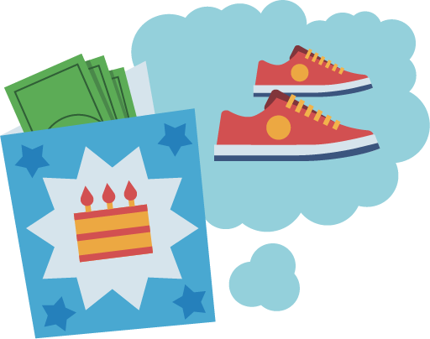
Use in conjunction with the Deciding to Save Money self-paced module.
Describe a decision you have made about money and later regretted. What was the decision about? What made you regret it later? What might have been the outcome if you’d made a different decision?
Complete the table with information about opportunity costs.
Define the term | Give an example | How does it apply to savings?
Why might picturing yourself at a future age help you save?
Optional: Use an app or filter to age yourself. Insert the image here.

Slide 5
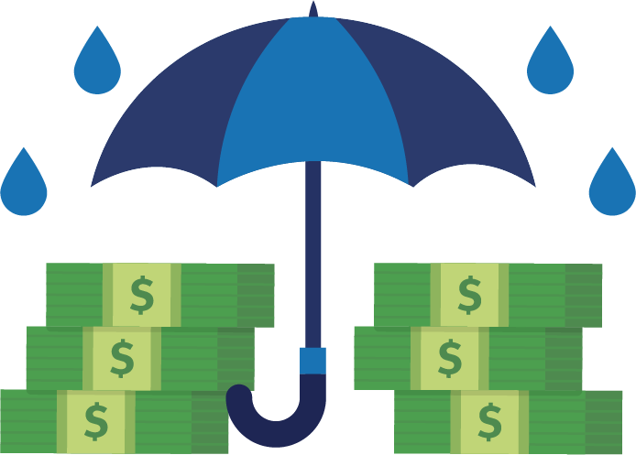
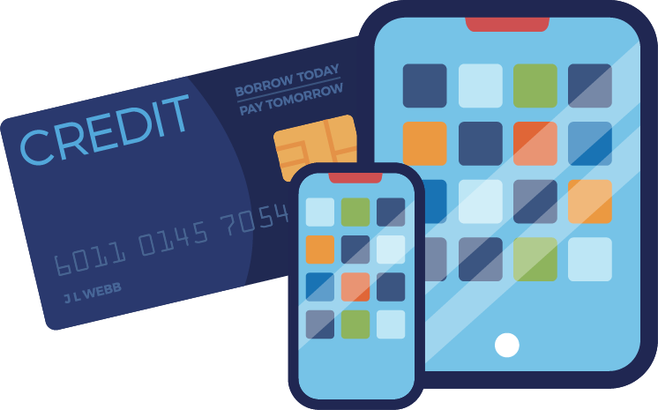
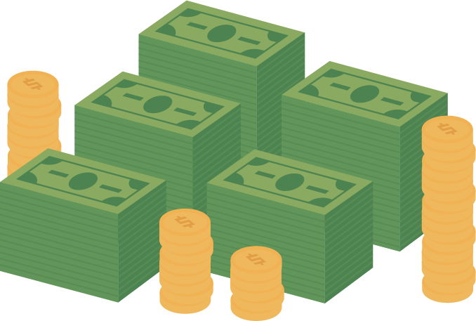
Use in conjunction with the Deciding to Save Money self-paced module.
Name three strategies for reminding yourself of a savings goal.
What is the effect of each action? What effects can you think of that aren’t mentioned in the module?
Cause | Effect
Not putting money in an emergency fund
Buying a large item on credit
Waiting to save for retirement
Wishing you’d saved more

Slide 6
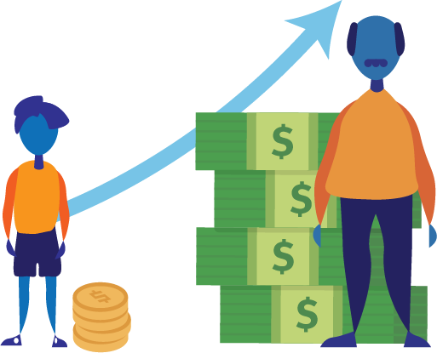
Use in conjunction with the Deciding to Save Money self-paced module.
Describe five ways your thoughts on saving for retirement might change over time?
List four advantages of starting to save at an early age.

Slide 7
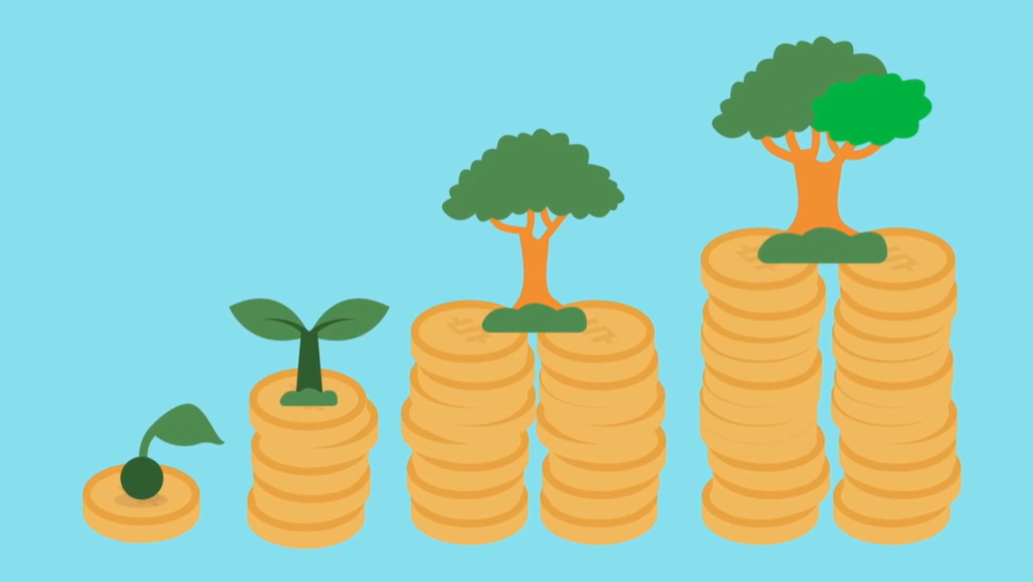
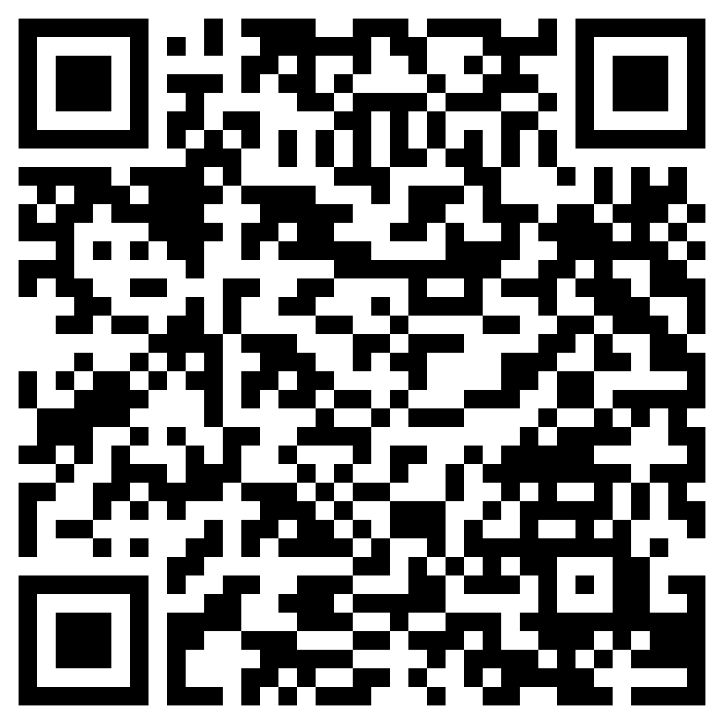
Growing Your Money
Use in conjunction with the animated video found in the Deciding to Save Money self-paced module.
Use this link or the QR code to the right to play the video from the module. Pause as needed to complete the graphic organizer below.
Write three interesting facts about the topic.
Share two reasons the information in the video is important.
Write a one-sentence summary of what you learned.

Slide 8
Use this page to reflect on what you have learned in Topic 1: Preparing for Work.
What are your personal thoughts on saving money? Do you already put money aside for the future? Is that hard to do? Explain where you stand now when it comes to saving and whether this is something you want to change.
End-of-Module Self-Evaluation
Consider the learning objectives for this module. How do you feel about each one after completing it? | Strongly Agree | Somewhat Agree | Somewhat Disagree | Strongly Disagree
I can identify the opportunity cost of a choice or decision I have made.
I can cite common reasons people put off saving for retirement and the potential consequences of waiting to save.
I am able to explain the impact inflation can have on my savings.

Slide 9
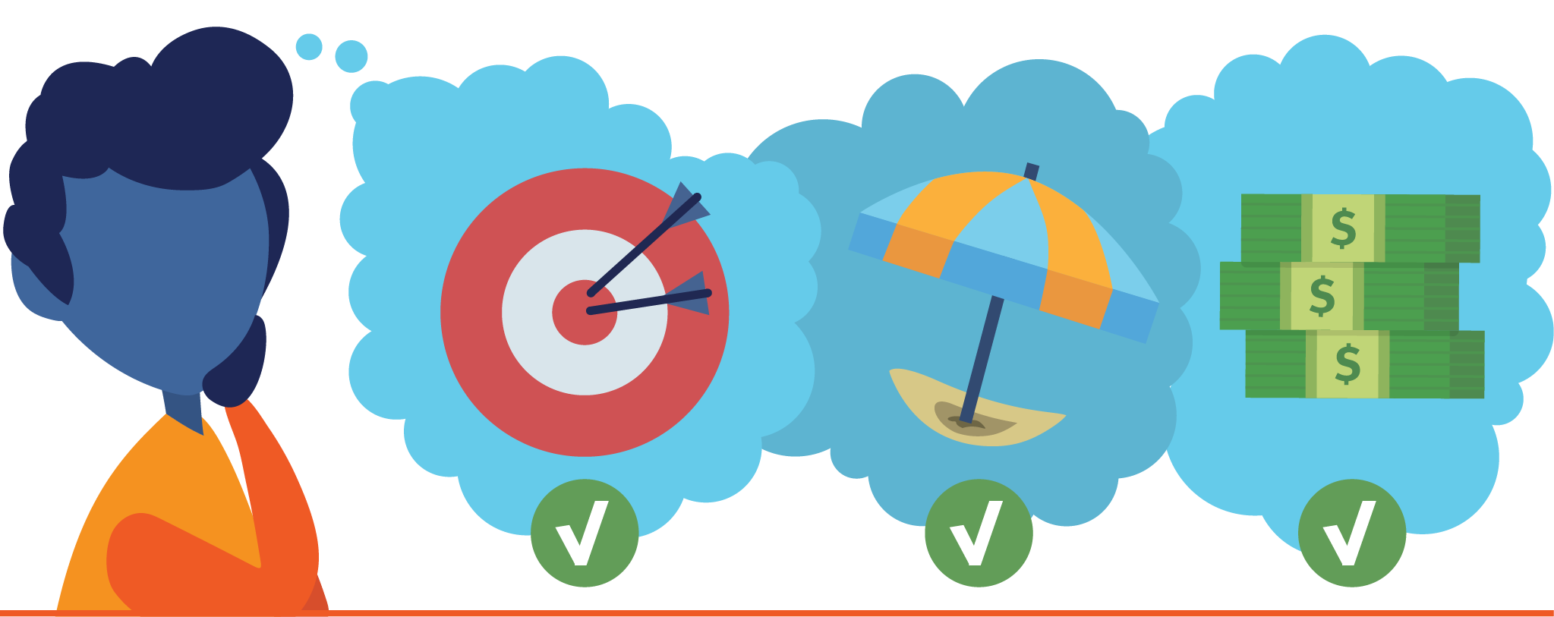
Future Spending
Use in conjunction with the Spend Now or Spend Later? classroom activity.
What will your life look like 5, 25, and 50 years from now? Complete the table with information for each timeframe.
 | 5 Years | 25 Years | 50 Years
How old will you be?
Where will you live?
How will you earn money?
What will you do with your time?
How will you spend your money?

Slide 10
Setting Savings Goals
After completing the module for this topic, you should be able to:
Give examples of savings goals you might set for yourself.
Describe how setting short-term goals might help you reach a longer-term goal.
Evaluate your savings goals and consider strategies to reach them.

Slide 11
Use in conjunction with the Setting Savings Goals self-paced module.
What are some financial goals you have for yourself? List at least one current goal and two future goals.
Current
Future
Future
Fill in the graphic organizer below with information about savings goals.
Definition | Example
Reasons to Set Them | Types You Can have
All About Savings Goals

Slide 12
Use in conjunction with the Setting Savings Goals self-paced module.
List five categories of savings goals and examples of each.
Category | Example

Slide 13
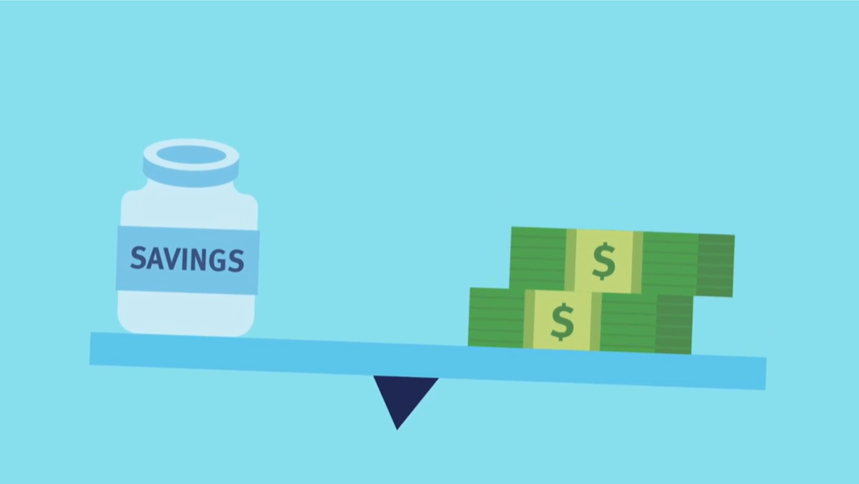
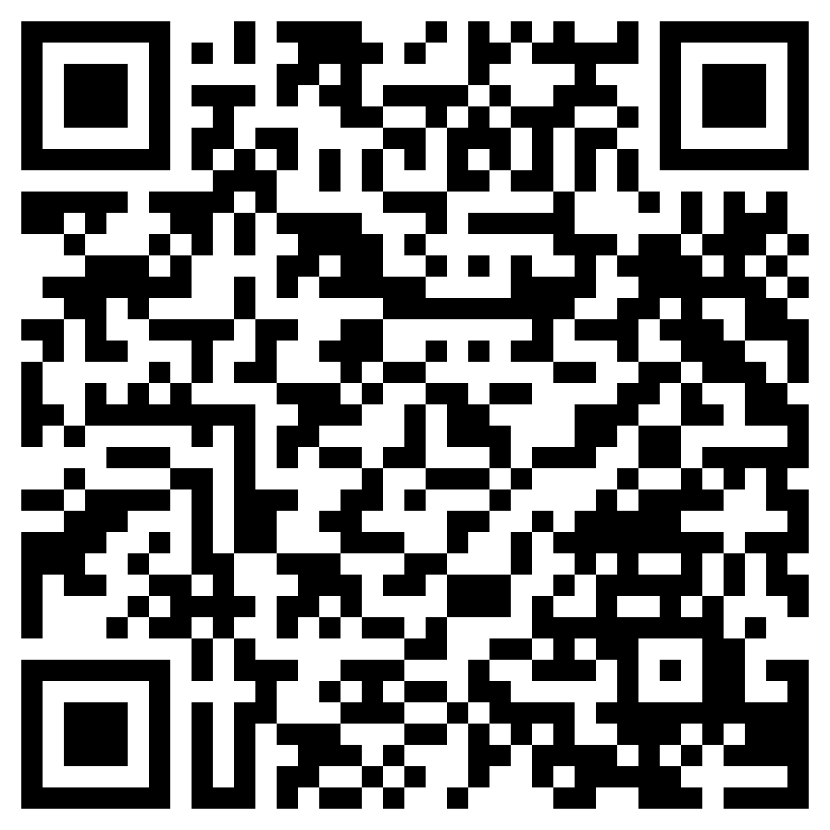
Balancing Savings Goals
Use in conjunction with the animated video found in the Setting Savings Goals self-paced module.
Your first thought when you see the letters AEIOU might be about vowels versus consonants, but in this case it is an abbreviation for an Adjective, Emotion, interesting, Oh, and Um.
Use this link or the QR code to the right to replay the video from this module. As you watch it, think of answers to the questions corresponding to each vowel in the abbreviation.
A—Adjective What words describe what you saw?
E—Emotion How does it make you feel?
I—Interesting Info What do you find interesting?
O—Oh! Did something surprise you?
U—Um? What questions do you have?

Slide 14
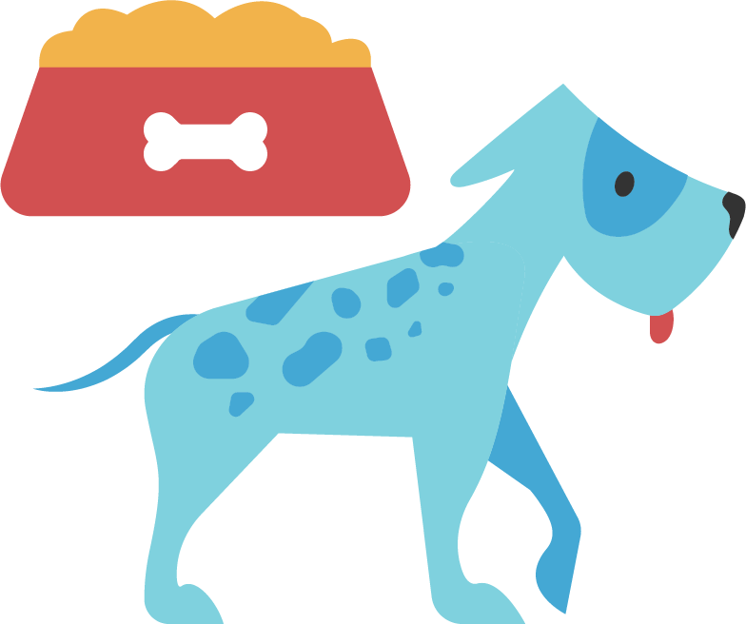
Use in conjunction with the Setting Savings Goals self-paced module.
How does each of the following relate to setting and/or reaching savings goals?
Budgeting
Automation
SMART Goals
Your Why

Slide 15
Use this page to reflect on what you have learned in Topic 2: Setting Savings Goals.
Did this module make you think differently about setting savings goals? Why or why not?
End-of-Module Self-Evaluation
Consider the learning goals for this module. How do you feel about each goal after completing it? | Strongly Agree | Somewhat Agree | Somewhat Disagree | Strongly Disagree
I can give examples of savings goals I might set for myself.
I can describe how setting short-term goals might help me reach a longer-term goal.
I am able to evaluate my savings goals and consider strategies to reach them.

Slide 16
Finding Money to Save
After completing the module for this topic, you should be able to:
Explain reasons people save money.
Identify a personal savings goal and develop a plan to achieve it.
Give examples of ways people can find money to save.

Slide 17
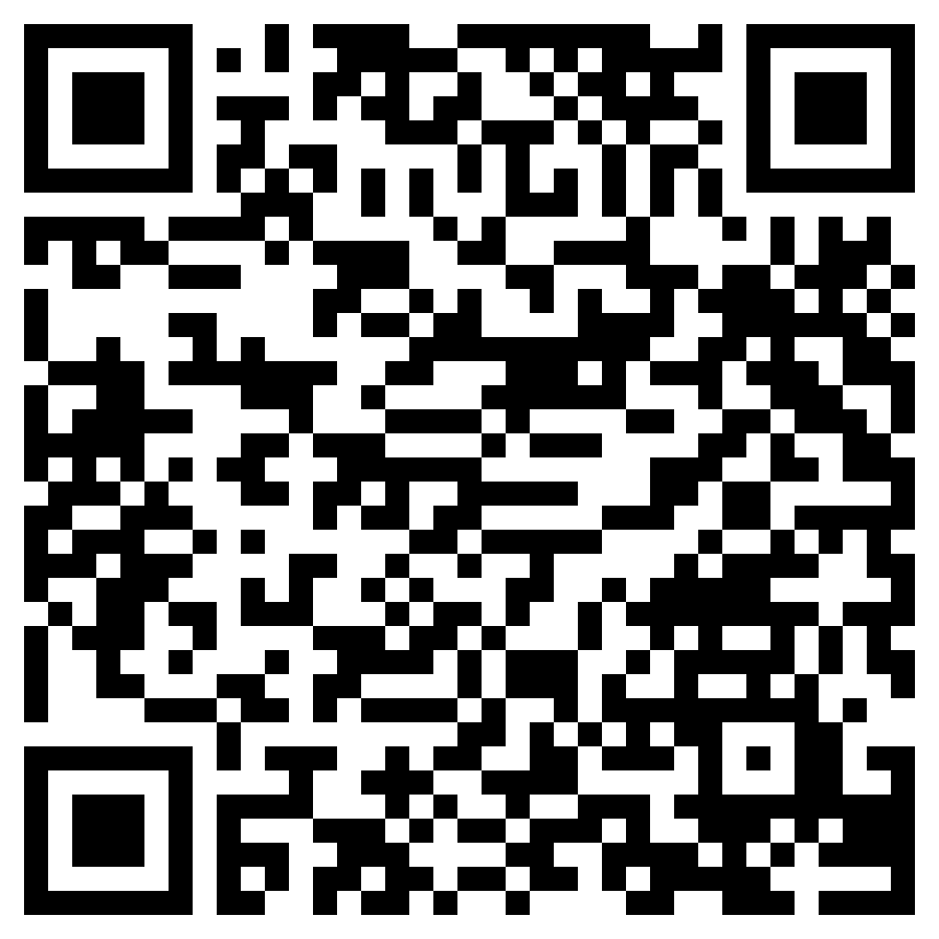
Reasons People Save
Use in conjunction with the animated video found in the Finding Money to Save self-paced module.
Use this link or the QR code to the right to replay the video from this module then consider the “would you rather” question below.
Would You Rather?
Save for an emergency fund | OR | Save towards the purchase of a specific item
Share your choice and explain your decision.

Slide 18
Use in conjunction with the Finding Money to Save self-paced module.
What are some of your own short- and long-term savings goals?
Short-Term Goals | Long-Term Goals
List the steps to creating a savings plan.
Step 1
Step 2
Step 3
Step 4
Step 5

Slide 19
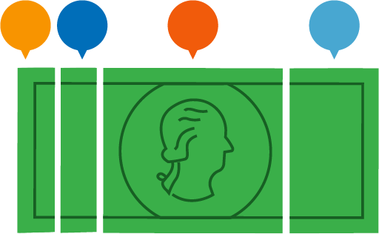
Use in conjunction with the Finding Money to Save self-paced module.
Describe these four strategies for finding money to save.
Separate Your Money | Make Savings Automatic | Pay Yourself First | Earn Extra Income
How much do experts recommend saving for each?
Insurance Type | Notes
Retirement
Emergency Savings
By Age 30

Slide 20
Use this page to reflect on what you have learned in Topic 3: Finding Money to Save.
Describe your thoughts on saving for each of the following purposes. Do you think it is important? When might you start saving for each?
Emergency Savings
The Purchase of a Specific Item
Retirement
End-of-Module Self-Evaluation
Consider the learning objectives for this module. How do you feel about each objective after completing it? | Strongly Agree | Somewhat Agree | Somewhat Disagree | Strongly Disagree
I can explain the reasons why people save money.
I am able to identify a personal savings goal and develop a plan to achieve it.
I can give examples of ways people can find money to save.

Slide 21
Savings App Research
Use in conjunction with the Saving Made Easy classroom activity.
Research a savings app and answer each of the questions.
App Name:
How does the app work?
What services does the app provide?
Who could benefit from using this app?
Are there any fees to use the app (sign up and/or ongoing)? If so, what are they?
What do you need to do to use the app?
Is the service associated with a specific bank or credit union or can you use your own?
Does the app seem like it would be easy to use?
Are there any reviews of the app? If so, are they positive or negative?
Would you use this app? Why or why not?
What is one thing that could improve this app?

Slide 22
Growing Savings Through Interest
After completing the module for this topic, you should be able to:
Explain what interest is and how it benefits savers.
Cite reasons young people should consider saving money at an early age.
Identify the relationship between risk and rates of return.

Slide 23
Use in conjunction with the Growing Savings Through Interest self-paced module.
Where do you view yourself in 50 years?
At what age do you hope to retire? | What age do you think you need to start saving in order to do that?
What do you already know about compound interest (before this module)?

Slide 24
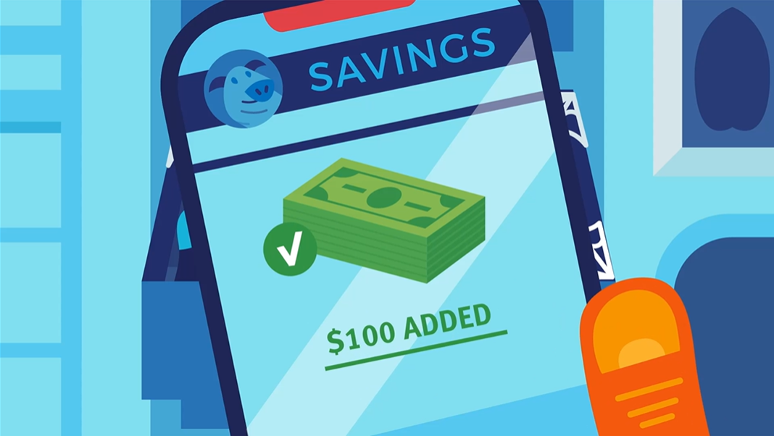
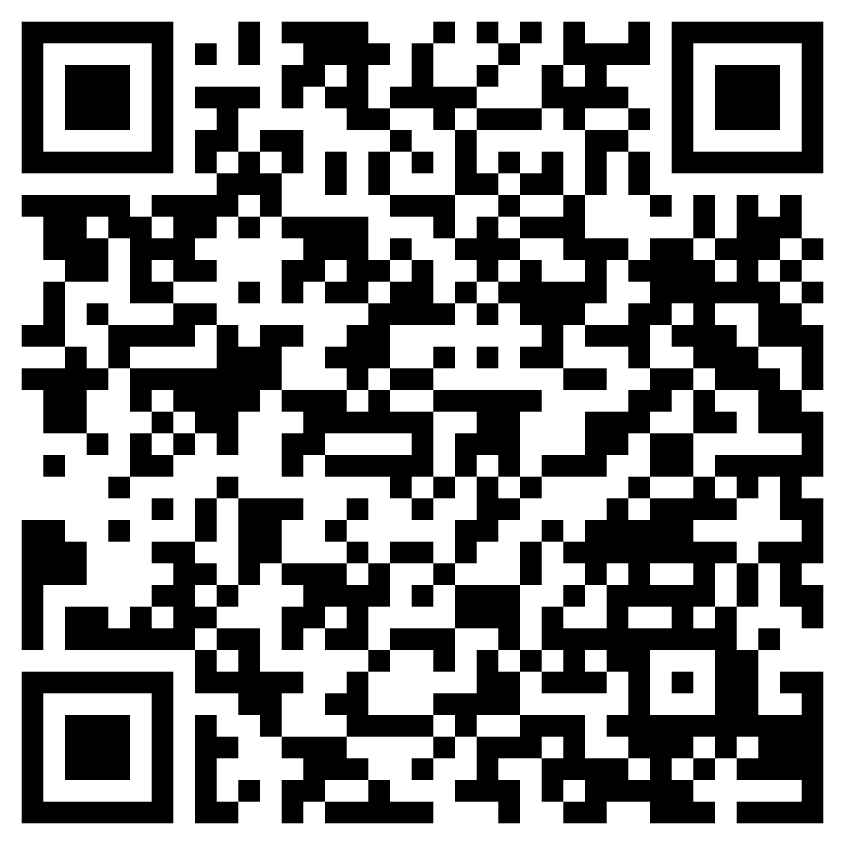
What is Compound Interest?
Use in conjunction with the animated video found in the Growing Savings Through Interest self-paced module.
Use this link or the QR code to the right to watch the video from this module and answer the questions below. You’ll end up watching it three times— looking for something different each time.
Watch the video. Identify key ideas and details from the video and write them below.
Watch the video a second time. Identify and define three key vocabulary terms.
Term | Definition
Watch the video a third and final time. How does the video connect to what you already knew about compound interest?

Slide 25
Use in conjunction with the Growing Savings Through Interest self-paced module.
Complete the table with information about Kim and Brad’s approaches to saving.
 | Kim | Brad
Age When Savings Began
Amount Saved Each Month
Amount Saved Each Year
Number of Years They Saved
Total Amount Saved
Interest Earned
Value of Savings at Age 65
Summarize the differences between how Kim and Brad saved and the results for each.

Slide 26
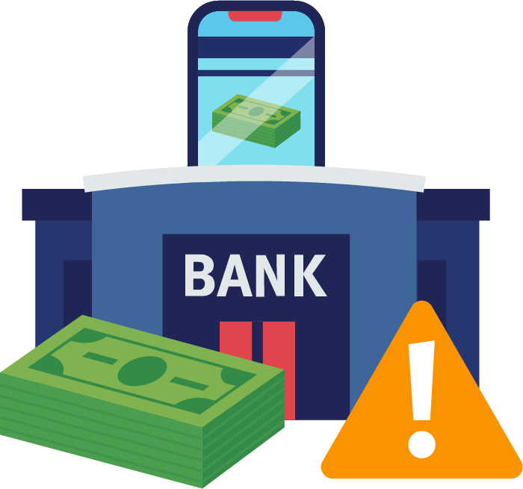
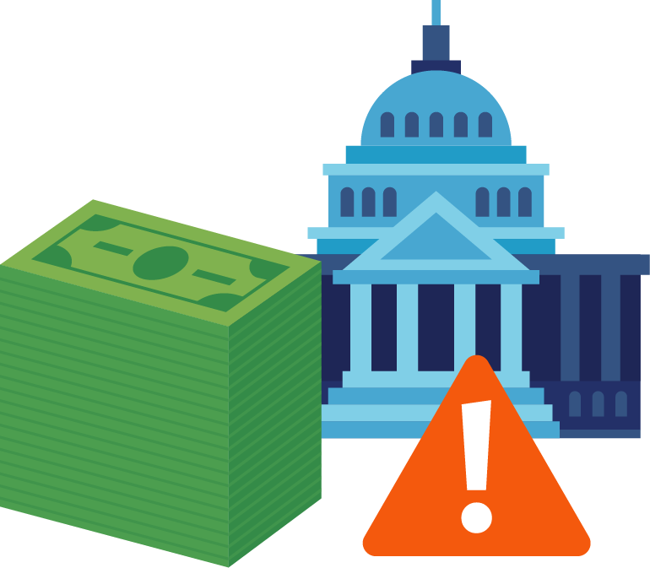
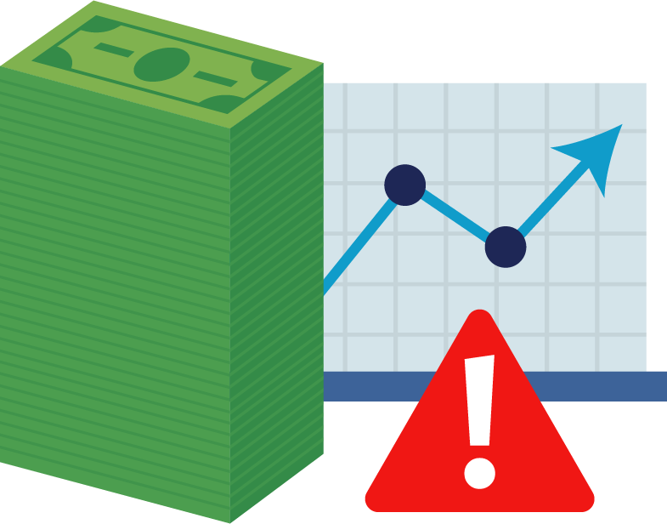
Use in conjunction with the Growing Savings Through Interest self-paced module.
If you set a retirement savings goal of $1 million at the age of 25, how much do you need to save to reach your goal based on each interest rate?
Amount | 4% | 6% | 8% | 10%
Per Day
Per Month
Per year
Describe the relationship between risk and rates of return.
How much risk is involved with saving or investing in each of these methods?
Savings Accounts
Government Bonds
Stocks

Slide 27
Use this page to reflect on what you have learned in Topic 4: Growing Savings Through Interest.
Would you rather take a small amount of risk and be likely to earn less on your savings or take more risk in the hope that your money will grow even more? Explain your rationale.
End-of-Module Self-Evaluation
Consider the learning objectives for this module. How do you feel about each goal after completing it? | Strongly Agree | Somewhat Agree | Somewhat Disagree | Strongly Disagree
I can explain what interest is and how it benefits savers.
I am able to cite reasons young people should consider saving money at an early age.
I can identify the relationship between risk and rates of return.

Slide 28
Choosing a Savings Method
After completing the module for this topic, you should be able to:
Explain the differences between various savings methods, including savings accounts, certificates of deposit, and money market accounts.
Identify ways government agencies help to protect savers.
List factors you should consider before choosing a savings method.

Slide 29
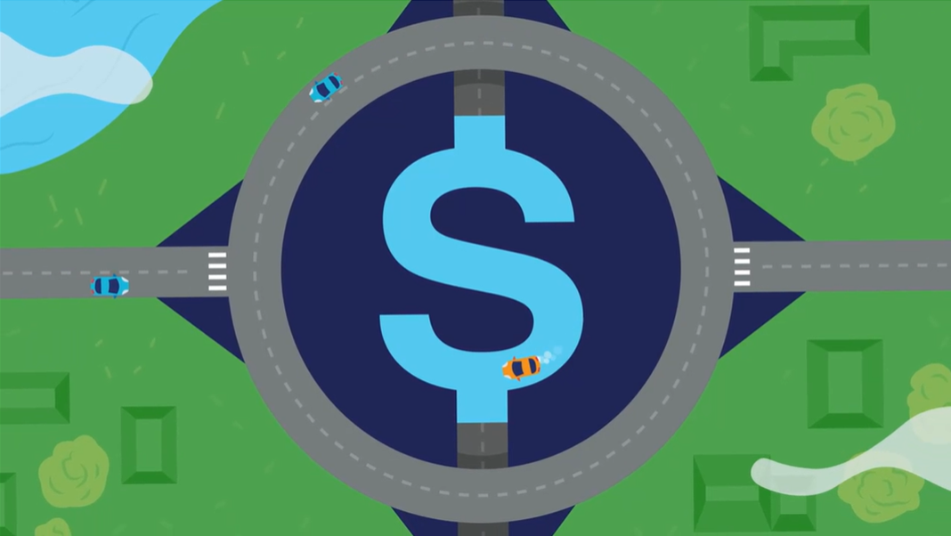
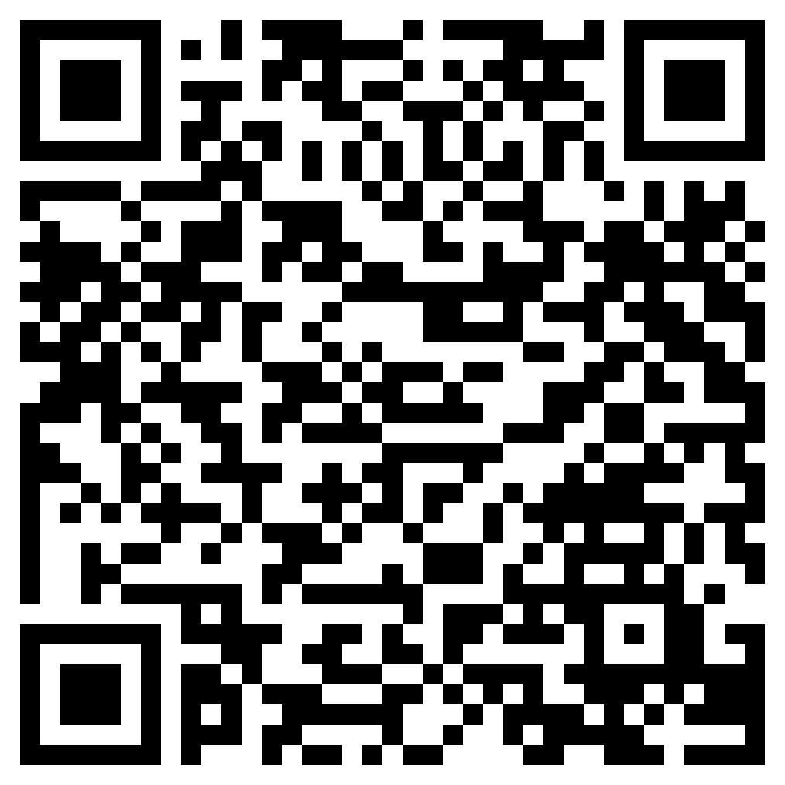
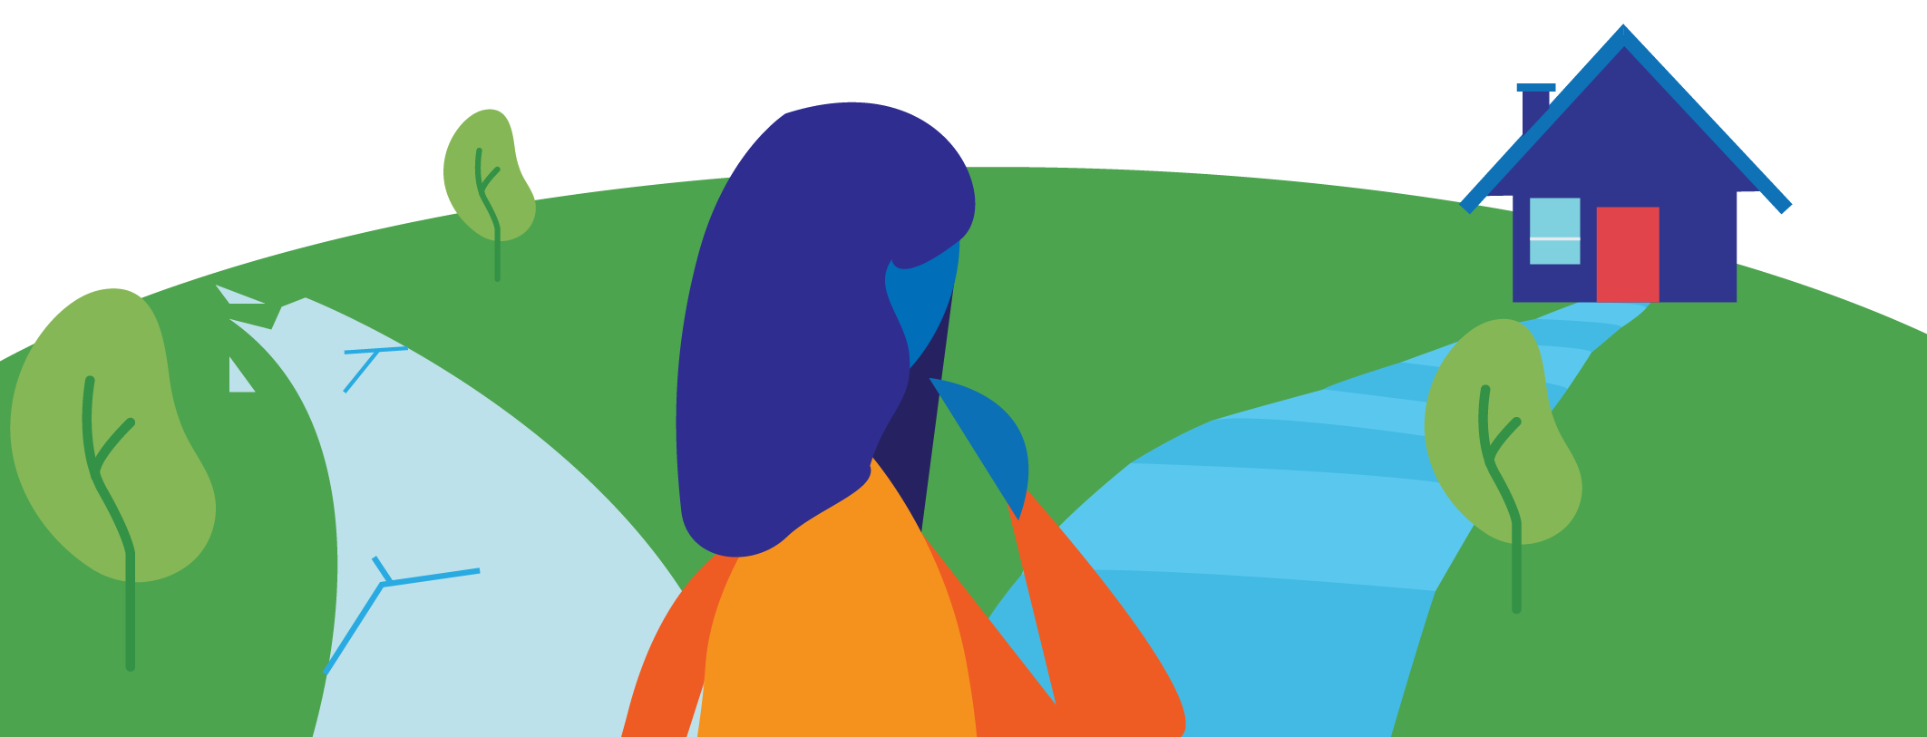
Thinking About Savings
Use in conjunction with the animated video found in the Choosing a Savings Method self-paced module.
Use this link or the QR code to the right to watch the video from this module. As you watch, categorize information as being a plus, minus, or interesting.
Plus Information that seems to be a plus, or positive, to you. | Minus Information that seems to be a minus, or negative, to you. | Interesting Information that is neither a plus nor a minus, but is interesting to you.

Slide 30
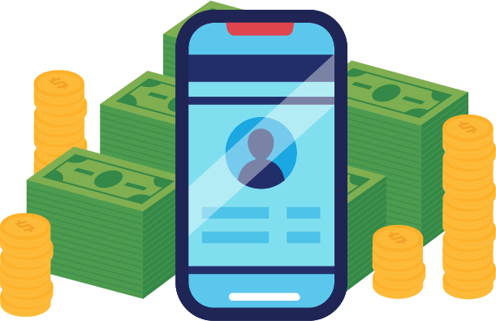
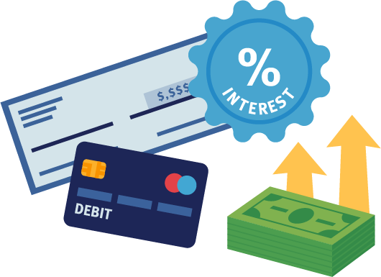
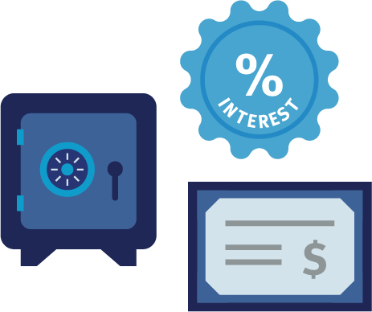
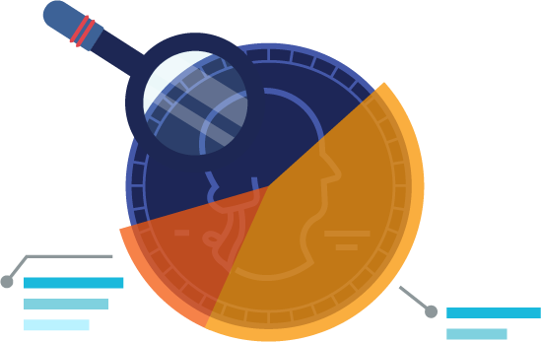
Use in conjunction with the Choosing a Savings Method self-paced module.
What does APY stand for and how is it used when comparing savings options?
What are some of the benefits and tradeoffs of each way to save?
 | Benefits | Tradeoffs
Savings Accounts
Money Market Accounts
Certificates of Deposit
Investments

Slide 31
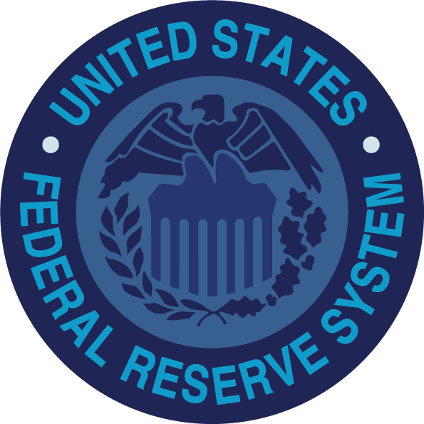
Use in conjunction with the Choosing a Savings Method self-paced module.
What role does each government entity play when it comes to saving or investing?
Congress and State Legislatures
FDIC and NCUA
Federal Reserve System
What should you know about each factor when selecting a savings method?
Interest Rates | Terms | Convenience
Why might you have more than one type of savings account or have accounts at more than one financial institution?

Slide 32
Use this page to reflect on what you have learned in Topic 5: Choosing a Savings Method.
Describe what you learned in this module about the types of accounts available to savers, the benefits and tradeoffs of each option, and what to consider when selecting accounts.
End-of-Module Self-Evaluation
Consider the learning goals for this module. How do you feel about each goal after completing this topic? | Strongly Agree | Somewhat Agree | Somewhat Disagree | Strongly Disagree
I can explain the differences between various savings methods, including savings accounts, certificates of deposit, and money market accounts.
I am able to identify ways government agencies help to protect savers.
I can list factors you should consider before choosing a savings method.

Slide 33
Paying Yourself First
Wrap Up

Slide 34
Unit 5: Glossary of Key Terms
Term | Definition | My Notes
Annual Percentage Yield | The effective annual rate of return taking into account the effect of compounding interest; also known as the APY
Bonds | A loan given to a corporation or government in exchange for an agreed-upon payment of interest
Certificate of Deposit | A certificate issued by a bank to a person depositing money for a specified length of time and interest rate
Compound Interest | Interest that is earned or paid on both the principal and previously earned interest
Emergency Savings | Money that is saved for unexpected costs in the future; also known as “saving for a rainy day”
FDIC | A government agency that regulates banks and insures money deposited in regulated institutions; stands for Federal Deposit Insurance Corporation

Slide 35
Unit 5: Glossary of Key Terms (continued)
Term | Definition | My Notes
Inflation | A general increase in the price of goods and services
Interest | Money paid at a specified rate for money that is borrowed, deposited in a bank, or owed to a lender
Interest Rate | The amount of interest being paid or charged; generally expressed as a percent
IRA | Traditional and Roth IRA accounts offer specific tax advantages for individuals saving for retirement
NCUA | A government agency that regulates credit unions and insures money deposited in regulated institutions; stands for National Credit Union Administration
Opportunity Cost | The next best thing that is given up when a choice is made
Principal | A sum of money originally invested or borrowed
Real Return | The real return on a financial asset is lower than its nominal return because of inflation

Slide 36
Unit 5: Glossary of Key Terms (continued)
Term | Definition | My Notes
Rule of 72 | A simplified formula in which 72 is divided by the expected rate of return to give the number of years it will take an amount of money to double
Savings Account | An account with a financial institution that typically pays interest in exchange for limited withdrawals and a minimum account balance
Savings Goal | The reason a person saves
Savings Plan | A plan used to reach a savings goal; involves determining the cost of the savings goal and how much time the person has to save
Simple Interest | Interest that is earned or paid on the principal only; calculated using the formula I = prt
Stock | An ownership share in a company that you can sell later

Slide 37
Unit 5: Personal Action Plan
Consider each of the topics addressed in this unit. Which actions will you take to pay yourself first? | Already Doing | Need to Do | Not in My Plans
I will set short-term savings goals for myself.
I will established several long-term savings goals.
I will create a plan for reaching my savings goals.
I will explore ways to earn interest on my savings.
I will open a savings account and deposit money into it.
I will compare interest rates for different savings accounts or other ways to save.
My notes and next steps:

Slide 38
Unit 5: Continuing the Conversation at Home
Families often approach conversations about money very differently. Some might welcome them, while others avoid the topic as much as possible. Review the conversation starters below. With whom could you have each conversation? How might you approach the conversations?
Conversation Starters | My Notes
Savings Goals What savings goals did you have when you were my age? What savings goals do you have now? What strategies do you use to reach your goals? Do you have any regrets about saving money, like wishing you’d started saving earlier or more? Do you feel like you are on track to reach your savings goals? What savings goals do you think I should consider?
Money to Save What tips do you have for finding money to save? How do you encourage yourself to save money when you’d rather use it now?
Earning Interest Do you save money in an account that earns interest? Do you know how much interest your money is earning now? How do you feel about taking more risk with your savings in hopes of earning a greater rate of return?
Ways to Save What financial institution(s) do you use for saving money? Where do you think I should save my money? When do you think I should set up a savings account and where? Can you help me to compare financial institutions and accounts to make sure I get the best possible interest rates and avoid paying unnecessary fees?

Slide 39
Unit 5: Dig Deeper
Interested in learning more about the topics covered in this unit? Consider exploring one or more of the following questions.
Dig into the Topics | My Notes
Savings Goals What savings goals are appropriate for someone my age? What apps or other tools are available to help track progress towards a savings goal? How much would I need to save in order to achieve some of my goals?
Money to Save What opportunities are there in my community for me to earn more money and increase my ability to save? How can I track my spending and establish a budget in order to find money to save? What apps could I use to encourage me to save?
Earning Interest What causes interest rates to go up and down? How much interest are accounts at banks and credit unions earning now? What makes some savings accounts “high yield?” Why do some financial institutions pay more in interest than others? What are promotional interest rates and what should I understand about them?
Ways to Save What are the age limits for savings accounts, certificates of deposits, and money market accounts at financial institutions near me? What about at ones that are online-only? How does the amount I deposit in an account influence the interest rate I might earn?

