Slide 1
Using Credit Wisely
Unit 6
Unit 6: Getting Started
Topic 1: Understanding Credit What is credit and are all forms of credit the same?
Topic 2: Deciding When to Use Credit When should you use credit and when should you avoid it?
Topic 3: Checking Your Credit Report What is a credit report and how do you know what is in yours?
Topic 4: Improving Your Credit Score How does a lender judge whether or not you will be a good borrower? What can you do to improve your credit score?
Topic 5: Managing Debt What can you do to pay off debt and avoid scams?
Wrap Up Glossary of Key Terms Personal Action Plan Continuing the Conversation at Home Dig Deeper

Slide 2
Unit 6: Getting Started
This unit explores a wide variety of personal finance topics within the theme of Using Credit Wisely. Going into this unit, how much do you already know about each topic?
 | Not Much | Some | A Lot
Topic 1: Understanding Credit What is credit and are all forms of credit the same? Examine three different types of credit: installment credit, revolving credit, and service credit.
Topic 2: Deciding When to Use Credit When should you use credit and when should you avoid it? Explore the question, “Is using credit good or bad?” and discover both benefits and tradeoffs of using credit.
Topic 3: Checking Your Credit Report What is a credit report and how do you know what’s in yours? Learn what credit reports are, how to check them, and the importance of checking them regularly.
Topic 4: Improving Your Credit Score How does a lender judge whether or not you will be a good borrower? What can you do to improve your credit score? Find out what factors influence a person’s credit score and how to establish good credit.
Topic 5: Managing Debt What can you do to pay off debt and avoid scams? Explore potential consequences of debt and steps people can take to begin dealing with debt challenges.

Slide 3
Understanding Credit
After completing the module for this topic, you should be able to:
Provide examples of installment, revolving, and service credit.
Compare various forms of credit.
Explain what happens to collateral if a loan is unpaid.

Slide 4
Use in conjunction with the Understanding Credit self-paced module.
The module’s introduction mentions many examples of credit. Put them in order from those you are most familiar with going into the module to those that are least familiar to you.
Credit cards Home loans Car loans |  | Student loans Business loans Cell phone bills
Most Familiar
Least Familiar
Fill in the blank in the statement below.
Credit is described in the introduction as “the ability to get something now and __________________.”

Slide 5
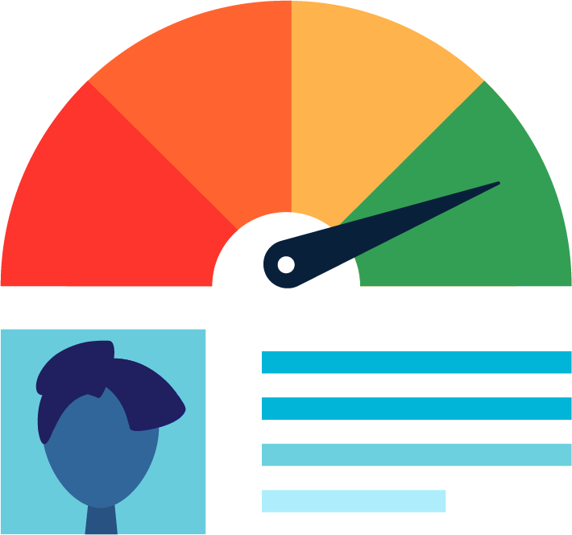
Use in conjunction with the Understanding Credit self-paced module.
List three examples of terms typically included in a credit agreement.
Answer the questions below based on the “Who Can Get Credit?” slide from the Basics of Credit section.
When do you expect that you will be able to obtain credit? Explain your answer based not only on your age but also on when you expect to meet the other criteria.
Do you think the limits on who can get credit are fair? Explain.

Slide 6
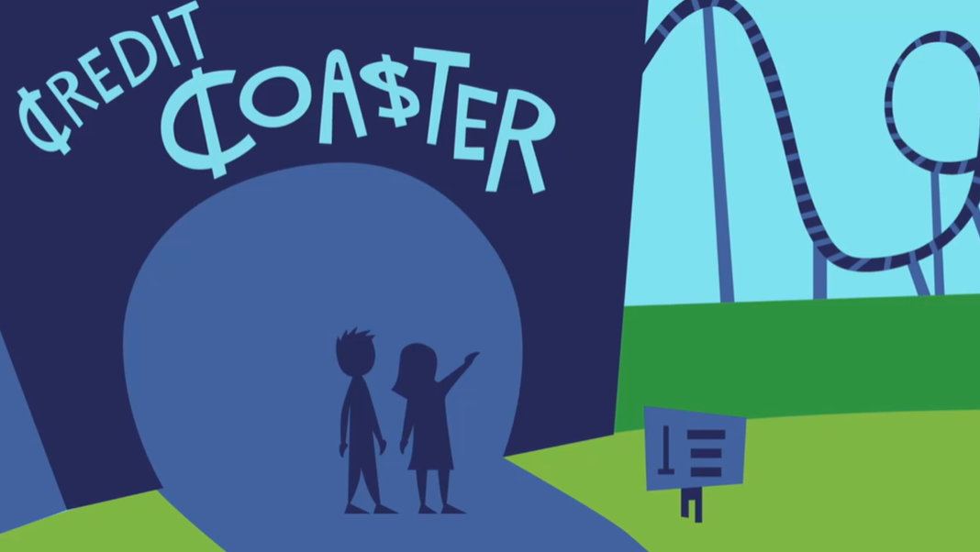
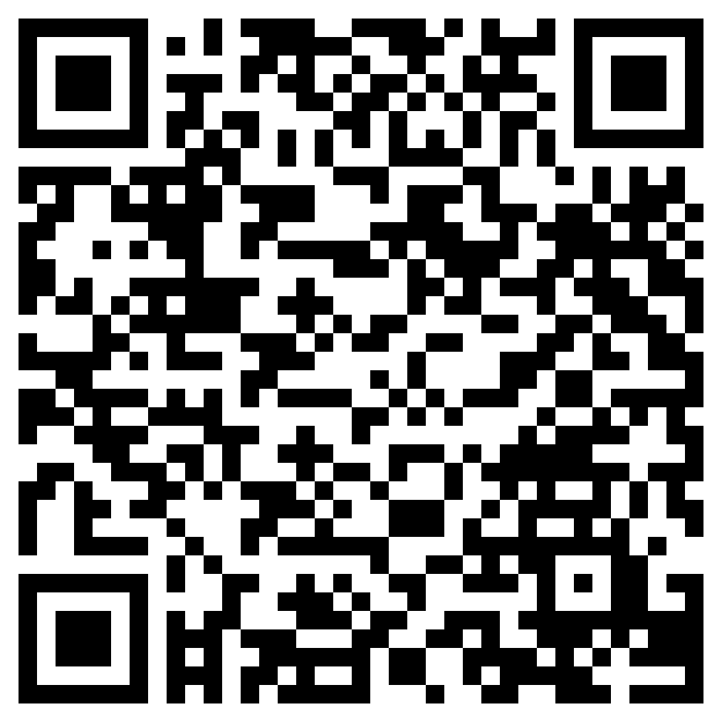
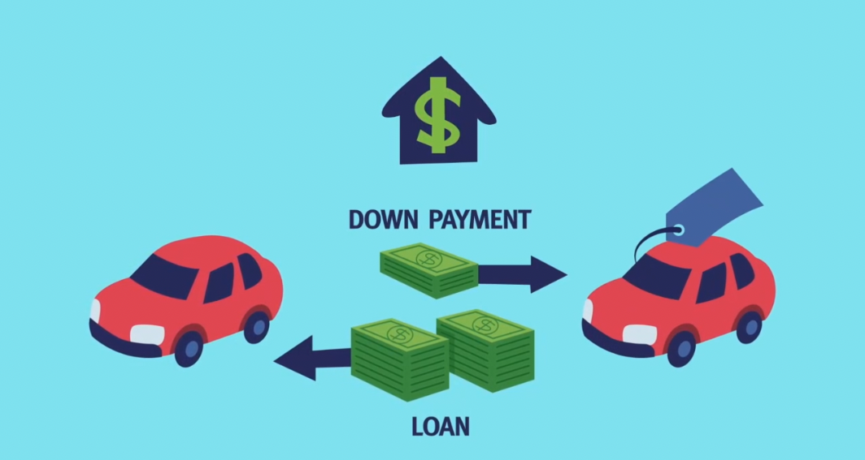
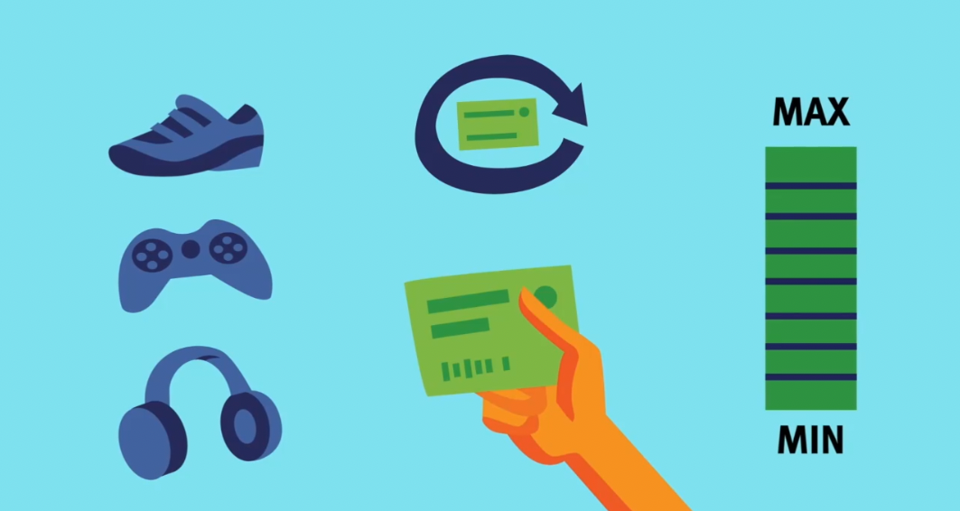
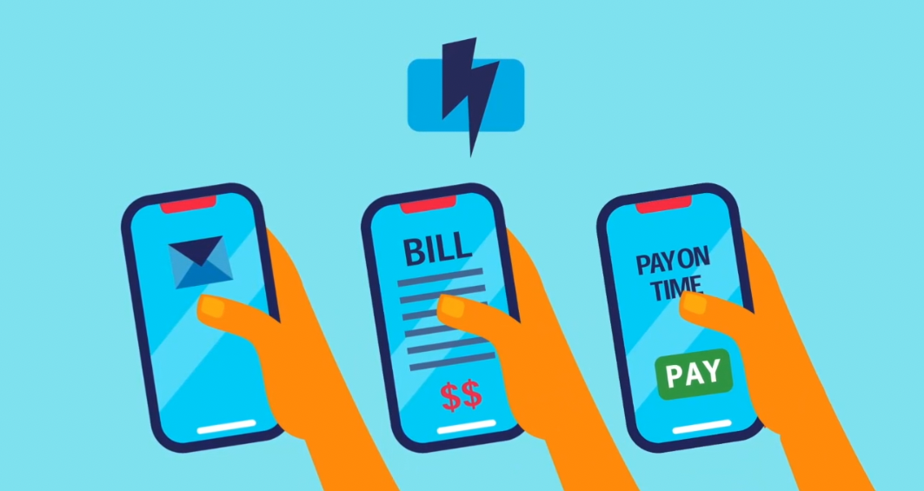
Common Types of Credit
Use in conjunction with the animated video found in the Understanding Credit self-paced module.
Use this link or the QR code below to watch the video from this module. Use the video and the images below to write a short story about the three types of credit. Be creative. You may use the characters riding the Credit Coaster in the video or write the story from a different perspective, such as a first-person point of view. Feel free to address the forms of credit in any order.
0:52
1:24
1:59
Write your short story using information from the video and the images above as inspiration.

Slide 7
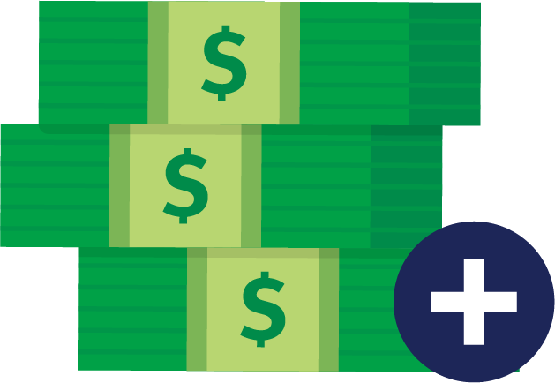
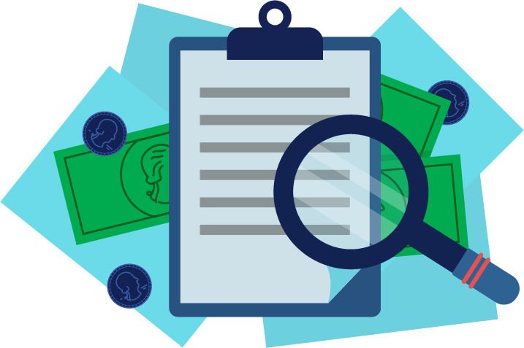
Use in conjunction with the Understanding Credit self-paced module.
Describe how each concept relates to credit.
Principal
Fixed or Variable Interest Rate
Secured or Unsecured
Prepayment Penalty
What type of credit do the terms above most commonly describe?

Slide 8
Use in conjunction with the Understanding Credit self-paced module.
List as many examples of service credit as you can. Four are mentioned in the module. Can you think of more?
Some people have strong opinions about the use of credit cards or revolving credit. Fill in the table with some of the benefits and tradeoffs of using credit cards.
Benefits | Tradeoffs
Where do YOU stand on the use of credit cards? Do you think it is a good idea, something to be avoided, or somewhere in between? Explain your thoughts.

Slide 9
Use in conjunction with the Understanding Credit self-paced module.
Write a definition of each type of credit in your own words and list at least one question to ask yourself before using each type.
Type of Credit | Definition in Your Own Words | Question(s) to Ask Myself
Installment
Revolving
Service or Open

Slide 10
Use this page to reflect on what you have learned in Topic 1: Understanding Credit.
Think about the three types of credit described in this module: installment, revolving, and service. Answer each question below.
Which type of credit do you expect you will use first? Why?
Which credit type do you understand the best? Why?
Which form of credit do you expect to use least or never use? Why?
End-of-Module Self-Evaluation
Consider the learning objectives for this module. How do you feel about each one after completing it? | Strongly Agree | Somewhat Agree | Somewhat Disagree | Strongly Disagree
I am able to provide examples of installment, revolving, and service credit.
I can compare various forms of credit.
I can explain what happens to collateral if a loan is unpaid.

Slide 11
Deciding When to Use Credit
After completing the module for this topic, you should be able to:
Identify forms of credit.
Explain both benefits and tradeoffs of using credit.
List factors to consider before using credit.

Slide 12
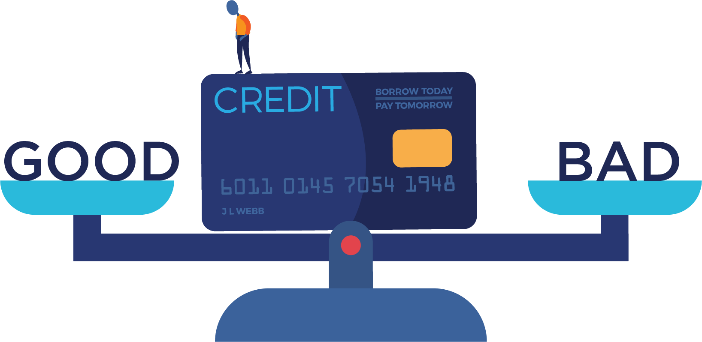
Use in conjunction with the Deciding When to Use Credit self-paced module.
Is credit good or bad? Some people have strong feelings about this topic. Think about a time you heard someone discussing the use of financial credit (borrowing money in order to get something now and paying for it later, usually with interest). What was the context of the conversation? Did you get the impression that they view credit as positive, negative, or a bit of each? If you’ve never heard people discuss credit, why do you think that is?
How did you answer the questions in the Credit and You section? Put an X in the boxes that apply.
 | Disagree | Unsure | Agree
I plan to have a credit card someday.
I might need to borrow money to go to college.
I hope to own a home when I am older.

Slide 13
Use in conjunction with the Deciding When to Use Credit self-paced module.
Describe three reasons people might choose to use credit.
1.
2.
3.
Using credit has risks. Fill in the graphic organizer with strategies you could use to avoid or minimize each potential risk.
Borrowing Too Much | Spending More Money
Losing Your Collateral | Paying Interest and Fees
Potential Credit Risks

Slide 14
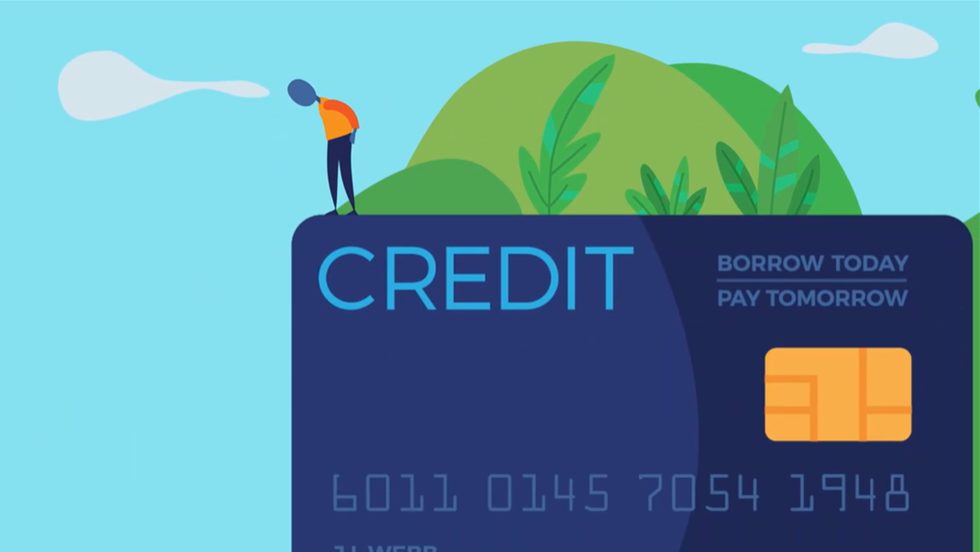
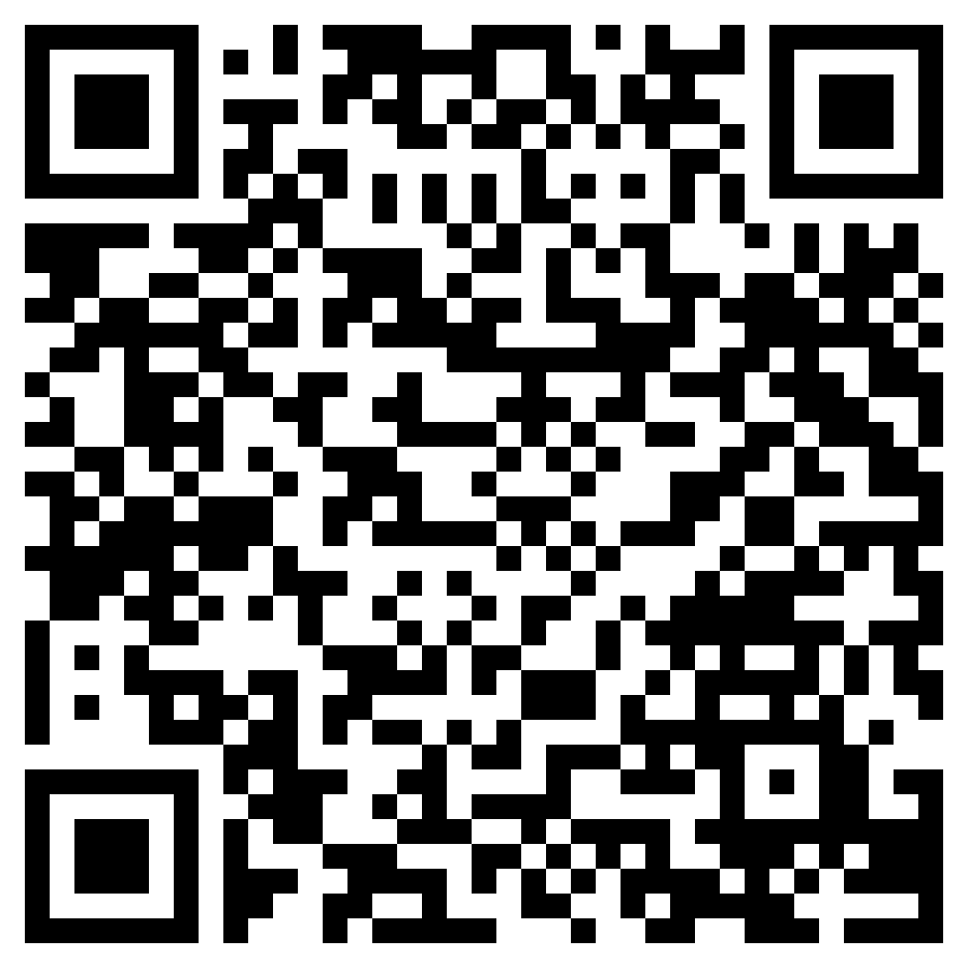
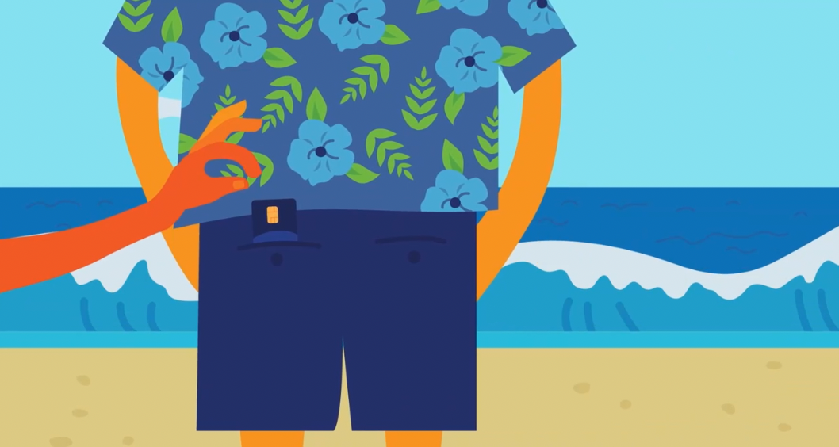
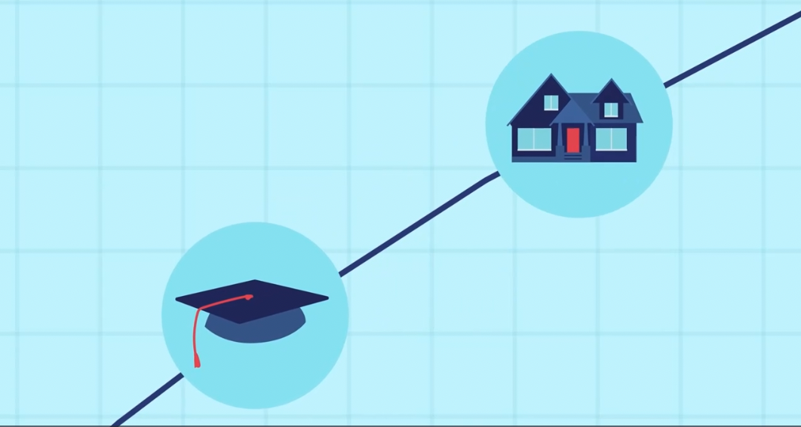
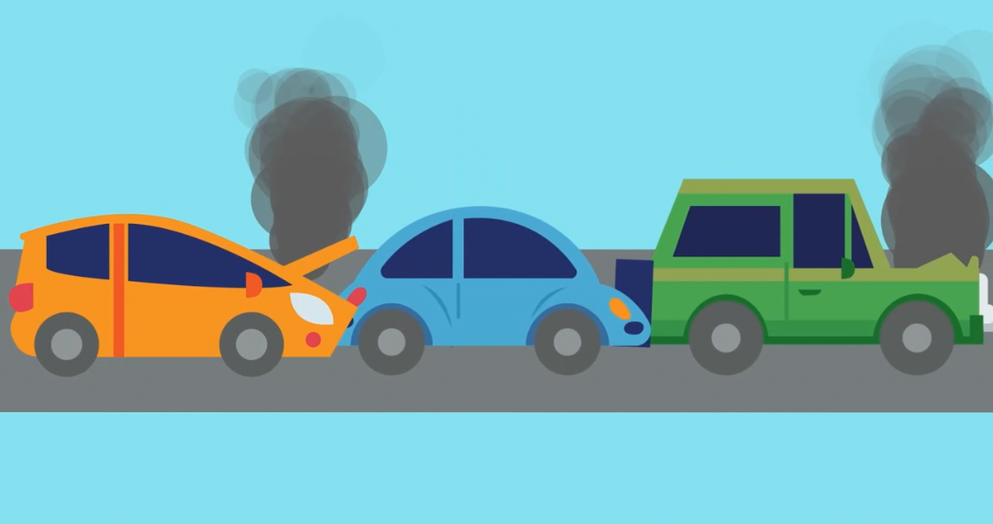
Benefits of Using Credit
Use in conjunction with the animated video found in the Deciding When to Use Credit self-paced module.
Use this link or the QR code below to watch the video from this module. Consider each image from the video and write a sentence or question inspired by each one. Be sure to demonstrate your understanding of the topic with what you write.
Write a sentence inspired by each of the images shown below.
Consider all four images and how they might be connected. What could you say about all four images in one sentence?

Slide 15
Use in conjunction with the Deciding When to Use Credit self-paced module.
The Use Credit section offers five scenarios in which you might use credit. Select three to share your answer and then explain your reason for each.
Scenario | Your Response | Reason
Make a list of questions you should ask yourself before using credit.

Slide 16
Use this page to reflect on what you have learned in Topic 2: Deciding When to Use Credit.
Imagine you are about to use credit for the first time. A family member questions your choice. Write a paragraph (3–5 sentences) explaining your decision-making process and the reasons you have for using credit. If you do not plan to use credit in the future, focus your paragraph on the reasons you have for this decision instead.
End-of-Module Self-Evaluation
Consider the learning goals for this module. How do you feel about each goal after completing it? | Strongly Agree | Somewhat Agree | Somewhat Disagree | Strongly Disagree
I am able to identify forms of credit.
I can explain both benefits and tradeoffs of using credit.
I can list factors to consider before using credit.

Slide 17
Checking Your Credit Report
After completing the module for this topic, you should be able to:
Summarize what a credit report is and how it is used.
Name the three major credit reporting bureaus.
Identify information contained in credit reports.
Explain the importance of regularly checking your own credit reports.

Slide 18
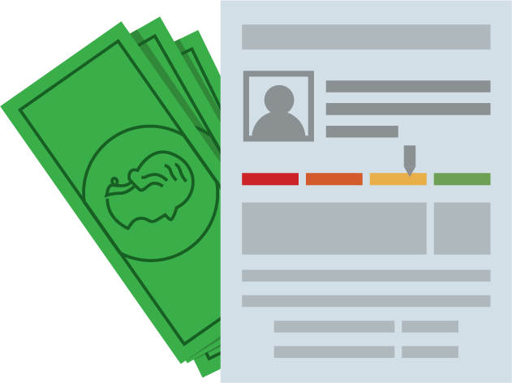
Use in conjunction with the Checking Your Credit Report self-paced module.
Credit reports compile detailed information about people’s use of credit. How do you feel about companies—referred to as credit bureaus—gathering and storing this information?
Fill in the answer to each question about credit.
Question | Answer
What is a credit report?
Who has a credit report?
Who creates credit reports?
Who uses credit reports?

Slide 19
Use in conjunction with the Checking Your Credit Report self-paced module.
There are three major credit bureaus. Name each and find its website.
 | Name | Website
1.
2.
3.
Credit reports from each of the three major credit bureaus might look different, but they all have similar information. Fill in the graphic organizer with information you would expect to find in each section of a credit report.
Personal Information | Credit Account Information
Inquiries | Bankruptcies and Collections
Contents of a Credit Report

Slide 20
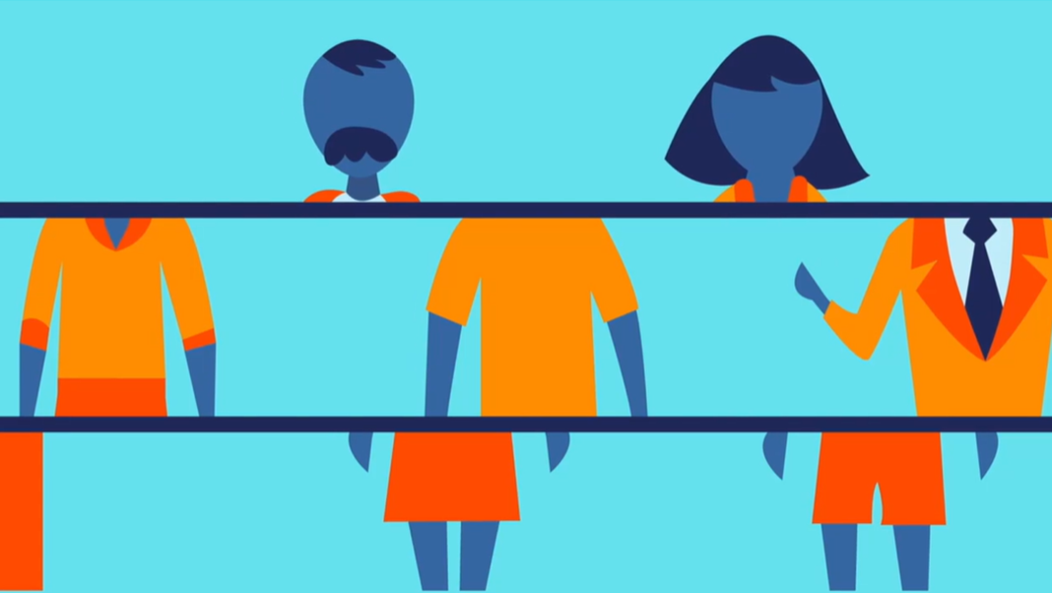
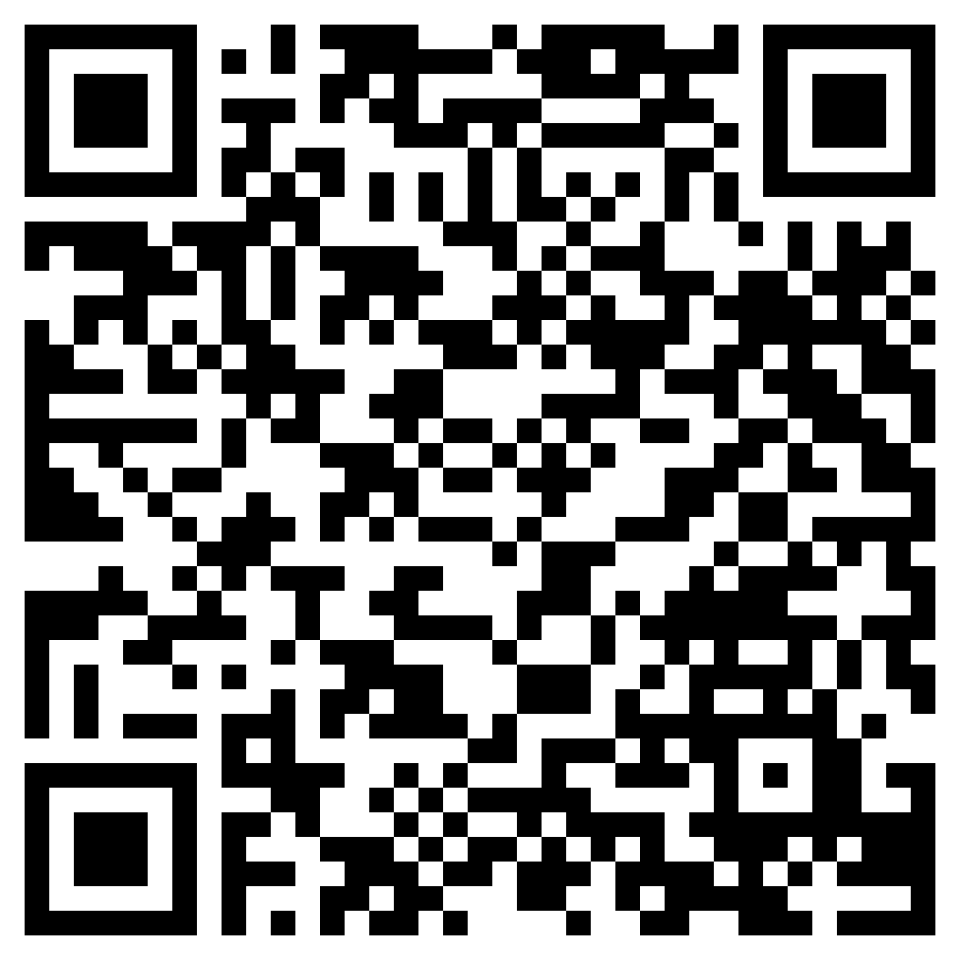
How to Get Your Credit Report
Use in conjunction with the animated video found in the Checking Your Credit Report self-paced module.
Use this link or the QR code to the right to watch the video from this module. As you watch, categorize information as being a plus, minus, or interesting.
Plus Information that seems to be a plus, or positive, to you. | Minus Information that seems to be a minus, or negative, to you. | Interesting Information that is neither a plus nor a minus, but is interesting to you.

Slide 21
Use in conjunction with the Checking Your Credit Report self-paced module.
It is a good idea to keep track of when you check your credit reports. The table below provides an example of one you could use—now or in the future.
Credit Bureaus | Date Requested | Date Reviewed | Notes About What Was Found or Steps to Take
Make a copy of the table and share where you can access it in the future. Options include:
Spreadsheet: Share the name of the file and where you saved it.
Email: Send yourself an email and share the subject line.
Phone: Create a note in your phone and share the title.
If you are under the age of 18, an adult will need to assist you in obtaining a copy of your credit report from each major credit bureau. The CFPB or Consumer Financial Protection Bureau offers tip sheets on how to do this.
For parents or guardians Helping Youth Start and Maintain Good Credit
For caseworkers of youth in foster care Helping Youth in Foster Care Start and Maintain Good Credit

Slide 22
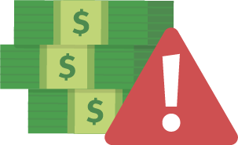
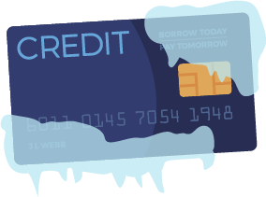
Use in conjunction with the Checking Your Credit Report self-paced module.
What steps should people take once they have obtained a copy of their credit report(s)?
Describe what each tool is and how it relates to credit reports.
Tool | Description
Fraud Alert
Credit Freeze
Credit Monitoring
Credit Protection

Slide 23
Use this page to reflect on what you have learned in Topic 3: Checking Your Credit Report.
What are you taking away from this module about credit reports, including how to access them, what they include, and how they are used?
End-of-Module Self-Evaluation
Consider the learning objectives for this module. How do you feel about each objective after completing it? | Strongly Agree | Somewhat Agree | Somewhat Disagree | Strongly Disagree
I can summarize what a credit report is and how it is used.
I am able to name the three major credit bureaus.
I can identify information contained in credit reports.
I am confident explaining the importance of regularly checking my own credit reports.

Slide 24
Improving Your Credit Score
After completing the module for this topic, you should be able to:
Explain what factors influence a person’s credit score.
Develop a plan to build good credit.
Describe the impact poor credit could have on yourself or another individual.

Slide 25
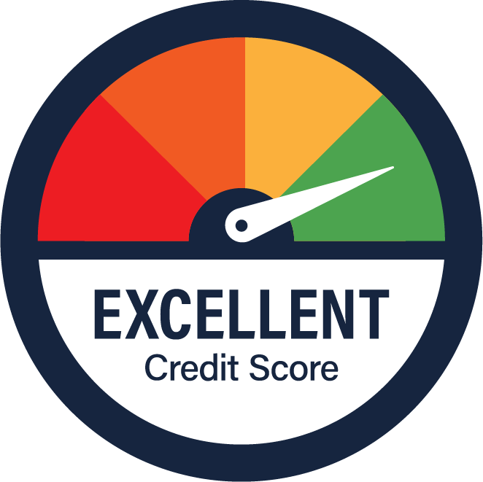
Use in conjunction with the Improving Your Credit Score self-paced module.
How would you describe your current borrowing habits? Do you think they are good, or could they use some improvement? Explain.
When it comes to credit scores, what do you already know? What do you want to know? Complete the first two columns now. Come back when the module is done, and share what you learned.
Know What do you already know about this topic? | Want What do you want to know about this topic? | Learn What have you learned after completing the module?

Slide 26
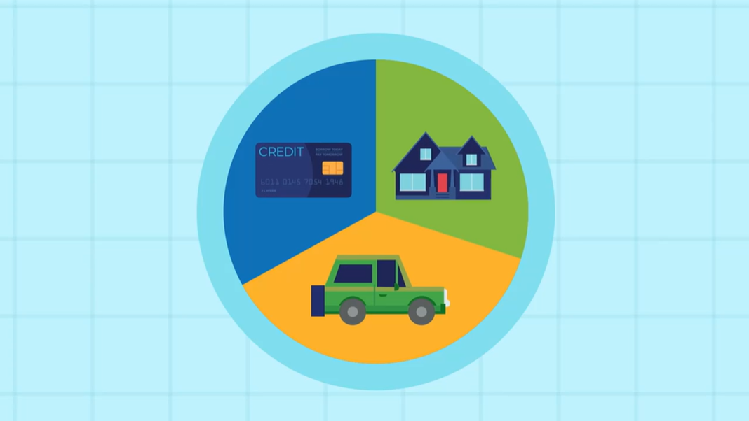
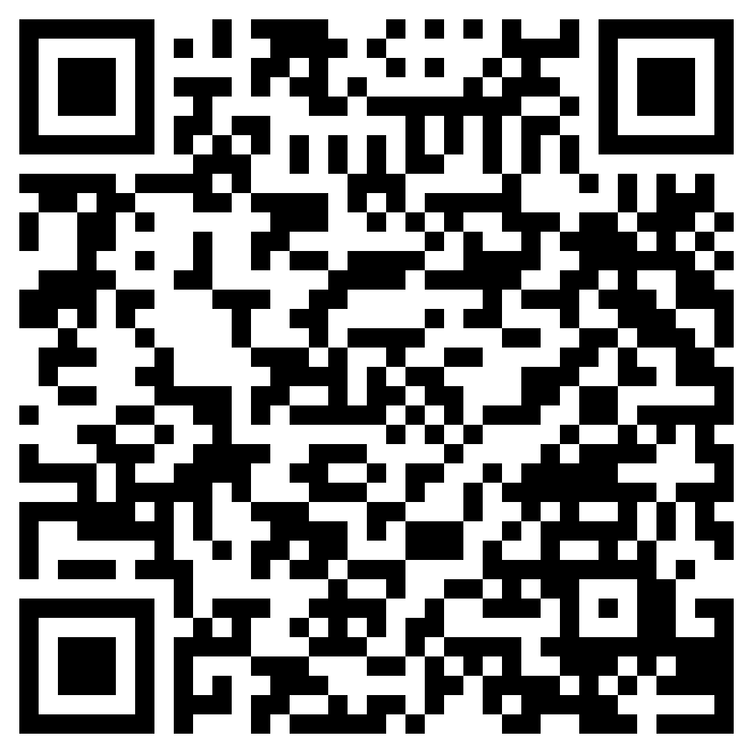
Understanding Credit Scores
Use in conjunction with the animated video found in the Improving Your Credit Score self-paced module.
Use this link or the QR code to the right to watch the video from this module two times. Answer the prompts below.
Watch the video without pausing. Write down as many key details as you can remember in one minute.
Watch the video again. Take one minute and list any additional key details that you missed the first time.
Use the key details to write a paragraph (3–4 sentences) summarizing the content of the video.

Slide 27
Use in conjunction with the Improving Your Credit Score self-paced module.
Label the pie chart below with the factors that contribute to your credit score. Fill in the name of each factor and write a brief description or provide examples.
10%
35%
10%
30%
15%
Which factor would each of the following influence?
Your student loan being paid late
Applying for a new credit card to save 15% on a purchase
Paying off a loan ahead of schedule

Slide 28
Use in conjunction with the Improving Your Credit Score self-paced module.
Using the Credit Pays Off section, compare and contrast the approach Makayla and Caleb each took to using credit.
 | Makayla | Caleb
When did they establish credit?
Do they pay their bills on time?
What impact has credit had on how much they pay for their home?
What impact has credit had on what they pay for a car?
Who pays less each year and by how much?
What can people learn from this example?

Slide 29
Use in conjunction with the Improving Your Credit Score self-paced module.
Make a list of tips for building good credit.
Which of these actions do you anticipate trying to take? What steps might you take to accomplish them?
Action | Anticipate Trying or Improving (Yes or No) | Steps to Take
Keep track of things I borrow
Talk to my parents about establishing credit
Set up reminders for due dates
Find out if I can become an authorized user
See if I can apply for a credit builder loan

Slide 30
Use this page to reflect on what you have learned in Topic 4: Improving Your Credit Score.
Based on what you learned in the module, do you believe it is important for you to establish good credit in the future? Explain.
Reminder: Go back to the first page for this module and complete the “Learn” column of the chart.
End-of-Module Self-Evaluation
Consider the learning goals for this module. How do you feel about each goal after completing it? | Strongly Agree | Somewhat Agree | Somewhat Disagree | Strongly Disagree
I am able to explain what factors influence a person’s credit score.
I can develop a plan to build good credit.
I can describe the impact poor credit could have on myself or another individual.

Slide 31
Managing Debt
After completing the module for this topic, you should be able to:
explain strategies for paying off debt.
give examples of debt-repayment scams.
describe potential consequences of accumulating more debt than you can afford or failing to pay it back.

Slide 32
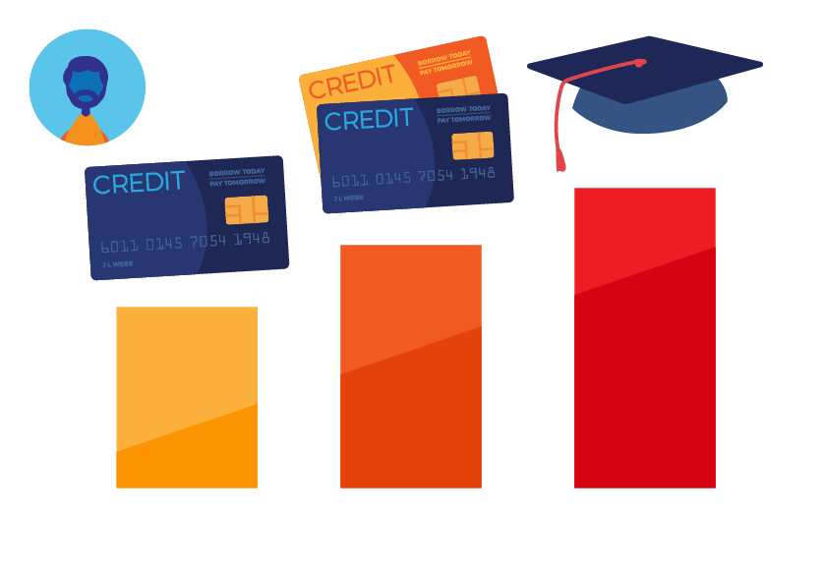
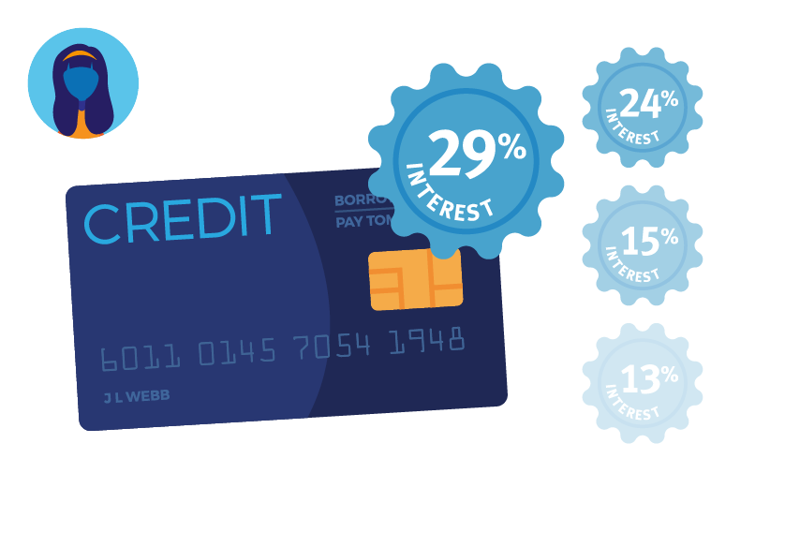
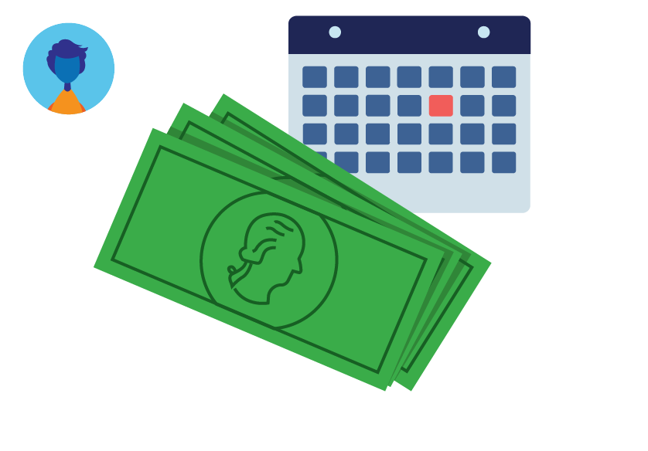
Use in conjunction with the Managing Debt self-paced module.
Summarize each person’s debt challenges and repayment approach.
Person | Debt Challenge | Repayment Approach
Carlos
Alexis
Omar
Whose strategy do you think will work best and why?

Slide 33
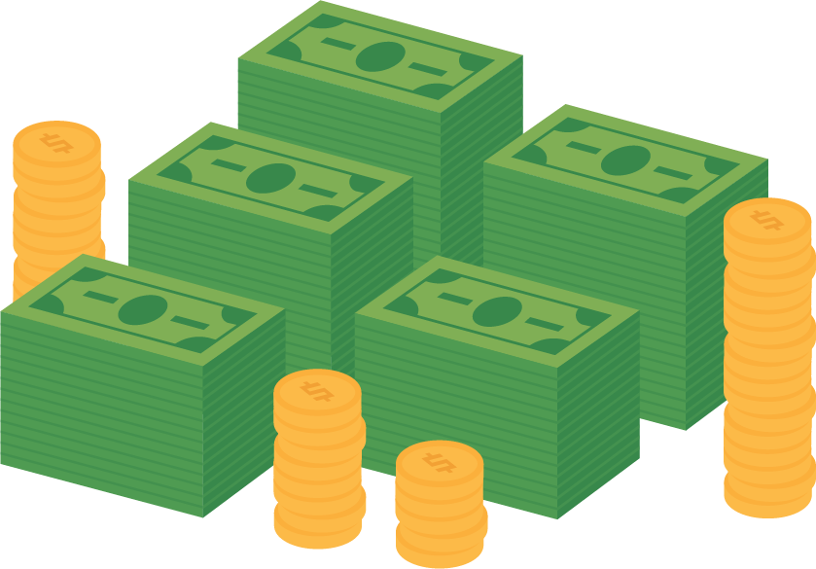
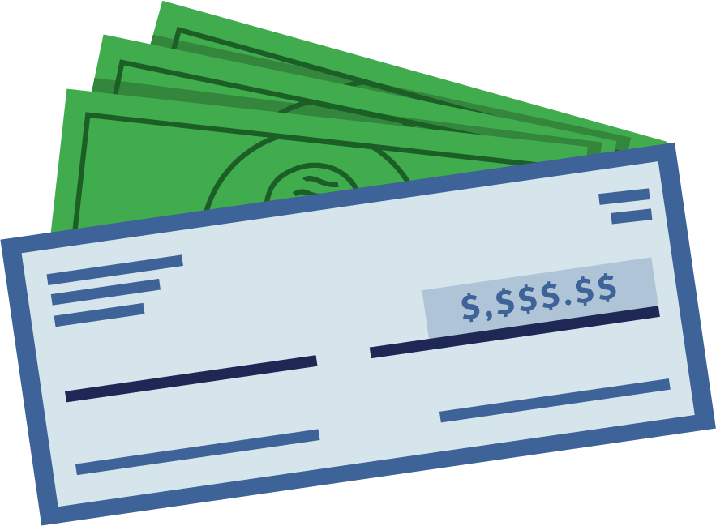
Use in conjunction with the Managing Debt self-paced module.
Explain each potential consequence of debt.
Cost Money
Lose Collateral
Increase Stress
Hurt Credit
Have Wages Garnished
What steps can people take to pay down debt?

Slide 34
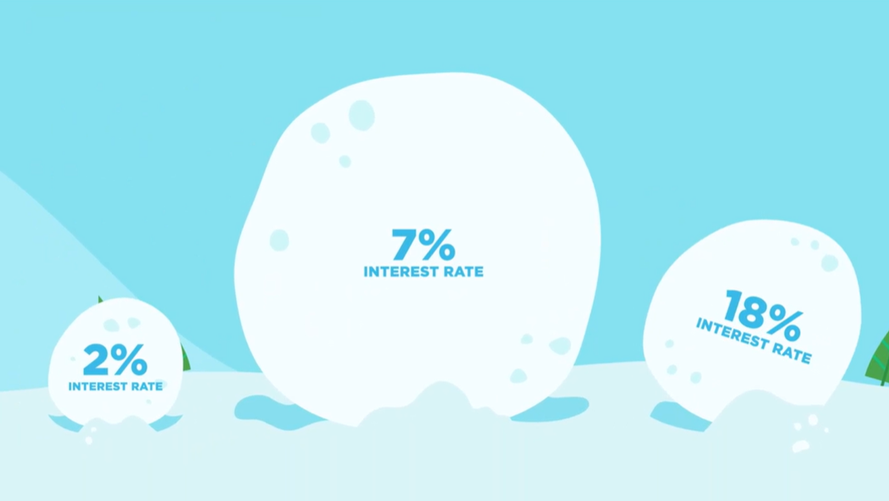
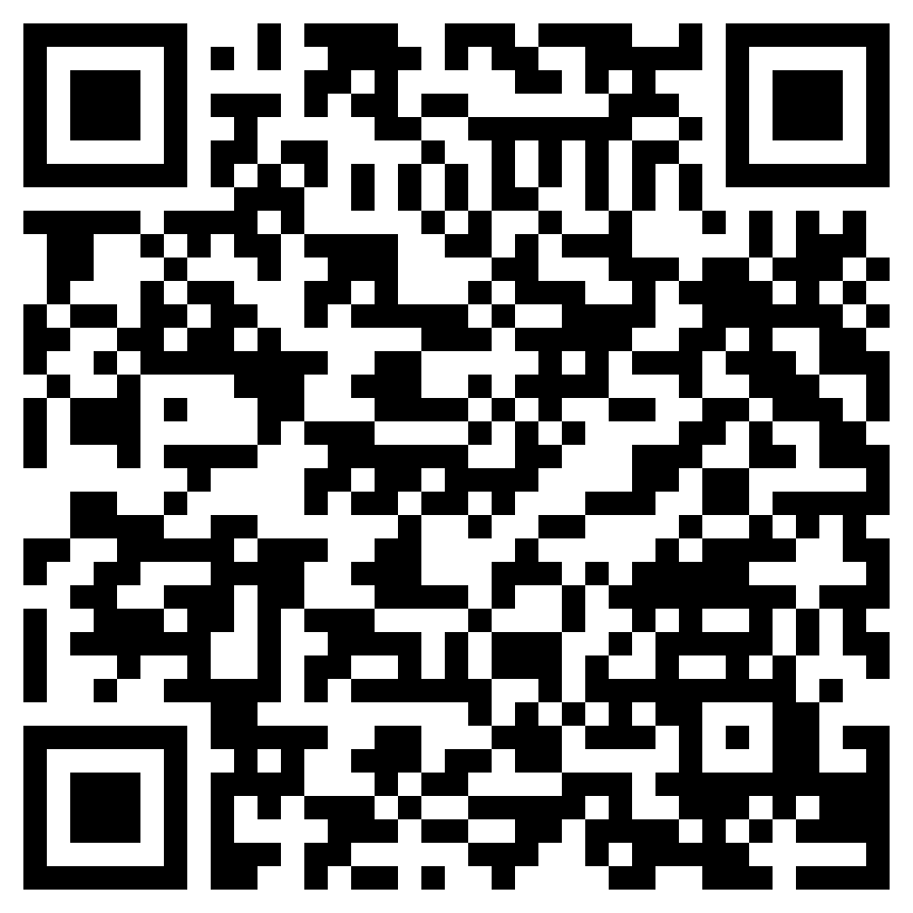
Debt Repayment Strategies
Use in conjunction with the animated video found in the Managing Debt self-paced module.
Use this link or the QR code to the right to play the video from the module. Pause as needed to complete the graphic organizer below.
Write three interesting facts about the topic.
Share two reasons the information in the video is important.
Write a one-sentence summary of what you learned.

Slide 35
Use in conjunction with the Managing Debt self-paced module.
List at least one benefit and one tradeoff of each debt repayment strategy.
Strategy | Benefits | Tradeoffs
Debt Avalanche Method
Debt Snowball Method
Balance Transfer
Debt Consolidation
Debt Management Plan
Give an example of each type of scam’s false claim and what people should know about it.
 | Pay Up Front | Debt Elimination | Trust Us | New ID
False Claim
Information People Should Know

Slide 36
Use this page to reflect on what you have learned in Topic 5: Managing Debt.
If you find yourself facing debt challenges some day, what key points from this module do you hope you will remember?
End-of-Module Self-Evaluation
Consider the learning goals for this module. How do you feel about each goal after completing it? | Strongly Agree | Somewhat Agree | Somewhat Disagree | Strongly Disagree
I can explain strategies for paying off debt.
I am able to give examples of debt-repayment scams.
I can describe potential consequences of accumulating more debt than I can afford or failing to pay it back.

Slide 37
Using Credit Wisely
Wrap Up

Slide 38
Unit 6: Glossary of Key Terms
Term | Definition | My Notes
Authorized User | A person who has permission to use someone else’s credit card but isn’t the one who must pay the bill
Automatic Bill Pay | When a consumer sets up a bill payment to be made automatically on a given date from a bank account or credit card
Balance | The amount currently owed on a loan or the amount of money in an account
Bankruptcy | A legal term for when a person or business cannot repay its outstanding debts
Collateral | Something of value pledged by a borrower to be given to the lender should the borrower fail to repay a loan
Co-signer | Someone who has to pay a debt if the primary user does not pay
Credit | The ability to buy something now and pay for it later
Credit Builder Loan | A “locked” savings account into which a person deposits money over a set period of time—usually 6 to 24 months—in exchange for the payments being reported to the credit bureaus; the money is returned when the person is done

Slide 39
Unit 6: Glossary of Key Terms (continued)
Term | Definition | My Notes
Credit Bureau or Credit Reporting Agencies | A business that researches and collects information about people’s credit histories; examples include Equifax, Experian, and TransUnion
Credit Card | A card issued by a financial institution that gives the holder access to credit for purchases and other transactions
Credit Freeze | A process that locks or “freezes” access to a person’s credit so that no new accounts can be opened in their name
Credit Limit | The maximum amount a person can borrow
Credit Report | A record of a person’s credit history that includes information about their identity, existing credit, public records, as well as inquiries about their credit history
Credit Score | A number calculated by a credit monitoring agency and assigned to a person that reflects the person's history of borrowing money and paying back loans
Debt | Something, typically money, that is owed or due
Down Payment | A portion of the purchase price paid in cash when the rest is paid with borrowed money

Slide 40
Unit 6: Glossary of Key Terms (continued)
Term | Definition | My Notes
Federal Trade Commission | A federal government agency tasked with protecting consumers, often called the FTC
Fixed Interest Rate | An interest rate that does not change over time
Identity Theft | A crime in which someone acquires and wrongly uses another person's personal information
Installment Credit | A loan that is paid back in fixed amounts (installments) over a period of time, such as mortgages and car loans
Interest | Money paid at a specified rate for money that is borrowed, deposited in a bank, or owed to a lender
Interest Rate | The amount of interest being paid or charged, generally expressed as a percent
Lender | A person or business that extends credit to others
Loan | Money that is borrowed and must be paid back with interest
Prepayment Penalty | A fee or amount a borrower must pay if a loan is paid off early according to some loan agreements

Slide 41
Unit 6: Glossary of Key Terms (continued)
Term | Definition | My Notes
Principal | A sum of money originally invested or borrowed
Revolving Credit | Borrowers are given a maximum amount they can borrow (a credit limit) with the ability to pay some or all of it back at a time and borrow again back to the limit, such as credit card or line of credit
Secured Credit Card | A credit card in which the borrower makes a security deposit up front to lower the risk of lending to them
Secured Loan | A loan in which the borrower offers collateral that the lender can take if the loan goes unpaid for a period of time
Service Credit | The ability to receive services such as utilities or a cell phone and pay for it later when billed
Unsecured Loan | A loan in which the borrower does not provide collateral
Variable Interest Rate | An interest rate that may increase or decrease over time
Wage Garnishment | A legal procedure by which a person’s earnings are withheld to repay a creditor

Slide 42
Unit 6: Personal Action Plan
Consider each of the topics addressed in this unit. Which actions will you take to use credit wisely? | Already Doing | Need to Do | Not in My Plans
I will consider what types of credit I might need in the future, including installment, revolving, and service credit.
I will check to see if I already have a credit report with the help of an adult.
I will use strategies such as setting reminders for due dates in order to make sure I pay my bills on time.
I will be a responsible borrower and pay back loans or return items on time.
I will read and understand the terms of any credit agreement I accept.
I will explore options for building credit.
My notes and next steps:

Slide 43
Unit 6: Continuing the Conversation at Home
Families often approach conversations about money very differently. Some might welcome them, while others avoid the topic as much as possible. Review the conversations starters below. With whom could you have each conversation? How might you approach the conversations?
Conversation Starters | My Notes
Deciding to Use Credit When did you first get a credit card? What was it for? Do you still have it? What was the first loan you had? Do you remember how much you borrowed or the interest rate you were charged? At what point do you think I should start to establish credit? How would you feel about helping me to build credit?
Credit Reports and Scores Have you ever seen your credit reports? If so, when? Have you ever used annualcreditreport.com or another source to access your credit reports? Would you be willing to help me access a copy of my credit reports to make sure I haven’t been a victim of identity theft? Do you think it is important to have a good credit score?
Impact of Credit How has establishing credit helped or hurt you over the years? What are your thoughts on using credit? Do you feel it is good, bad, or a mix of each? What advice do you have for me as I think about establishing and using credit?
Debt Strategies What regrets, if any, do you have about using credit? Have you heard of the avalanche or snowball methods of paying off debt? If you accumulated debt, would you rather pay off the debt with the highest interest rate or the lowest balance first?

Slide 44
Unit 6: Dig Deeper
Interested in learning more about the topics covered in this unit? Consider exploring one or more of the following questions.
Dig into the Topics | My Notes
Deciding to Use Credit What options for building credit does your bank or credit union offer? Do your parents or guardians have a credit card that allows children to be authorized users? If so, does this information get sent to credit reporting agencies? What are the current interest rates on various forms of credit: credit cards, car loans, student loans, home loans, etc.?
Credit Reports and Scores What is the average credit score in your state? How do you obtain a copy of your credit report? What financial institutions or lenders offer credit scores as a free benefit of having an account? What apps and other services help people monitor credit? What fees do they charge?
Impact of Credit What is the financial impact of having a high or low credit score? Can insurance companies charge more to people with poor credit in your state?
Debt Strategies Are there credit counseling services in your area? If so, what services do they provide? Does your state regulate debt management plan providers? If so, what agency is responsible for it and how do you contact them?

