Slide 1
Growing and Protecting Your Finances
Unit 8
Unit 8: Getting Started
Topic 1: Understanding Investing Options How can you grow your money through investments?
Topic 2: Building a Diversified Portfolio Are there ways to reduce your risks when investing?
Topic 3: Making Charitable Donations What should you look for when making a charitable contribution?
Topic 4: Avoiding Financial Fraud How can you avoid becoming the victim of financial fraud?
Topic 5: Getting Help with Financial Decisions Who can you trust for sound financial advice?
Wrap Up Glossary of Key Terms Personal Action Plan Continuing the Conversation at Home Dig Deeper

Slide 2
Unit 8: Getting Started
This unit explores a wide variety of personal finance topics within the theme of Growing and Protecting Your Finances. Going into this unit, how much do you already know about each topic?
 | Not Much | Some | A Lot
Topic 1: Understanding Investing Options How can you grow your money through investments? Examine investing options including stocks, bonds, and mutual funds.
Topic 2: Building a Diversified Portfolio Are there ways to reduce your risks when investing? Consider how some of the risks involved with investing can be reduced through diversification.
Topic 3: Making Charitable Donations What should you look for when making a charitable contribution? Explore ways to give to charitable organizations and factors you should consider before making a charitable contribution.
Topic 4: Avoiding Financial Fraud How can you avoid becoming the victim of financial fraud? Learn how to avoid identity theft and various forms of investment fraud.
Topic 5: Getting Help with Financial Decisions Who can you trust for sound financial advice? Explore ways to get help making financial decisions both on your own and with the help of financial professionals.

Slide 3
Understanding Investing Options
After completing the module for this topic, you should be able to:
Explain the difference between a stock and a bond.
Give examples of how you could diversify your own investment portfolio.
Describe potential risks and rewards associated with investing.

Slide 4
Use in conjunction with the Understanding Investing Options self-paced module.
There’s an old saying that “money doesn’t grow on trees.” While no one has found a way to grow money like a plant, many people DO try to grow or increase the value of their money by investing. What do you think about the comparison of growing money like you would a plant? How are the two the same and/or different?
Going into this module, how much do you already know about these forms of investments? Put an X for each.
 | Stocks | Bonds | Mutual Funds
I know a lot. I could easily explain it to someone else.
I’ve heard of them before or have a basic understanding.
I don’t know much about this form of investing.

Slide 5
Use in conjunction with the Understanding Investing Options self-paced module.
Select a publicly-traded company that interests you (one that allows investors to purchase stock). Use an online tool such as Google Finance, Yahoo Finance, Wall Street Journal Market Data, or MarketWatch to locate a graph showing the price of the stock. Adjust the graphs and take screenshots of each to meet the criteria for each box below. Underneath, provide the lowest and highest price within each range.
1D or One Day Graph and Information
Lowest Price
Highest Price
Replace with a screenshot of the graph.
6M or Six Month Graph and Information
Lowest Price
Highest Price
Replace with a screenshot of the graph.
5Y or Five Year Graph and Information
Lowest Price
Highest Price
Replace with a screenshot of the graph.

Slide 6
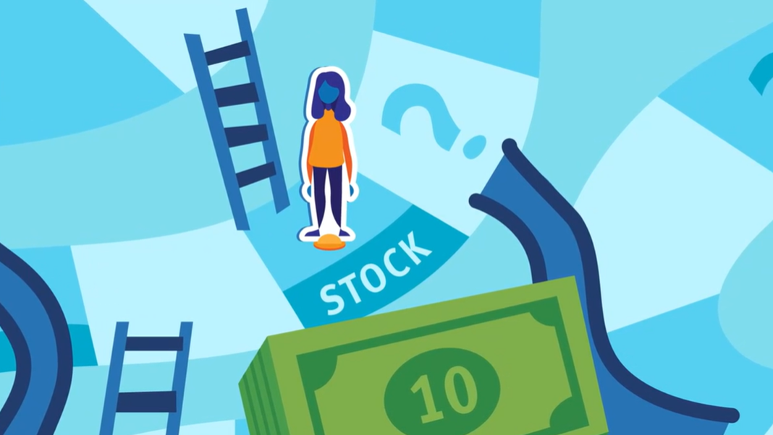
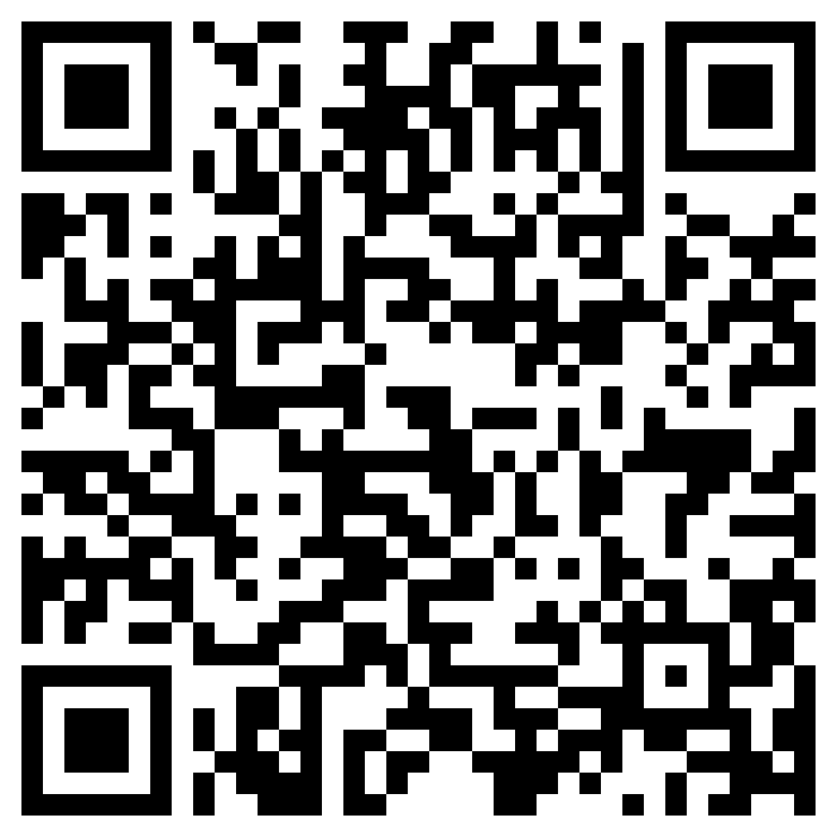
Diversification
Use in conjunction with the Understanding Investing Options self-paced module.
Check out the headline below and think about what it means. Then use this link or the QR code to the right to watch the video from this module, pausing to take notes.
Old Saying Still True,
“Don’t Put All Your Eggs in One Basket”
Write three statements that support the headline.

Slide 7
Use in conjunction with the Understanding Investing Options self-paced module.
What do you see as the pros and cons of investing in stocks and bonds?
 | Stocks | Bonds
Pros
Cons
Why do you think many investors choose to invest in both?
Would you rather invest in individual stocks and bonds, mutual funds, or a combination of each? Explain.
The “Buy Low, Sell High” section features three investors with different approaches. Which one is most similar to what you might do with investing, or would you take a different approach altogether? Explain.

Slide 8
Use this page to reflect on what you have learned in Topic 1: Understanding Investing Options.
At the end of the module, you are encouraged to “do your homework and ask questions.” What research is important to do before choosing investments and what questions do you plan to ask before investing?
End-of-Module Self-Evaluation
Consider the learning objectives for this module. How do you feel about each one after completing it? | Strongly Agree | Somewhat Agree | Somewhat Disagree | Strongly Disagree
I am able to explain the difference between a stock and a bond.
I can give examples of how I could diversify my own investment portfolio.
I am confident describing potential risks and rewards associated with investing.

Slide 9
Building a Diversified Portfolio
After completing the module for this topic, you should be able to:
explain how investment risks can be decreased through diversification.
compare ways to diversify.
identify investments with “built-in” diversification, including mutual funds and exchange traded funds (ETFs).

Slide 10
Use in conjunction with the Building a Diversified Portfolio self-paced module.
How is investing like driving a car? The module’s intro video shares a few ideas. Expand on these by answering the questions below.
 | Driving | Investing
What risk(s) are involved?
Why do people do it when it involves risk?
How can people reduce their risks?
Going into the module, how familiar were you with each of the following forms of saving or investing from the “Investments and Risk” portion of the Prepare section? Place each of the eight types into one of the categories below.
Not Familiar | Somewhat Familiar | Very Familiar

Slide 11
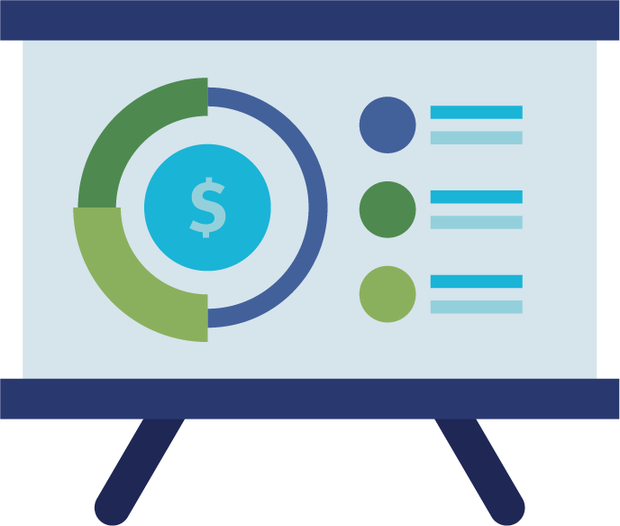
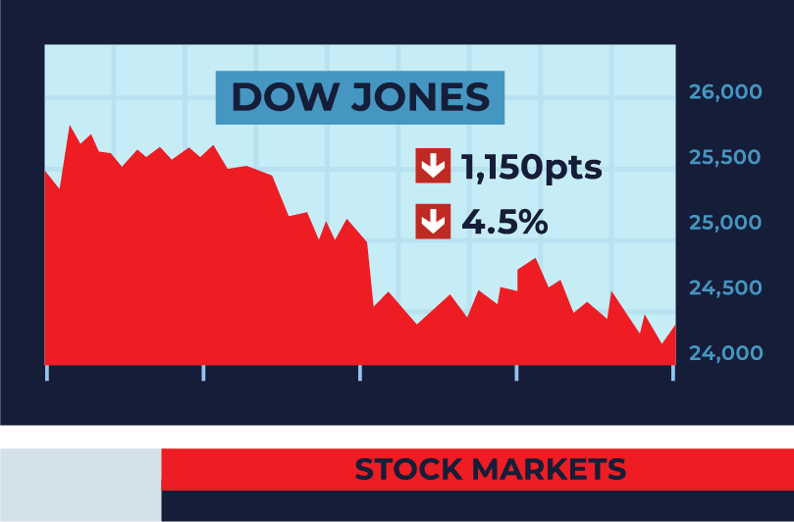
Use in conjunction with the Building a Diversified Portfolio self-paced module.
Consider how each term applies to investing. Write a definition of each one in your own words.
Portfolio
Risk
Return
Stocks
Bonds
Diversification
Provide at least two examples of ways to diversify investments in both stocks and bonds.
Ways to Diversify with Stocks | Ways to Diversify with Bonds

Slide 12
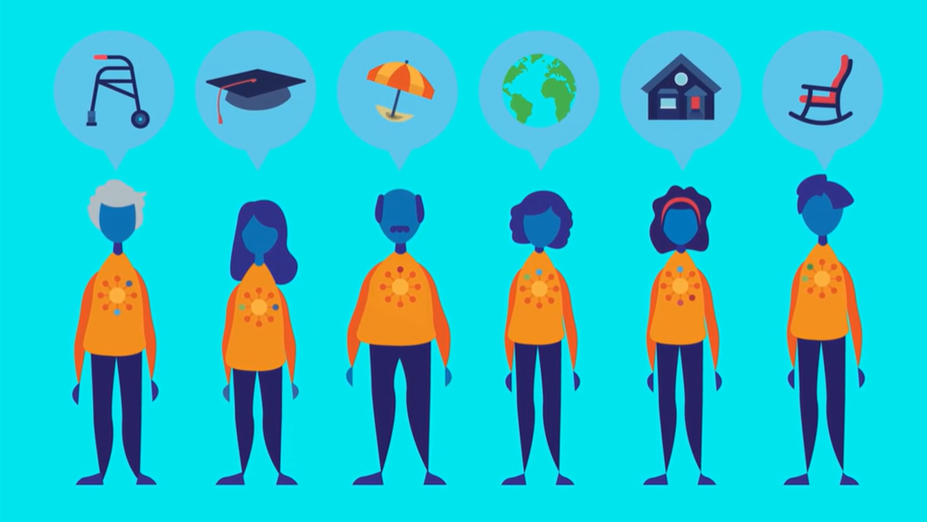
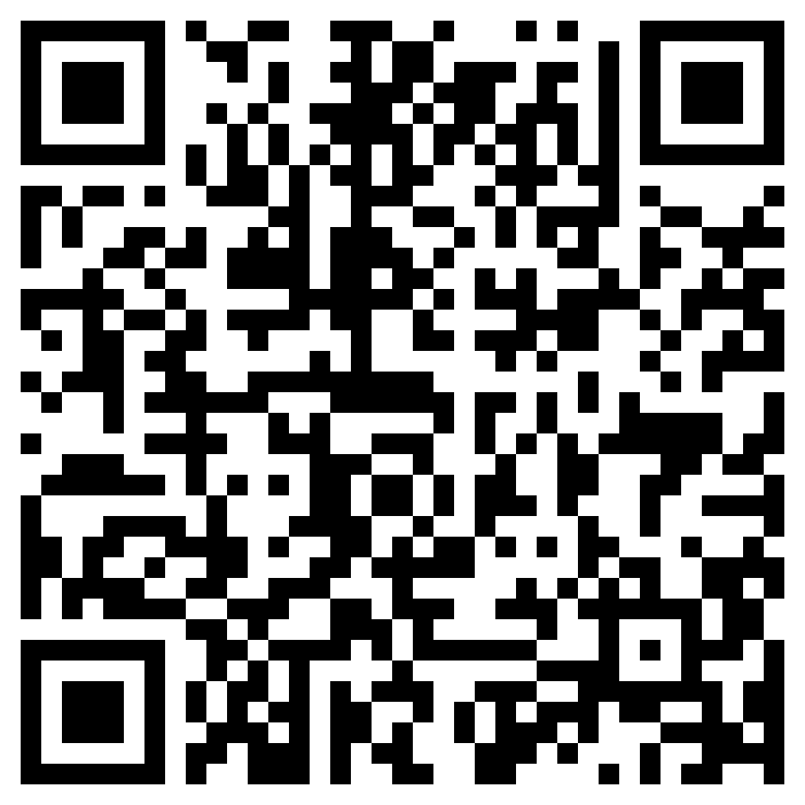
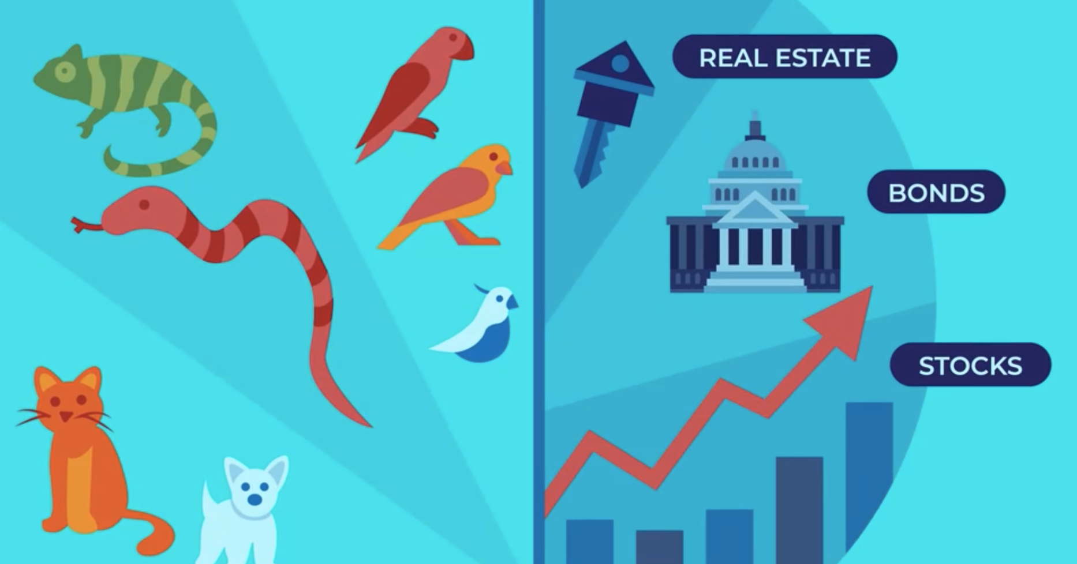
Ways to Diversify
Use in conjunction with the Building a Diversified Portfolio self-paced module.
Use this link or the QR code to the right to replay the video from this module. Once you’re done, summarize what you learned in a six-word story.
1
2
3
4
5
6

Slide 13
Use in conjunction with the Building a Diversified Portfolio self-paced module.
Explain how each of the following offers built-in diversification.
Mutual Funds | Exchange-Traded Funds
Target-Date Funds | Stock Indexes
Built-In Diversification
Below are questions investors should ask themselves before making investment decisions. What is a potential consequence of NOT asking each question prior to investing?
How comfortable are you with risk?
When will you need the money?
Why are you investing?
Do you understand the investment?

Slide 14
Use this page to reflect on what you have learned in Topic 2: Building a Diversified Portfolio.
Reflect on what you’ve learned about investing and diversification and answer each of the questions below.
How old do you think you might be when you start investing? Why this age?
Are you likely to prefer forms of investing that involve more or less risk? Explain.
How do you think your approach to investing might change over time?
Of the ways you learned to diversify investments, which one(s) appeal to you the most?
End-of-Module Self-Evaluation
Consider the learning goals for this module. How do you feel about each goal after completing it? | Strongly Agree | Somewhat Agree | Somewhat Disagree | Strongly Disagree
I am able to explain how investment risks can be decreased through diversification.
I am confident comparing ways to diversify.
I can identify investments with “built-in” diversification, including mutual funds and exchange traded funds (ETFs).

Slide 15
Making Charitable Donations
After completing the module for this topic, you should be able to:
Explain how charitable organizations vary from other types of businesses.
Describe the impact charities have in the community and elsewhere.
List ways you could support charitable organizations.
Identify factors you might consider before donating.

Slide 16
Use in conjunction with the Making Charitable Donations self-paced module.
Name one or more charitable organizations that fit in each category. Think of ones in your community along with those you might have heard of or found online.
Focus on your area or state
Support youth or education
Work to improve people’s health in some way
Serve people in other countries
Focused on the environment
Affiliated with a religion
In your opinion, is it better to support a charitable organization by donating money or your time? Explain your answer.

Slide 17
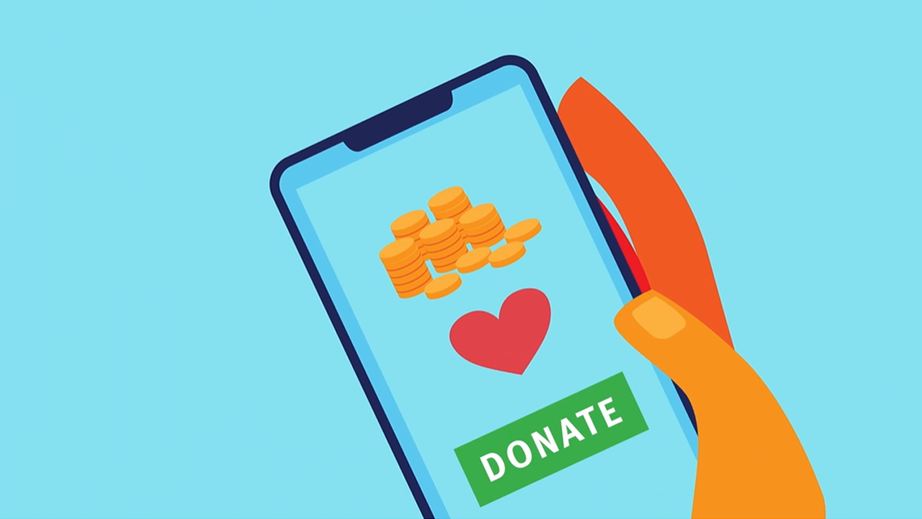
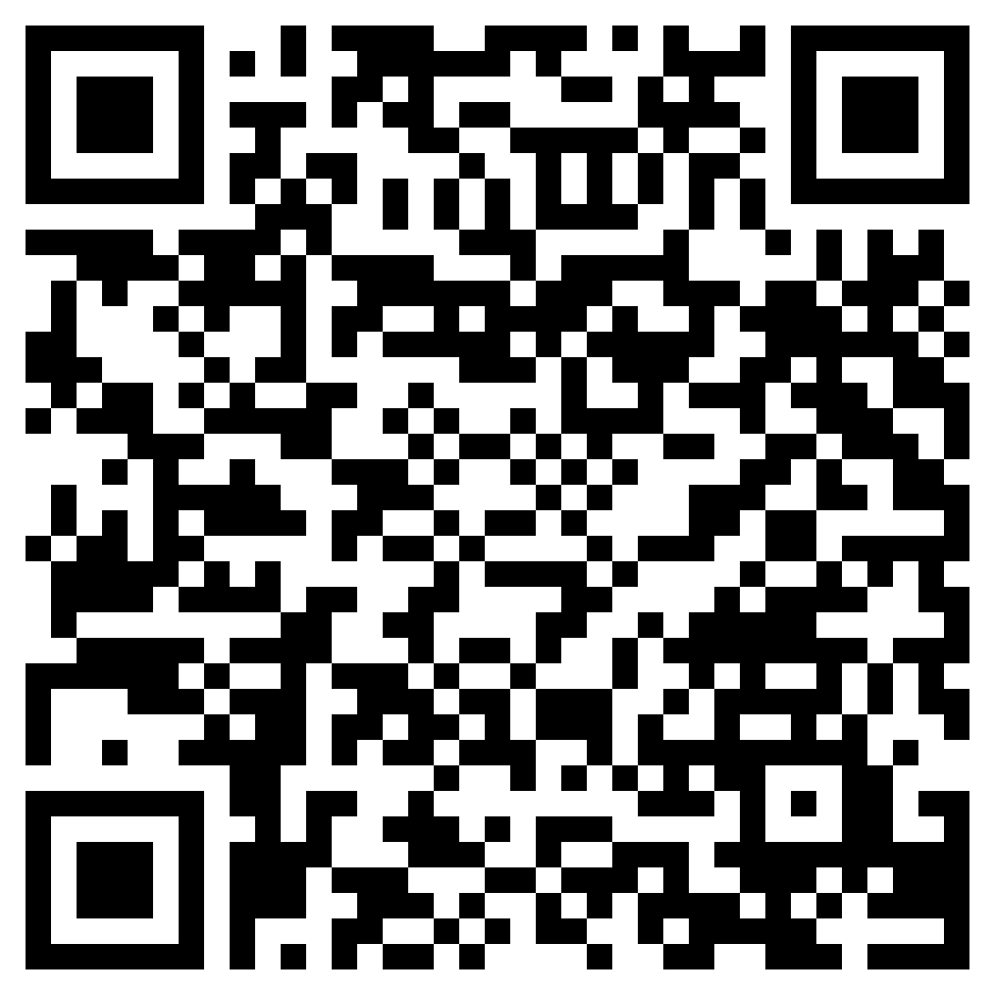
Charitable Organizations
Use in conjunction with the animated video found in the Making Charitable Donations self-paced module.
Use this link or the QR code to the right to watch the video from this module.
Write a social media post that relates to the video in some way. For example, you could write it from the perspective of a specific non-profit organization that wants potential donors to know more about what it means to be a 501(c)3 organization. Other options include writing it for the IRS’s social media account or an individual who got scammed by an organization claiming to be a non-profit. Use your imagination and be creative.
@ What is the username of the account?
The Post
# List at least four hashtags you could add to the post.

Slide 18
Use in conjunction with the Making Charitable Donations self-paced module.
What do for-profit companies and non-profit organizations have in common? What are some of their differences?
Similarities | Differences
If you could create your own charitable organization, what would it do? What impact would it make?
List four ways people can support charitable organizations.
1
2
3
4

Slide 19
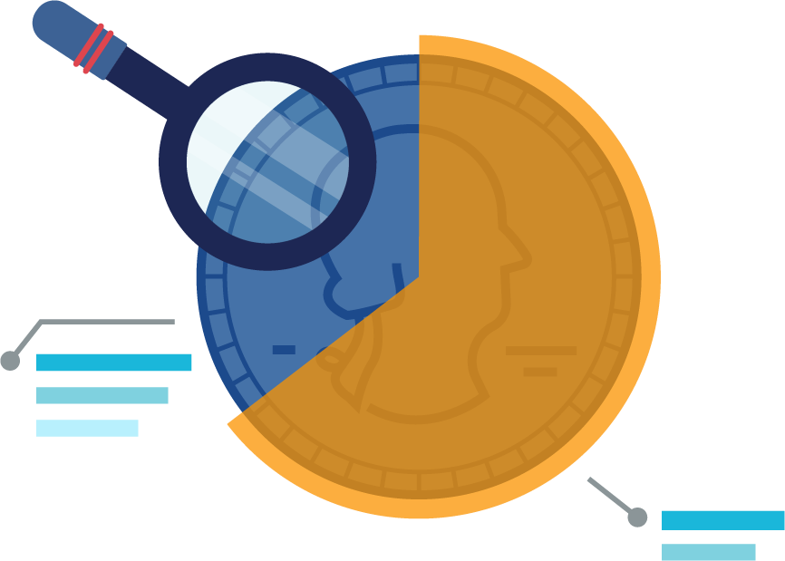
Use in conjunction with the Making Charitable Donations self-paced module.
Imagine you have been tasked with selecting a charitable organization to receive a large donation. What would you look for in each category?
Transparency
Mission
Financials
Some people include charitable donations in their personal budgets or spending plans. Think ahead to the future and answer each question below.
Do you anticipate including charitable giving in your budget someday as an adult?
If so, approximately what percent of your income can you imagine donating?
What will influence this decision?
What types of charities would you be most interested in donating to?

Slide 20
Use this page to reflect on what you have learned in Topic 3: Making Charitable Donations.
What have you learned in this module about charitable organizations and factors you should consider before donating your time or money?
End-of-Module Self-Evaluation
Consider the learning objectives for this module. How do you feel about each objective after completing it? | Strongly Agree | Somewhat Agree | Somewhat Disagree | Strongly Disagree
I am confident explaining how charitable organizations vary from other types of businesses.
I can describe the impact charities have in the community and elsewhere.
I can list ways I could support charitable organizations.
I am able to identify factors to consider before donating.

Slide 21
Avoiding Financial Fraud
After completing the module for this topic, you should be able to:
explain how identity theft can happen to people of all ages.
give examples of investing scams.
describe ways to avoid financial fraud.

Slide 22
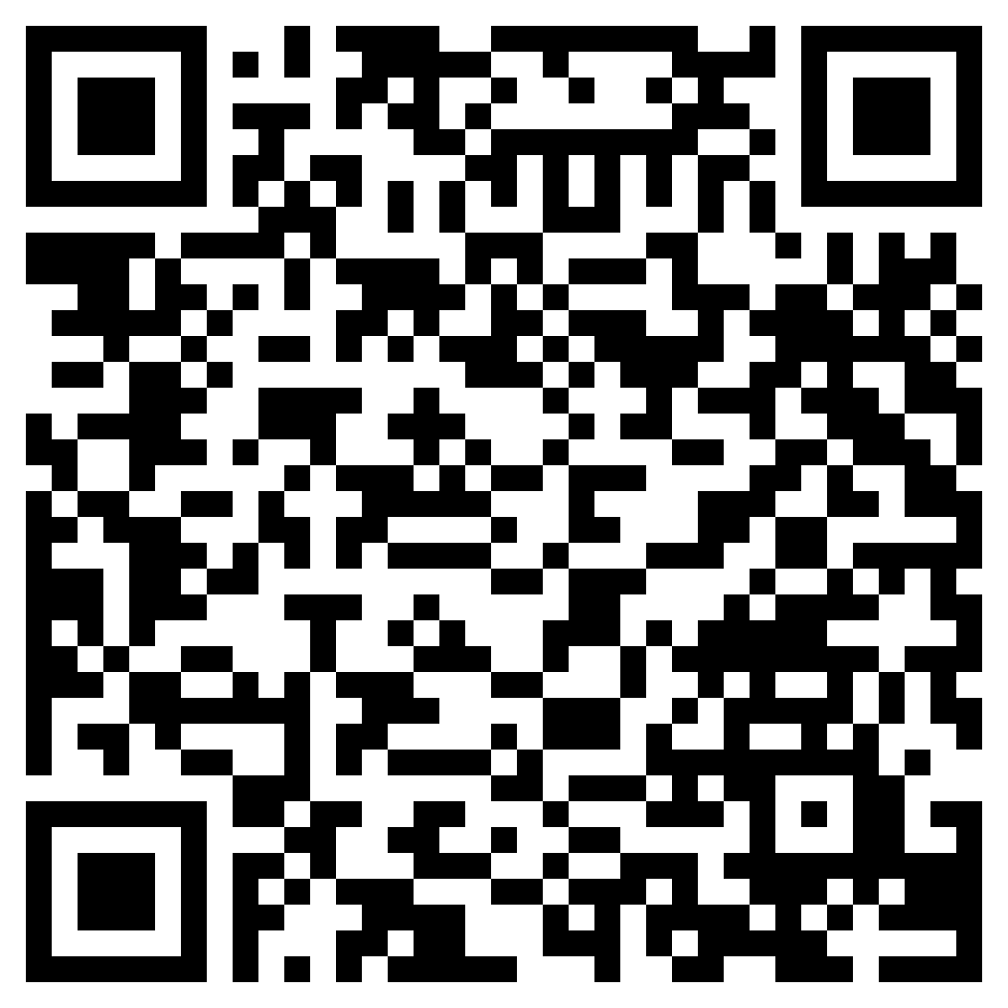
Identity Theft and Young People
Use in conjunction with the animated video found in the Avoiding Financial Fraud self-paced module.
Use this link or the QR code to the right to play the video from the module. Pause as needed to complete the graphic organizer below.
Write three interesting facts about the topic.
Share two reasons the information in the video is important.
Write a one-sentence summary of what you learned.

Slide 23
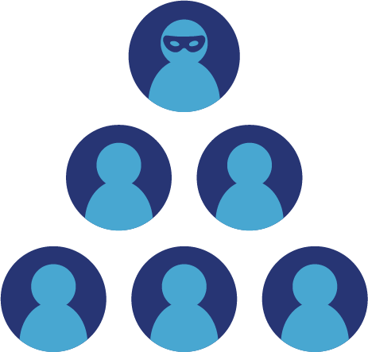
Use in conjunction with the Avoiding Financial Fraud self-paced module.
Review the factors from the Prevent Identity Theft section and answer each question below.
How many of the five could you work on to decrease your risk?
Which factor relates the least to you?
Which one would require the most effort on your part to improve or change?
Take notes on each of the following types of investment scam.
Ponzi scheme
Boiler room
Pump and dump
Advance fee

Slide 24
Use in conjunction with the Avoiding Financial Fraud self-paced module.
What “red flags” should you look out for to avoid becoming a victim of a scam? |  | Name four resources you could turn to if you become a victim of a scam.
1 |  | 1
2 |  | 2
3 |  | 3
4 |  | 4
Each state has agencies dedicated to protecting consumers and their finances. Find information on the ones where you live.
Agency | Name in Your State | Website
State Attorney General
State Securities Regulator
State Insurance Regulator
State Banking Regulator

Slide 25
Use this page to reflect on what you have learned in Topic 4: Avoiding Financial Fraud.
If someone asked you about what you learned today, what could you tell them about the key takeaways of this module?
End-of-Module Self-Evaluation
Consider the learning goals for this module. How do you feel about each goal after completing it? | Strongly Agree | Somewhat Agree | Somewhat Disagree | Strongly Disagree
I can explain how identity theft can happen to people of all ages.
I am able to give examples of investing scams.
I am confident describing ways to avoid financial fraud.

Slide 26
Getting Help with Financial Decisions
After completing the module for this topic, you should be able to:
Share why people get help with financial decisions.
Give examples of places you can turn for financial advice.
Explain the importance of turning to trustworthy sources for financial advice.

Slide 27
Use in conjunction with the Getting Help with Financial Decisions self-paced module.
Share your responses from the Where You Turn section.
 | Family or Friends | Financial Professional | Internet Search
Deciding how to finance higher education
Knowing how to prepare taxes
Getting out of debt
Choosing investments
Share one or more examples for each reason people might seek financial advice.
Plan Ahead | Fix Mistakes
Life Happens | New Options
Reasons to Get Financial Advice

Slide 28
Use in conjunction with the Getting Help with Financial Decisions self-paced module.
There are many places that you can turn to learn more about personal finance. Fill in the table below with at least two examples for each category. Try to find ones that you think would be useful to you now or in the future.
 | Online Calculator | Experts on Social Media
1
2
3
 | Podcast | Book
1
2
3
Of the sources you listed below, which interests you the most? Why?

Slide 29
Use in conjunction with the Getting Help with Financial Decisions self-paced module.
There are many types of financial professionals. Take notes on what each kind does and information you should know before using them.
 | How They Help | What to Look For
Accountants
Bankers
Financial Planners
Financial Counselor
Some people want to handle their finances completely on their own. Others would prefer to turn that responsibility over to professionals. Do you fit one of those descriptions or are you somewhere in between? Are there some aspects of your finances that you’d especially want help with? Explain.

Slide 30
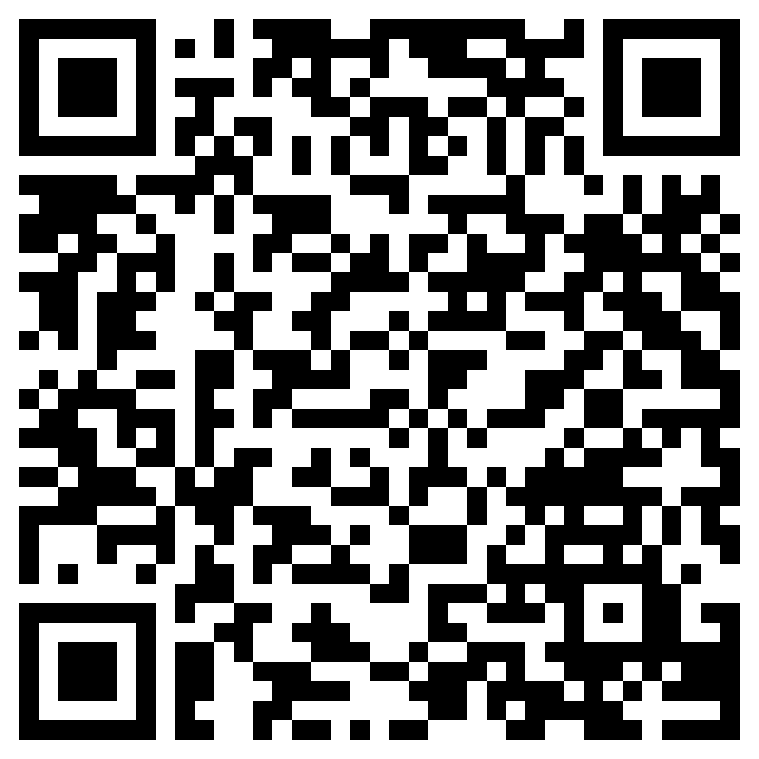
Trusting Financial Advice
Use in conjunction with the animated video found in the Getting Help with Financial Decisions self-paced module.
Watch the video, pausing it to take notes. Use what you learned to write a Haiku poem. Haiku is a traditional form of Japanese poetry written about a topic the reader knows well. The poem consist of three lines that rarely rhyme.
First line 5 syllables
Second line 7 syllables
Third line 5 syllables
Use this link or the QR code to the right to watch the video from this module.
First Line 5 syllables
Second Line 7 syllables
Third Line 5 syllables

Slide 31
Use in conjunction with the Getting Help with Financial Decisions self-paced module.
In your own words, what does it mean when a financial professional is paid through a commission?
What are some of the pros and cons of working with a financial professional who earns a commission?
Pros | Cons
Provide at least one example of each reason to be suspicious when it comes to taking financial advice.
Too Good to Be True
Behavioral Biases
Loss Aversion

Slide 32
Use this page to reflect on what you have learned in Topic 5: Getting Help with Financial Decisions.
What is a fact you already knew that connects with this module?
What is something you’d still like to know about the topic of getting help from financial professionals?
End-of-Module Self-Evaluation
Consider the learning goals for this module. How do you feel about each goal after completing it? | Strongly Agree | Somewhat Agree | Somewhat Disagree | Strongly Disagree
I can share why people get help with financial decisions.
I am able to give examples of places I can turn for financial advice.
I am confident explaining the importance of turning to trustworthy sources for financial advice.

Slide 33
Growing and Protecting Your Finances
Wrap Up

Slide 34
Unit 8: Glossary of Key Terms
Term | Definition | My Notes
Accountant | An Individual who helps people and businesses manage their finances, in particular with filing taxes
Boiler Room Fraud | An investment scam in which a fake investment office and staff are used to convince victims to invest
Bond | A loan given to a corporation or government in exchange for an agreed-upon payment of interest
Brokerage Firm | Business that provides services related to the buying and selling of stocks, bonds, and mutual funds
Charitable Organization | An organization that exists to serve a specific charitable purpose such as advancement of religion, education, or science; eliminating prejudice and discrimination; or defending human or civil rights
Diversification | Holding a mix of different kinds of investments to achieve growth and lower risk
Exchange-Traded Fund | Collections of stocks and/or bonds that can be traded at any time of the day unlike mutual funds that are traded only at the closing price (also called ETFs)

Slide 35
Unit 8: Glossary of Key Terms (continued)
Term | Definition | My Notes
Fiduciary | A person or organization that acts on behalf of someone else, putting the clients' interests ahead of their own
Financial Advisor or Planner | An individual who provides financial advice to help people manage their money and plan for their financial future including strategies to save and invest
Financial Counselor | An individual who helps clients tackle financial topics such as budgeting, debt, and saving by providing advice and information
Identity Theft | A crime in which someone acquires and wrongly uses another person's personal information
Invest | Using money in a way that offers potential growth in the amount with some risk of loss
Investment Portfolio | All the investments a person owns
Mutual Fund | A collection of stocks and/or bonds managed by a professional financial planner
Ponzi Scheme | An investment scam that lures investors and pays profits to earlier investors with funds from more recent ones

Slide 36
Unit 8: Glossary of Key Terms (continued)
Term | Definition | My Notes
Portfolio | A person’s collection of different investments
Pump and Dump Scam | A form of securities fraud that involves artificially inflating the price of an owned stock through false and misleading positive statements in order to sell the cheaply purchased stock at a higher price
Return | The amount of money made or lost on an investment
Risk | The possibility of loss
Stock | An ownership share in a company that you can sell later
Stock Index | A specific collection or list of investments whose performance is tracked and reported, examples include the Dow Jones Industrial Average and the S&P 500

Slide 37
Unit 8: Personal Action Plan
Consider each of the topics addressed in this unit. Which actions will you take to grow and protect your finances? | Already Doing | Need to Do | Not in My Plans
I will investigate options for saving and investing.
I will ask about ways to invest money that I earn, including options like setting up a 401(k) or IRA.
I will learn about organizations before donating my time, money, or possessions.
I will check to see if I have a credit report.
I will take precautions to prevent being a victim of identity theft.
I will explore my options for getting help handling my money, including the first time I file taxes, if needed.
My notes and next steps:

Slide 38
Unit 8: Continuing the Conversation at Home
Families often approach conversations about money very differently. Some might welcome them, while others avoid the topic as much as possible. Review the conversations starters below. With whom could you have each conversation? How might you approach the conversations?
Conversation Starters | My Notes
Investing Have you ever owned shares of stock in a company? If so, what did you or do you own? How did you pick it? Do you feel like you have saved and/or invested enough money for retirement? What advice would you give to someone about saving and investing for the future?
Donating to Charity Are there charities to which you donate your time or money? How do you know if a charity is legitimate? What influences your decision to donate time or money to a particular cause? What non-profit organizations do you see making a difference in our community?
Identity Theft Have you ever been the victim of identity theft? If so, how did you find out? What happened? What did you need to do to fix the problem? Have you ever used a credit freeze? If not, do you know what they are? How familiar are you with financial scams? Have you ever known anyone to fall prey to one?
Financial Professionals Where do you turn for financial information or advice? Have you ever used a financial professional for help with money management, investing, taxes, or another personal finance-related purpose?

Slide 39
Unit 8: Dig Deeper
Interested in learning more about the topics covered in this unit? Consider exploring one or more of the following questions.
Dig into the Topics | My Notes
Investing What companies produce goods or services that you use? Are they public? If so, what is the current price of their stock? What stocks make up the Dow Jones Industrial Average? How are they selected? If you have earned income, what would it take for you to set up a Traditional or Roth IRA account? What are the tax advantages of those accounts? Is there a trusted adult who could assist you in setting up your own investment account?
Donating to Charity What non-profit organizations are active in your community, and what services do they provide? What organizations use teen volunteers? How can you get involved? What does it take to set up a non-profit, charitable organization in your state?
Identity Theft What are the most common scams in your state? Who is most often the victim of those? What organizations are active in your state when it comes to consumer protection and fraud prevention?
Financial Professionals What does it take to become a Certified Public Accountant (CPA), or Certified Financial Planner (CFP)? What do people in these jobs do? What other certifications are there for financial professionals? How are they all different?

